Slide 1
Calculate Length of Arcs
Silent
Teacher
Intelligent Practice
Narration
Your Turn
3 cm
36°
9 cm
26°
30 cm
260°
Practice

Slide 2
Worked Example
Your Turn
Calculate the length of the arc
Calculate the length of the arc
9cm
9cm
144°
120°
@webstermaths

Slide 3
Calculate the lengths of the arcs
36°
9 cm
26°
30 cm
3 cm
36°
10 cm
260°
10°
36 cm
110°
3 cm
10°
72 cm
20°
36 cm
@webstermaths

Slide 4
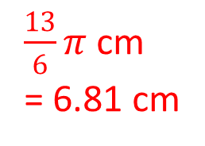
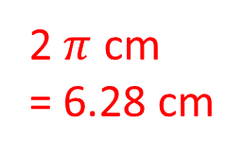
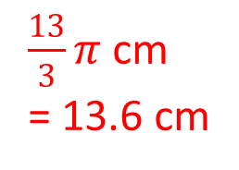
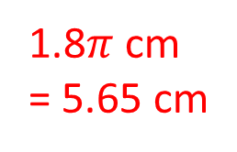
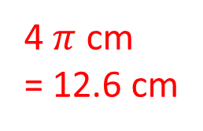
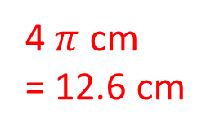
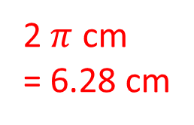
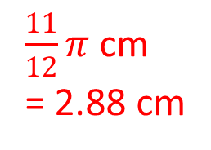
Calculate the lengths of the arcs
9 cm
1.8$π$ cm
= 5.65 cm
30 cm
$\frac{13}{3}π$ cm
= 13.6 cm
36°
26°
2 $π$ cm
= 6.28 cm
3 cm
36°
10 cm
$\frac{13}{6}π$ cm
= 6.81 cm
260°
2 $π$ cm
= 6.28 cm
10°
36 cm
110°
3 cm
4 $π$ cm
= 12.6 cm
10°
72 cm
$\frac{11}{12}π$ cm
= 2.88 cm
4 $π$ cm
= 12.6 cm
20°
36 cm
@webstermaths

