Slide 1
Trigonometry: Using exact trig ratios
Silent
Teacher
Intelligent Practice
Narration
Your Turn
Practice

Slide 2
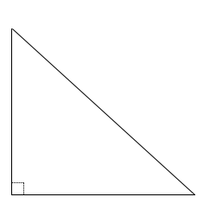
Worked Example
Your Turn
$$30°$$
$$x cm$$
$$y cm$$
$$30°$$
$$6 cm$$
$$6 cm$$

Slide 3
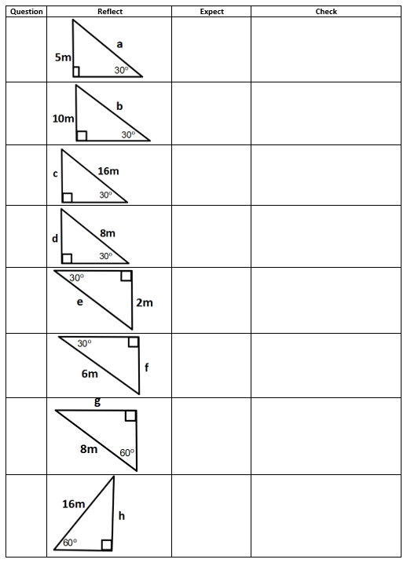

Slide 4
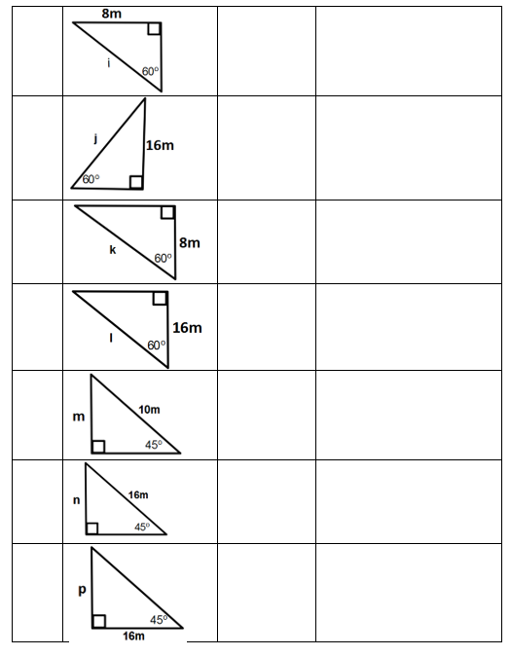

Slide 5
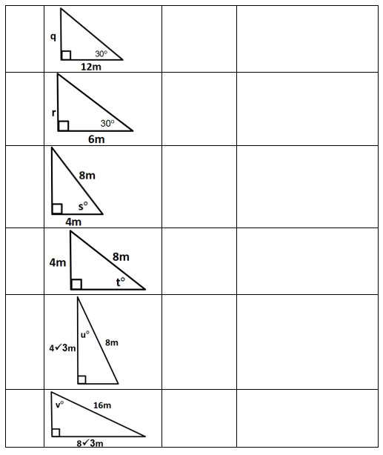

Slide 6
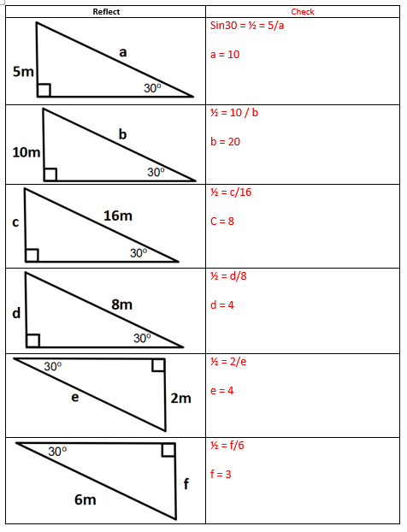

Slide 7
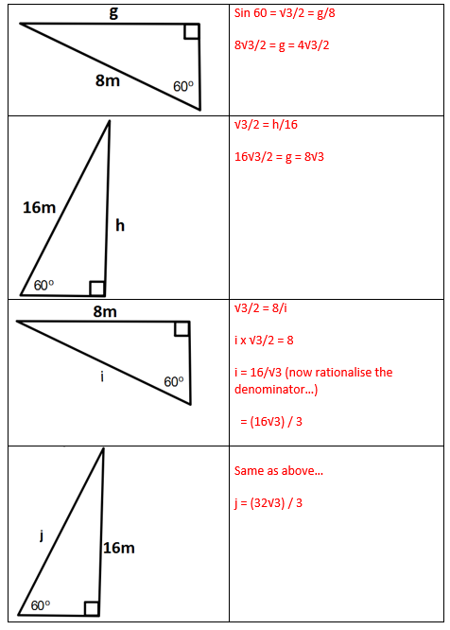

Slide 8
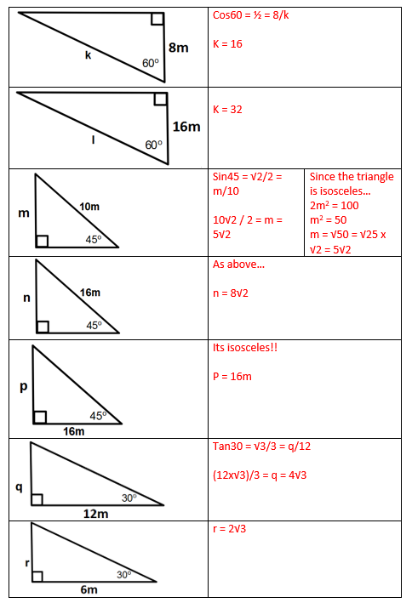

Slide 9
