Slide 1
Expanding Brackets: Squaring a bracket
Pattern spot
Reflect
Your Turn
$$(x+4)^{2}$$
$$(x+5)^{2}$$
$$(x+6)^{2}$$
Pattern

Slide 2


$$(x+1)^{2}$$
$$(x+2)^{2}$$
$$(x+3)^{2}$$
$$(x+4)^{2}$$
$$(x+5)^{2}$$
$$(x+6)^{2}$$
$$(x+7)^{2}$$
$$(x+8)^{2}$$
$$(x+9)^{2}$$
$$(x+10)^{2}$$
. . .
$$(x+12)^{2}≡$$
$$(x+15)^{2}≡$$
$$(x+20)^{2}≡$$
$≡x^{2}+28x+196$
$$≡x^{2}+60x+900$$
$$(x−1)^{2}$$
$$(x−2)^{2}$$
$$(x−3)^{2}$$
$$(x−4)^{2}$$
$$(x−5)^{2}$$
$$(x−6)^{2}$$
$$(x−7)^{2}$$
$$(x−8)^{2}$$
$$(x−9)^{2}$$
$$(x−10)^{2}$$
. . .
$$(x−13)^{2}≡$$
$$(x−15)^{2}≡$$
$$(x−40)^{2}≡$$
$≡x^{2}−22x+121$
$$≡x^{2}−80x+1600$$
@mathsmrgordon

Slide 3
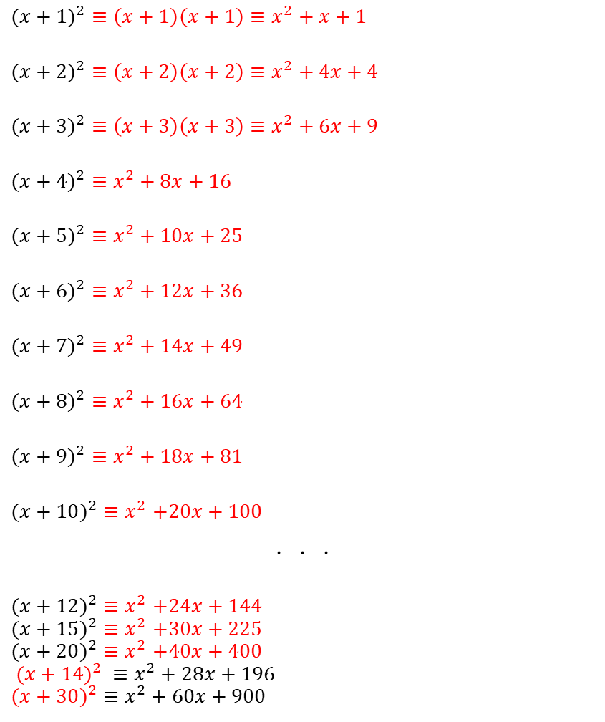

$$(x+1)^{2}≡\left(x+1\right)\left(x+1\right)≡x^{2}+x+1$$
$$(x+2)^{2}≡\left(x+2\right)\left(x+2\right)≡x^{2}+4x+4$$
$$(x+3)^{2}≡\left(x+3\right)\left(x+3\right)≡x^{2}+6x+9$$
$$(x+4)^{2}≡x^{2}+8x+16$$
$$(x+5)^{2}≡x^{2}+10x+25$$
$$(x+6)^{2}≡x^{2}+12x+36$$
$$(x+7)^{2}≡x^{2}+14x+49$$
$$(x+8)^{2}≡x^{2}+16x+64$$
$$(x+9)^{2}≡x^{2}+18x+81$$
$$(x+10)^{2}{≡x}^{2}+20x+100$$
. . .
$$(x+12)^{2}{≡x}^{2}+24x+144$$
$$(x+15)^{2}{≡x}^{2}+30x+225$$
$$(x+20)^{2}{≡x}^{2}+40x+400$$
$$(x+14)^{2} ≡x^{2}+28x+196$$
$$(x+30)^{2}≡x^{2}+60x+900$$
$(x−1)^{2}≡(x−1)(x−1)≡x^{2}−2x+1$
$(x−2)^{2}$ $≡(x−2)(x−2)≡x^{2}−4x+$2
$(x−3)^{2}$ $≡(x−3)(x−3)≡x^{2}−6x+$9
$(x−4)^{2}$ $≡x^{2}−8x+16$
$(x−5)^{2}$ $≡x^{2}−10x+25$
$(x−6)^{2}$ $≡x^{2}−12x+36$
$(x−7)^{2}$ $≡x^{2}−14x+49$
$(x−8)^{2}$ $≡x^{2}−16x+64$
$(x−9)^{2}$ $≡x^{2}−18x+81$
$(x−10)^{2}$ $≡x^{2}−20x+100$
. . .
$$(x−13)^{2}≡x^{2}−26x+169$$
$$(x−15)^{2}≡x^{2}−30x+225$$
$$(x−40)^{2}≡x^{2}−80x+1600$$
$(x−11)^{2}$ $≡x^{2}−22x+121$
$$(x−40)^{2}≡x^{2}−80x+1600$$
@mathsmrgordon

