Slide 1
Quadratic simultaneous Equations 3
Silent
Teacher
Intelligent Practice
Narration
Your Turn
$$y=x^{2}+5x−2$$
$$y=x+3$$
$$y=x^{2}−3x−2$$
$$y=x+3$$
Practice

Slide 2
Worked Example
Your Turn
Solve the following pair of simultaneous equations:
Solve the following pair of simultaneous equations:
$$y=x^{2}+x−2$$
$$y=2x+4$$
$$y=x^{2}+7x−2$$
$$y=2x+4$$

Slide 3
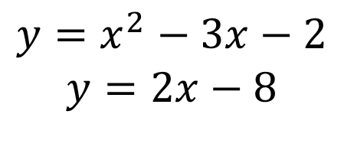
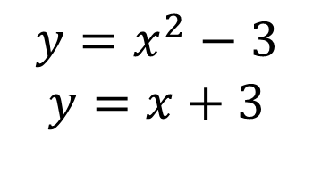
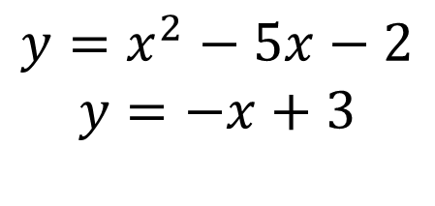
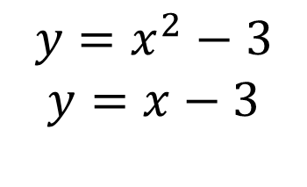
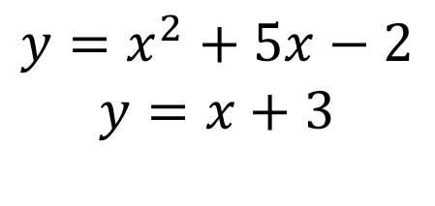
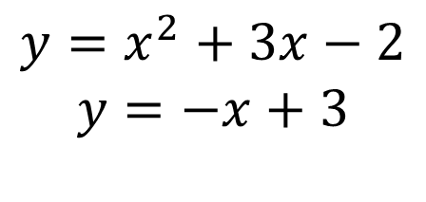
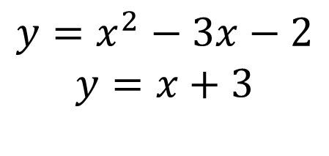
Solve the following pairs of simultaneous equations:
1.
$$y=x^{2}+5x−2$$
$$y=x+3$$
5.
$$y=x^{2}−3x−2$$
$$y=2x−8$$
2.
$$y=x^{2}−3x−2$$
$$y=x+3$$
6.
$$y=x^{2}−3$$
$$y=x−3$$
3.
$$y=x^{2}−5x−2$$
$$y=−x+3$$
7.
$$y=x^{2}−3$$
$$y=x+3$$
4.
$$y=x^{2}+3x−2$$
$$y=−x+3$$

Slide 4
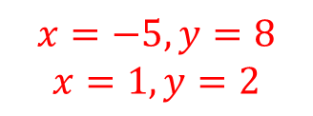
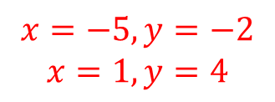
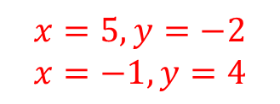
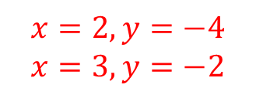
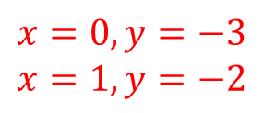
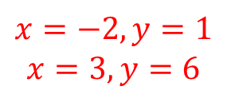
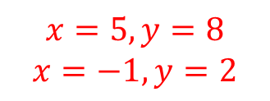
Solve the following pairs of simultaneous equations:
1.
$$y=x^{2}+5x−2$$
$$y=x+3$$
5.
$$y=x^{2}−3x−2$$
$$y=2x−8$$
$$x=−5, y=−2$$
$$x=1, y=4$$
$$x=2, y=−4$$
$$x=3, y=−2$$
2.
$$y=x^{2}−3x−2$$
$$y=x+3$$
6.
$$y=x^{2}−3$$
$$y=x−3$$
$$x=5, y=8$$
$$x=−1, y=2$$
$$x=0, y=−3$$
$$x=1, y=−2$$
3.
$$y=x^{2}−5x−2$$
$$y=−x+3$$
7.
$$y=x^{2}−3$$
$$y=x+3$$
$$x=5, y=−2$$
$$x=−1, y=4$$
$$x=−2, y=1$$
$$x=3, y=6$$
4.
$$y=x^{2}+3x−2$$
$$y=−x+3$$
$$x=−5, y=8$$
$$x=1, y=2$$

