Slide 1
Power and indices: Reciprocals
True/false
Reflect
Your Turn
$$3$$
$$\frac{1}{3}$$
$$\frac{4}{3}$$
Rule

Slide 2
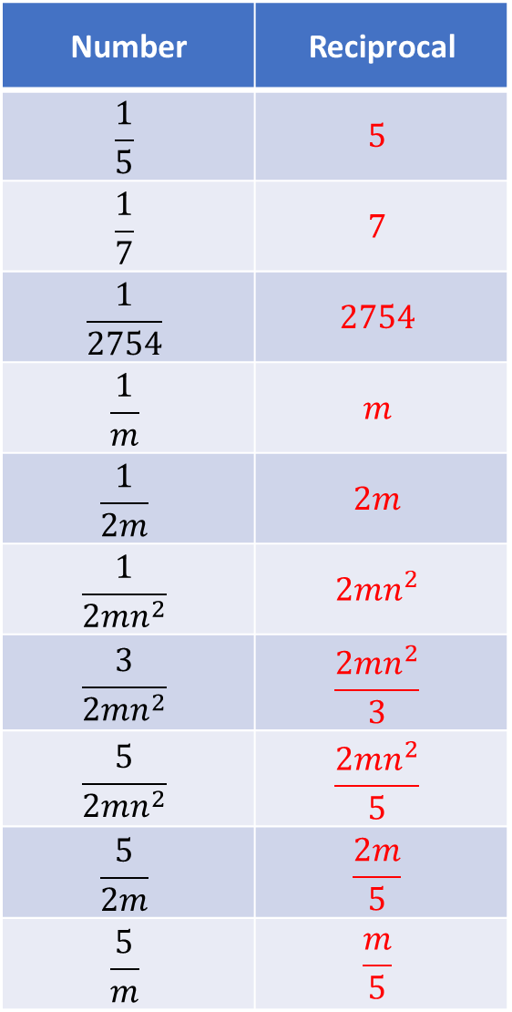
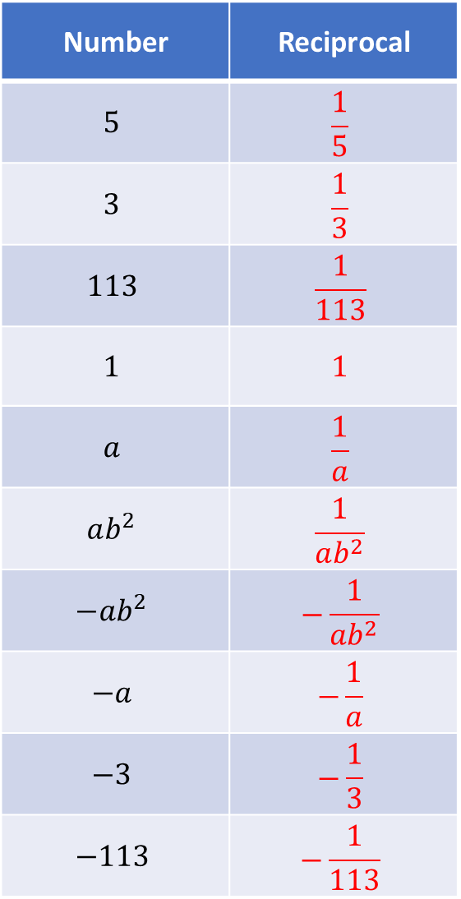
Number | Reciprocal
$$5$$ | $$\frac{1}{5}$$
$$3$$ | $$\frac{1}{3}$$
$$113$$ | $$\frac{1}{113}$$
$$1$$ | $$1$$
$$a$$ | $$\frac{1}{a}$$
$$ab^{2}$$ | $$\frac{1}{ab^{2}}$$
$$−ab^{2}$$ | $$−\frac{1}{ab^{2}}$$
$$−a$$ | $$−\frac{1}{a}$$
$$−3$$ | $$−\frac{1}{3}$$
$$−113$$ | $$−\frac{1}{113}$$
Number | Reciprocal
$$\frac{1}{5}$$ | $$5$$
$$\frac{1}{7}$$ | $$7$$
$$\frac{1}{2754}$$ | $$2754$$
$$\frac{1}{m}$$ | $$m$$
$$\frac{1}{2m}$$ | $$2m$$
$$\frac{1}{2mn^{2}}$$ | $$2mn^{2}$$
$$\frac{3}{2mn^{2}}$$ | $$\frac{2mn^{2}}{3}$$
$$\frac{5}{2mn^{2}}$$ | $$\frac{2mn^{2}}{5}$$
$$\frac{5}{2m}$$ | $$\frac{2m}{5}$$
$$\frac{5}{m}$$ | $$\frac{m}{5}$$

Slide 3
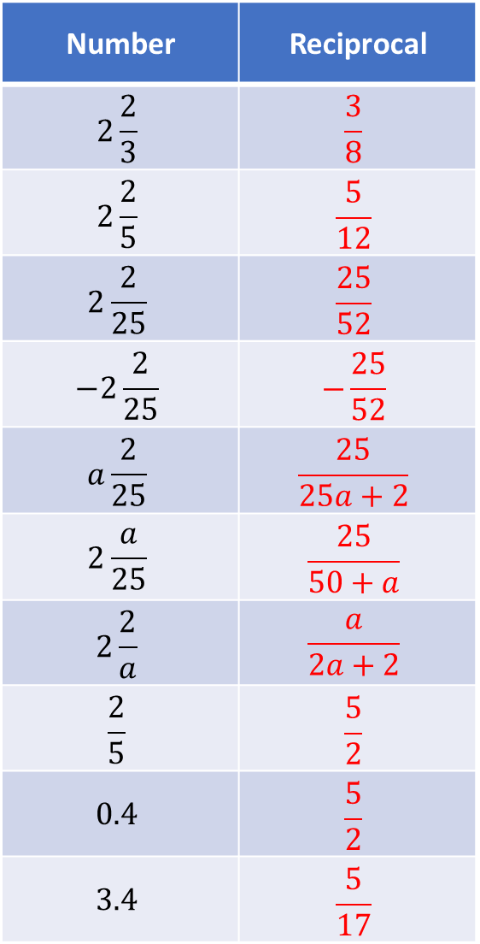
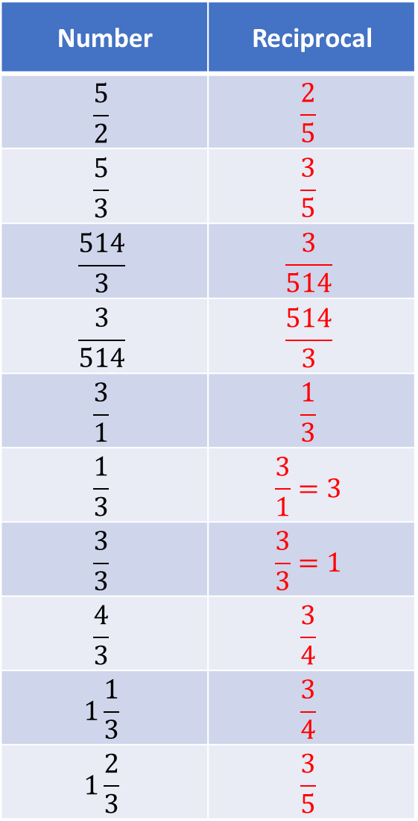
Number | Reciprocal
$$\frac{5}{2}$$ | $$\frac{2}{5}$$
$$\frac{5}{3}$$ | $$\frac{3}{5}$$
$$\frac{514}{3}$$ | $$\frac{3}{514}$$
$$\frac{3}{514}$$ | $$\frac{514}{3}$$
$$\frac{3}{1}$$ | $$\frac{1}{3}$$
$$\frac{1}{3}$$ | $$\frac{3}{1}=3$$
$$\frac{3}{3}$$ | $$\frac{3}{3}=1$$
$$\frac{4}{3}$$ | $$\frac{3}{4}$$
$$1\frac{1}{3}$$ | $$\frac{3}{4}$$
$$1\frac{2}{3}$$ | $$\frac{3}{5}$$
Number | Reciprocal
$$2\frac{2}{3}$$ | $$\frac{3}{8}$$
$$2\frac{2}{5}$$ | $$\frac{5}{12}$$
$$2\frac{2}{25}$$ | $$\frac{25}{52}$$
$$−2\frac{2}{25}$$ | $$−\frac{25}{52}$$
$$a\frac{2}{25}$$ | $$\frac{25}{25a+2}$$
$$2\frac{a}{25}$$ | $$\frac{25}{50+a}$$
$$2\frac{2}{a}$$ | $$\frac{a}{2a+2}$$
$$\frac{2}{5}$$ | $$\frac{5}{2}$$
$$0.4$$ | $$\frac{5}{2}$$
$$3.4$$ | $$\frac{5}{17}$$

Slide 4
Number | Reciprocal
$$5$$ | $$\frac{1}{5}$$
$$3$$ | $$\frac{1}{3}$$
$$113$$ | $$\frac{1}{113}$$
$$1$$ | $$1$$
$$a$$ | $$\frac{1}{a}$$
$$ab^{2}$$ | $$\frac{1}{ab^{2}}$$
$$−ab^{2}$$ | $$−\frac{1}{ab^{2}}$$
$$−a$$ | $$−\frac{1}{a}$$
$$−3$$ | $$−\frac{1}{3}$$
$$−113$$ | $$−\frac{1}{113}$$
Number | Reciprocal
$$\frac{1}{5}$$ | $$5$$
$$\frac{1}{7}$$ | $$7$$
$$\frac{1}{2754}$$ | $$2754$$
$$\frac{1}{m}$$ | $$m$$
$$\frac{1}{2m}$$ | $$2m$$
$$\frac{1}{2mn^{2}}$$ | $$2mn^{2}$$
$$\frac{3}{2mn^{2}}$$ | $$\frac{2mn^{2}}{3}$$
$$\frac{5}{2mn^{2}}$$ | $$\frac{2mn^{2}}{5}$$
$$\frac{5}{2m}$$ | $$\frac{2m}{5}$$
$$\frac{5}{m}$$ | $$\frac{m}{5}$$

Slide 5
Number | Reciprocal
$$\frac{5}{2}$$ | $$\frac{2}{5}$$
$$\frac{5}{3}$$ | $$\frac{3}{5}$$
$$\frac{514}{3}$$ | $$\frac{3}{514}$$
$$\frac{3}{514}$$ | $$\frac{514}{3}$$
$$\frac{3}{1}$$ | $$\frac{1}{3}$$
$$\frac{1}{3}$$ | $$\frac{3}{1}=3$$
$$\frac{3}{3}$$ | $$\frac{3}{3}=1$$
$$\frac{4}{3}$$ | $$\frac{3}{4}$$
$$1\frac{1}{3}$$ | $$\frac{3}{4}$$
$$1\frac{2}{3}$$ | $$\frac{3}{5}$$
Number | Reciprocal
$$2\frac{2}{3}$$ | $$\frac{3}{8}$$
$$2\frac{2}{5}$$ | $$\frac{5}{12}$$
$$2\frac{2}{25}$$ | $$\frac{25}{52}$$
$$−2\frac{2}{25}$$ | $$−\frac{25}{52}$$
$$a\frac{2}{25}$$ | $$\frac{25}{25a+2}$$
$$2\frac{a}{25}$$ | $$\frac{25}{50+a}$$
$$2\frac{2}{a}$$ | $$\frac{a}{2a+2}$$
$$\frac{2}{5}$$ | $$\frac{5}{2}$$
$$0.4$$ | $$\frac{5}{2}$$
$$3.4$$ | $$\frac{5}{17}$$

Slide 6
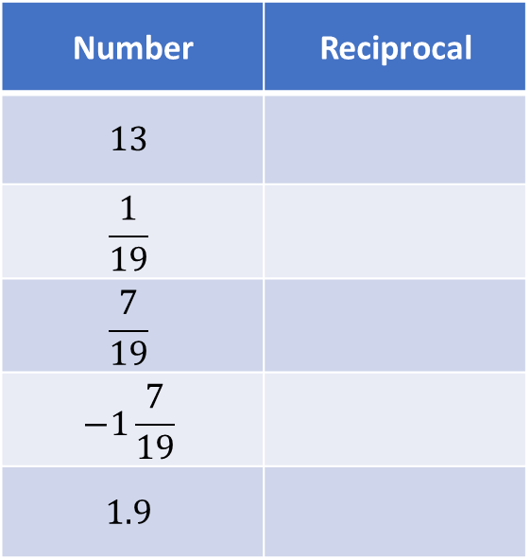
Your Turn
Number | Reciprocal
$$13$$
$$\frac{1}{19}$$
$$\frac{7}{19}$$
$$−1\frac{7}{19}$$
$$1.9$$
@mrbartonmaths

Slide 7
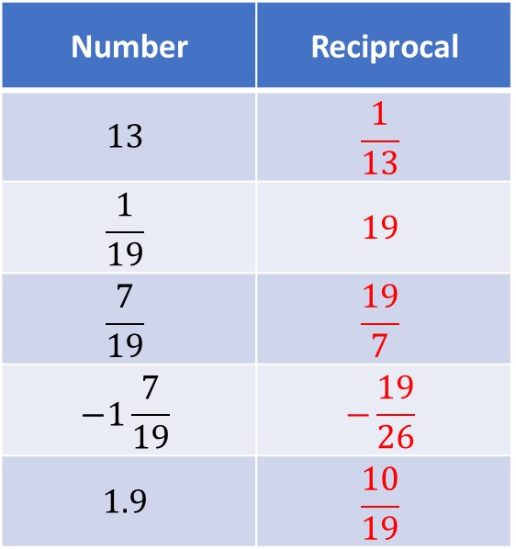
Your Turn - answers
Number | Reciprocal
$$13$$ | $$\frac{1}{13}$$
$$\frac{1}{19}$$ | $$19$$
$$\frac{7}{19}$$ | $$\frac{19}{7}$$
$$−1\frac{7}{19}$$ | $$−\frac{19}{26}$$
$$1.9$$ | $$\frac{10}{19}$$
@mrbartonmaths

