Slide 1
Calculate Areas of Sectors
Silent
Teacher
Intelligent Practice
Narration
Your Turn
3 cm
36°
9 cm
26°
30 cm
260°
Practice

Slide 2
Worked Example
Your Turn
Calculate the area of the sector
Calculate the area of the sector
9cm
12cm
120°
120°
@webstermaths

Slide 3
Calculate the areas of the sectors
36°
9 cm
26°
30 cm
3 cm
36°
10 cm
260°
10°
36 cm
110°
3 cm
10°
72 cm
20°
36 cm
@webstermaths

Slide 4
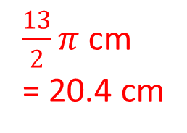
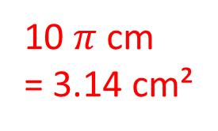
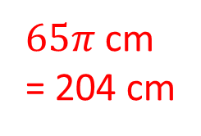
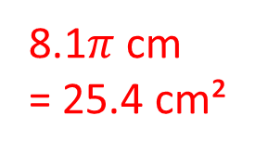
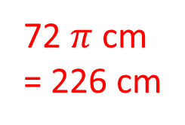
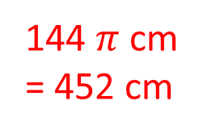
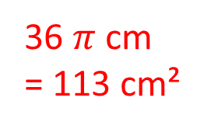
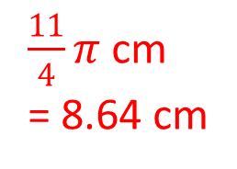
Calculate the lengths of the arcs
9 cm
8.1$π$ cm
= 25.4 cm²
30 cm
$65π$ cm
= 204 cm
36°
26°
10 $π$ cm
= 3.14 cm²
3 cm
36°
10 cm
$\frac{13}{2}π$ cm
= 20.4 cm
260°
36 $π$ cm
= 113 cm²
10°
36 cm
110°
3 cm
$\frac{11}{4}π$ cm
= 8.64 cm
144 $π$ cm
= 452 cm
10°
72 cm
72 $π$ cm
= 226 cm
20°
36 cm
@webstermaths

