Slide 1
Quadratic Equations: Solving by factorising
Silent
Teacher
Intelligent Practice
Narration
Your Turn
$x^{2}+9x +20$ = 0
$x^{2}+12x +20$ = 0
$x^{2}−9x +20$ = 0
Practice

Slide 2

Worked Example
Your Turn
$x^{2}+8x +15$ = 0 $x^{2}+16x +15$ = 0
@j0shmartin

Slide 3

Worked Example
Your Turn
$x^{2}+2x$= $15$ $x^{2}−15$ = $2x$
@j0shmartin

Slide 4

$x^{2}+9x +20$ = 0
$x^{2}+12x +20$ = 0
$x^{2}−9x +20$ = 0
$x^{2}−12x +20$ = 0
$21x +20+x^{2}$= 0
$x^{2}+9x$= $−20$
$x^{2}+21x$= $−20$
$x^{2}+20=9x$
$x^{2}=12x −20$
$20=9x{−x}^{2}$
@j0shmartin

Slide 5
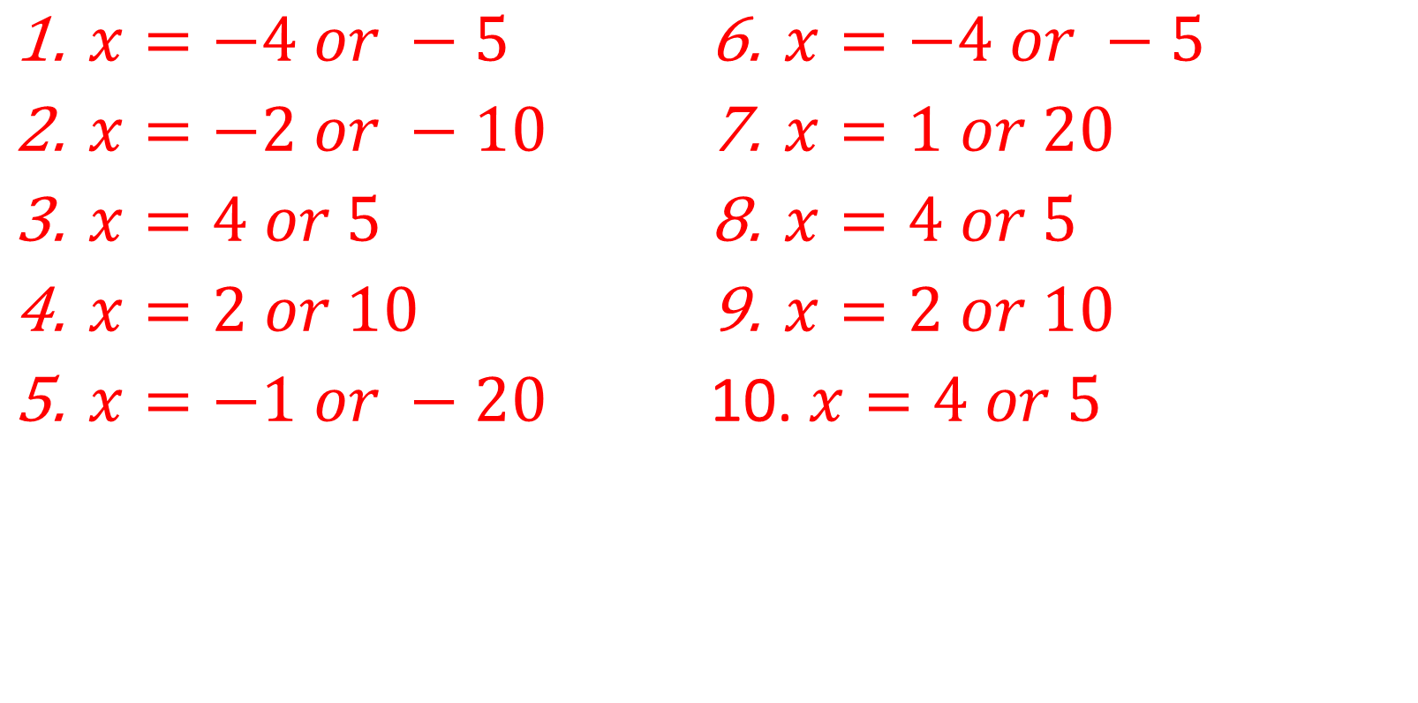
$x=−4 or −5$
$x=−2 or −10$
$x=4 or 5$
$x=2 or 10$
$x=−1 or −20$
$x=−4 or −5$
$x=1 or 20$
$x=4 or 5$
$x=2 or 10$
$x=4 or 5$
@j0shmartin

