Slide 1
Rearranging Formulae: With powers and roots
Silent
Teacher
Intelligent Practice
Narration
Your Turn
$$2a^{2}=c$$
$${4a}^{2}−b=c$$
$$\frac{\sqrt{a}}{2}=c$$
Practice

Slide 2
Worked Example
Your Turn
$$a^{2}=c$$
$$\sqrt{a}=c$$

Slide 3
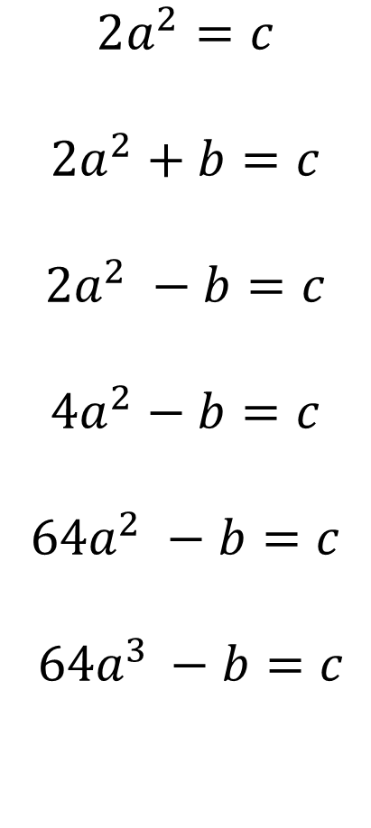

$$2a^{2}=c$$
$${2a}^{2}+b=c$$
$${2a}^{2} −b=c$$
$${4a}^{2}−b=c$$
$${64a}^{2} −b=c$$
$64a^{3 }−b=c$
$$\frac{\sqrt{a}}{2}=c$$
$$2\sqrt{a}=c$$
$$2\sqrt{a}+b=c$$
$$2\sqrt{3a}+b=c$$
$$\sqrt[3]{a}=c$$
$$2\sqrt[3]{a}=c$$

Slide 4
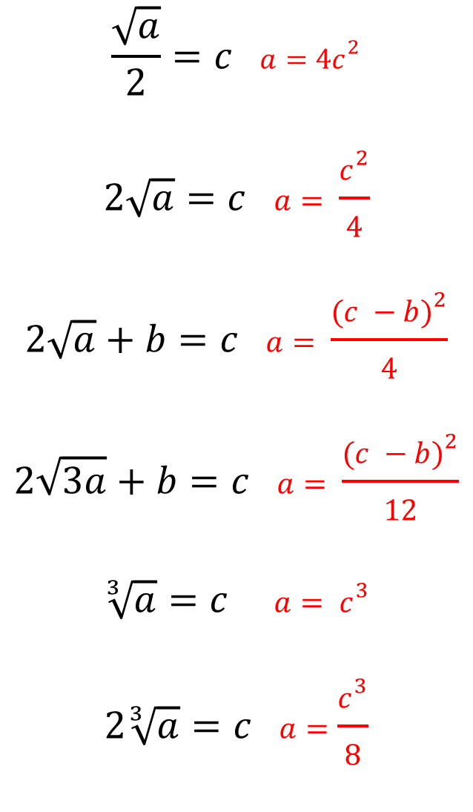
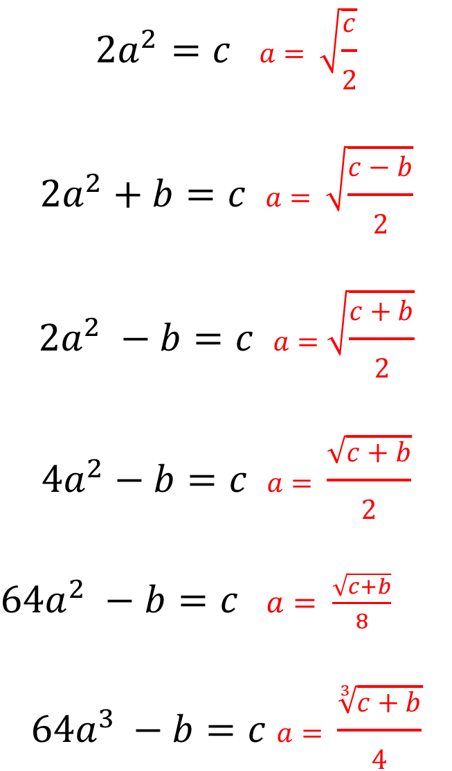
$$2a^{2}=c a= \sqrt{\frac{c}{2}}$$
$${2a}^{2}+b=c a= \sqrt{\frac{c−b}{2}}$$
$${2a}^{2} −b=c a=\sqrt{\frac{c+b}{2}}$$
$${4a}^{2}−b=c a= \frac{\sqrt{c+b}}{2}$$
${64a}^{2} −b=c$ $a= \frac{\sqrt{c+b}}{8}$
$$64a^{3 }−b=c a= \frac{\sqrt[3]{c+b}}{4}$$
$$\frac{\sqrt{a}}{2}=c a=4c^{2}$$
$$2\sqrt{a}=c a= \frac{c^{2}}{4}$$
$$2\sqrt{a}+b=c a= \frac{{(c −b)}^{2}}{4}$$
$$2\sqrt{3a}+b=c a= \frac{{(c −b)}^{2}}{12}$$
$$\sqrt[3]{a}=c a= c^{3}$$
$$2\sqrt[3]{a}=c a=\frac{c^{3}}{8}$$

