Slide 1
Percentages: Compound Interest
Silent
Teacher
Intelligent Practice
Narration
Your Turn
$$5\% compound interest over 3 years$$
5% compound interest over 4 years
$$5\% compound interest over 5 years$$
Practice

Slide 2
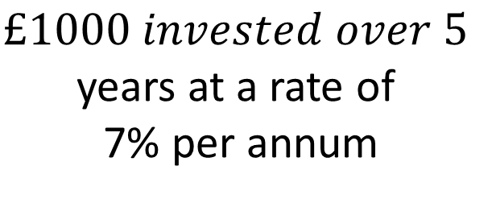
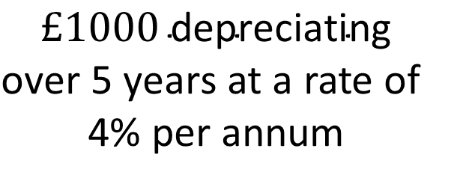
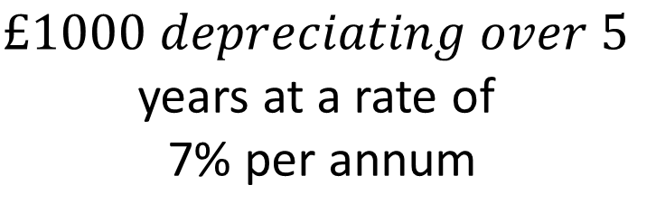
Worked Example
Your Turn
$$£1000 invested over 5$$
years at a rate of
7% per annum
$$£1000 \text{in}\text{vested} \text{over}\text{ 5 }\text{years}$$
at a rate of 4% per annum
$$£1000 depreciating over 5$$
years at a rate of
7% per annum
$$£1000 \text{depreciating}$$
$\text{over}\text{ 5 }\text{years}$ at a rate of
4% per annum

Slide 3
$£1000 invested over 8$years at a rate of 4% per annum
$£1000 invested over 4$years at a rate of 4% per annum
$£1000 depreciating over 4$years at a rate of 4% per annum
$£1000 depreciating over 4$years at a rate of 9% per annum
$£1000 invested over 7$years at a rate of 9% per annum
$£1000 depreciating over 7$years at a rate of 3.5% per annum
$£1000 invested over 4$years at a rate of 3.5% per annum
$£1000 depreciating over 18 months$ at a rate of 3.5% per annum

Slide 4
$£1000 invested over 8$years at a rate of 4% per annum
1368.57
$£1000 invested over 4$years at a rate of 4% per annum
1169.86
$£1000 depreciating over 4$years at a rate of 4% per annum
849.35
$£1000 depreciating over 4$years at a rate of 9% per annum
685.74
$£1000 invested over 7$years at a rate of 9% per annum
1828.04
$£1000 depreciating over 7$years at a rate of 3.5% per annum
779.28
$£1000 invested over 4$years at a rate of 3.5% per annum
1272.28
$£1000 depreciating over 18 months$ at a rate of 3.5% per annum
947.96

