Slide 1
Brackets: Expanding double brackets 3
Silent
Teacher
Intelligent Practice
Narration
Your Turn
$$\left(x+5\right)\left(x+3\right)=$$
$$\left(x+3\right)\left(x+5\right)=$$
$$\left(x−3\right)\left(x+5\right)=$$
Practice

Slide 2
Worked Example
Your Turn
$$(x+7)\left(x−2\right)=$$
$$(x−7)(x+2)=$$
@mrbartonmaths

Slide 3
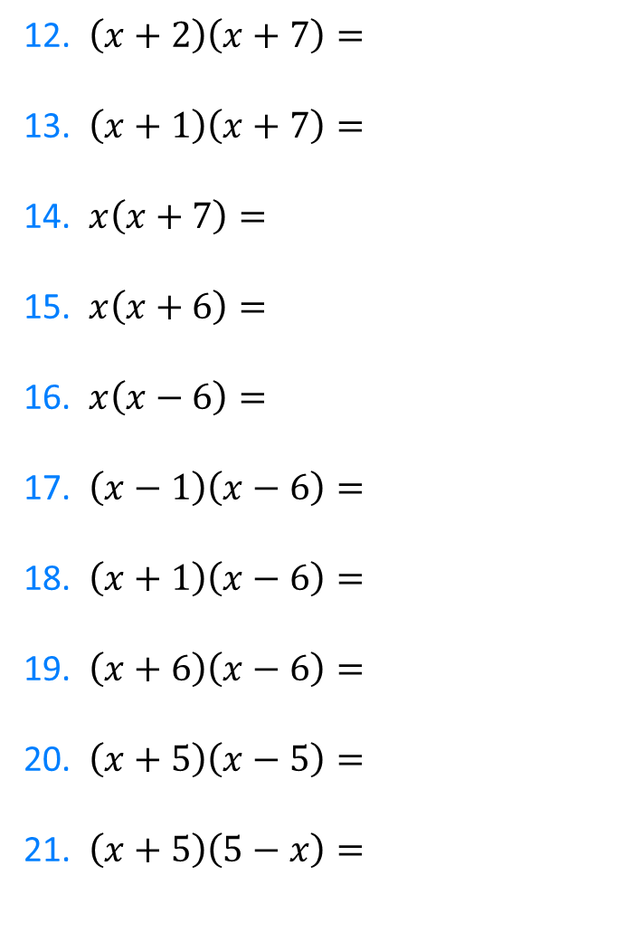
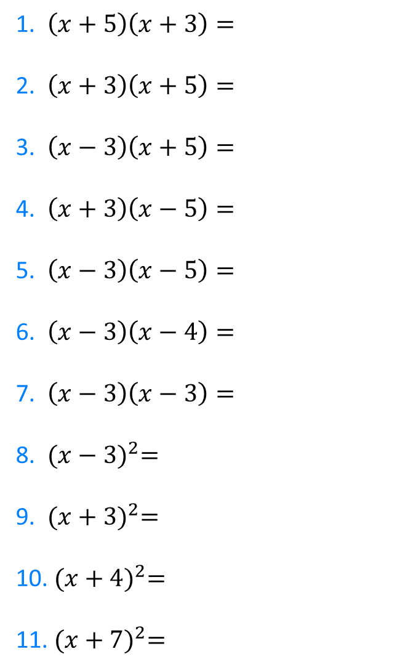
1. $\left(x+5\right)\left(x+3\right)=$
2. $\left(x+3\right)\left(x+5\right)=$
3. $\left(x−3\right)\left(x+5\right)=$
4. $\left(x+3\right)\left(x−5\right)=$
5. $\left(x−3\right)\left(x−5\right)=$
6. $\left(x−3\right)\left(x−4\right)=$
7. $\left(x−3\right)\left(x−3\right)=$
8. ${(x−3)}^{2}=$
9. ${(x+3)}^{2}=$
10. ${(x+4)}^{2}=$
11. ${(x+7)}^{2}=$
12. $\left(x+2\right)\left(x+7\right)=$
13. $\left(x+1\right)\left(x+7\right)=$
14. $x\left(x+7\right)=$
15. $x\left(x+6\right)=$
16. $x\left(x−6\right)=$
17. $\left(x−1\right)\left(x−6\right)=$
18. $\left(x+1\right)\left(x−6\right)=$
19. $\left(x+6\right)\left(x−6\right)=$
20. $\left(x+5\right)\left(x−5\right)=$
21. $\left(x+5\right)\left(5−x\right)=$
@mrbartonmaths

Slide 4
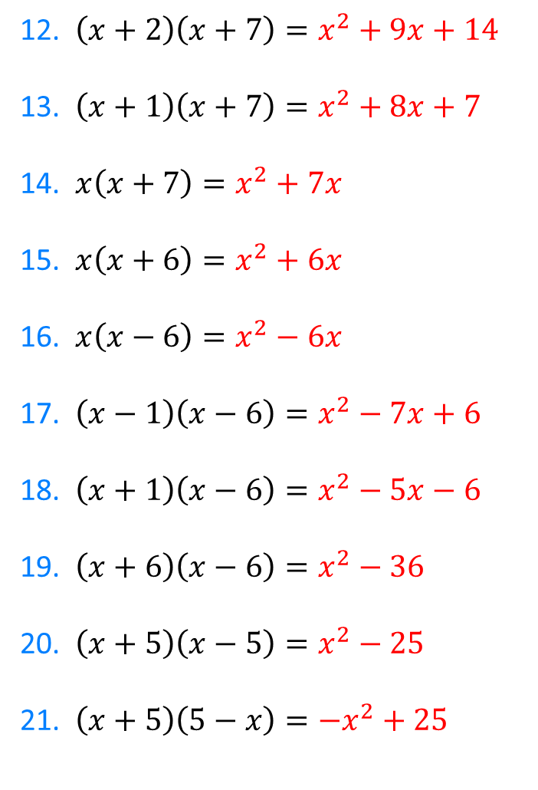
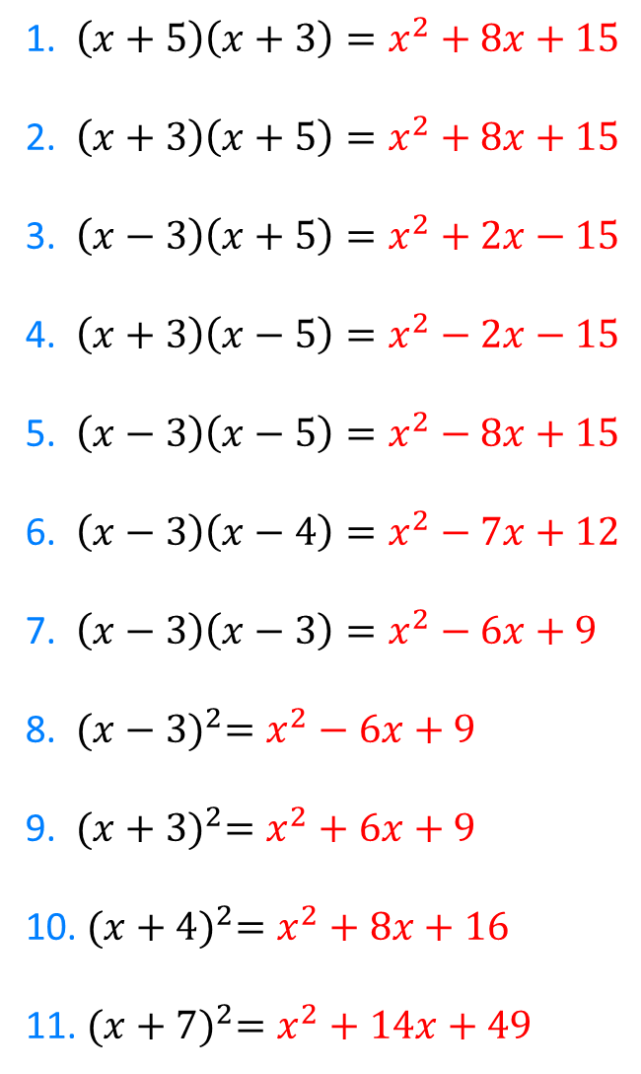
1. $\left(x+5\right)\left(x+3\right)=x^{2}+8x+15$
2. $\left(x+3\right)\left(x+5\right)=x^{2}+8x+15$
3. $\left(x−3\right)\left(x+5\right)=x^{2}+2x−15$
4. $\left(x+3\right)\left(x−5\right)=x^{2}−2x−15$
5. $\left(x−3\right)\left(x−5\right)=x^{2}−8x+15$
6. $\left(x−3\right)\left(x−4\right)=x^{2}−7x+12$
7. $\left(x−3\right)\left(x−3\right)=x^{2}−6x+9$
8. ${(x−3)}^{2}=x^{2}−6x+9$
9. ${(x+3)}^{2}=x^{2}+6x+9$
10. ${(x+4)}^{2}=x^{2}+8x+16$
11. ${(x+7)}^{2}=x^{2}+14x+49$
12. $\left(x+2\right)\left(x+7\right)=x^{2}+9x+14$
13. $\left(x+1\right)\left(x+7\right)=x^{2}+8x+7$
14. $x\left(x+7\right)=x^{2}+7x$
15. $x\left(x+6\right)=x^{2}+6x$
16. $x\left(x−6\right)=x^{2}−6x$
17. $\left(x−1\right)\left(x−6\right)=x^{2}−7x+6$
18. $\left(x+1\right)\left(x−6\right)=x^{2}−5x−6$
19. $\left(x+6\right)\left(x−6\right)=x^{2}−36$
20. $\left(x+5\right)\left(x−5\right)=x^{2}−25$
21. $\left(x+5\right)\left(5−x\right)={−x}^{2}+25$
@mrbartonmaths

