Slide 1
Histograms: Fill in the gaps
Silent
Teacher
Intelligent Practice
Narration
Your Turn
Practice

Slide 2
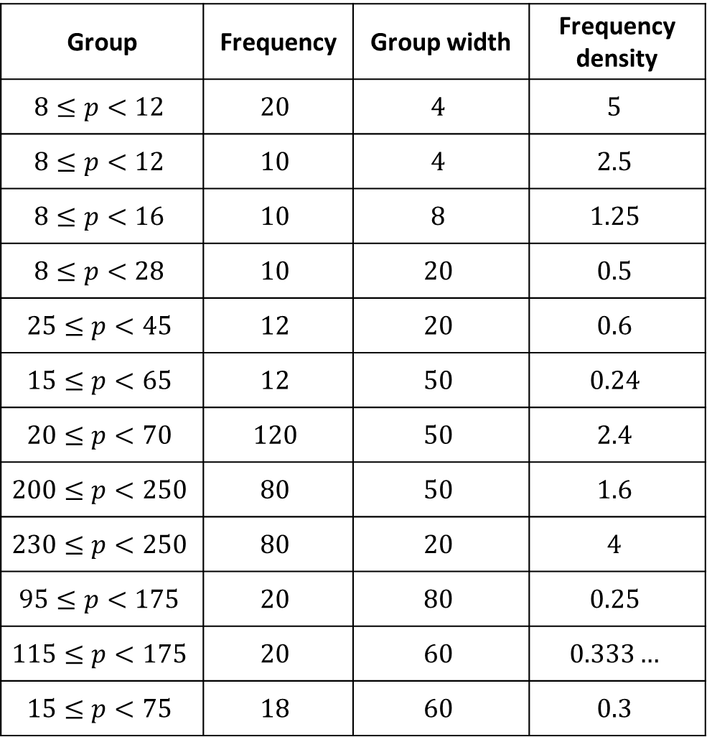
Group | Frequency | Group width | Frequency density
$$8≤p<12$$ | $$20$$ | $$4$$ | $$5$$
$$8≤p<12$$ | $$10$$ | $$4$$ | $$2.5$$
$$8≤p<16$$ | $$10$$ | $$8$$ | $$1.25$$
$$8≤p<28$$ | $$10$$ | $$20$$ | $$0.5$$
$$25≤p<45$$ | $$12$$ | $$20$$ | $$0.6$$
$$15≤p<65$$ | $$12$$ | $$50$$ | $$0.24$$
$$20≤p<70$$ | $$120$$ | $$50$$ | $$2.4$$
$$200≤p<250$$ | $$80$$ | $$50$$ | $$1.6$$
$$230≤p<250$$ | $$80$$ | $$20$$ | $$4$$
$$95≤p<175$$ | $$20$$ | $$80$$ | $$0.25$$
$$115≤p<175$$ | $$20$$ | $$60$$ | $$0.333…$$
$$15≤p<75$$ | $$18$$ | $$60$$ | $$0.3$$

Slide 3
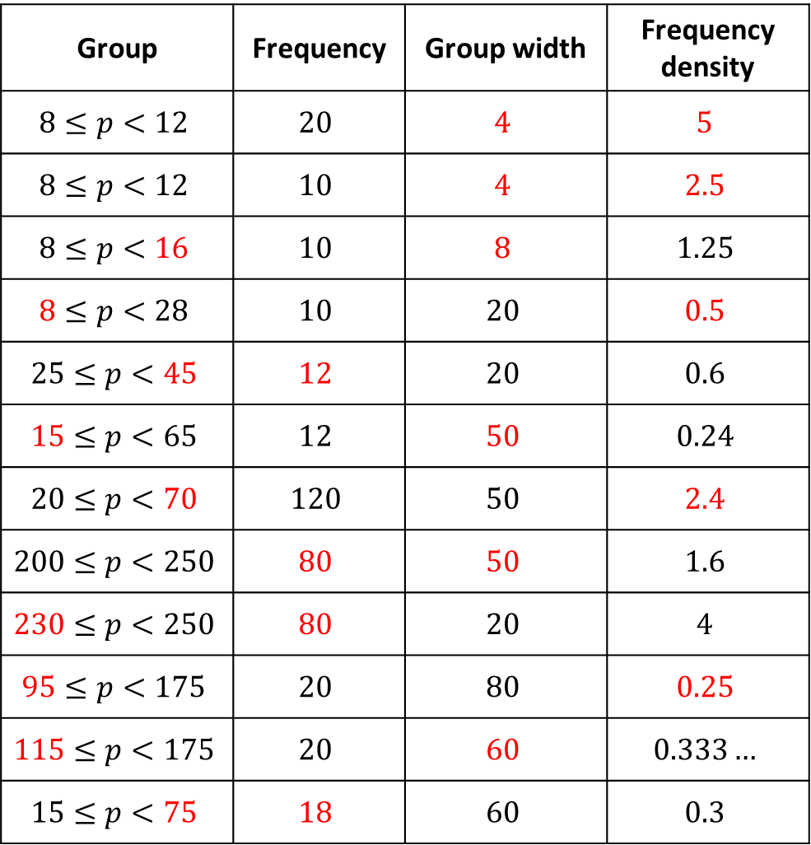
Group | Frequency | Group width | Frequency density
$$8≤p<12$$ | $$20$$ | $$4$$ | $$5$$
$$8≤p<12$$ | $$10$$ | $$4$$ | $$2.5$$
$$8≤p<16$$ | $$10$$ | $$8$$ | $$1.25$$
$$8≤p<28$$ | $$10$$ | $$20$$ | $$0.5$$
$$25≤p<45$$ | $$12$$ | $$20$$ | $$0.6$$
$$15≤p<65$$ | $$12$$ | $$50$$ | $$0.24$$
$$20≤p<70$$ | $$120$$ | $$50$$ | $$2.4$$
$$200≤p<250$$ | $$80$$ | $$50$$ | $$1.6$$
$$230≤p<250$$ | $$80$$ | $$20$$ | $$4$$
$$95≤p<175$$ | $$20$$ | $$80$$ | $$0.25$$
$$115≤p<175$$ | $$20$$ | $$60$$ | $$0.333…$$
$$15≤p<75$$ | $$18$$ | $$60$$ | $$0.3$$

Slide 4
Group | Frequency | Group width | Frequency density
$$8≤p<12$$ | $$20$$ | $$4$$ | $$5$$
$$8≤p<12$$ | $$10$$ | $$4$$ | $$2.5$$
$$8≤p<16$$ | $$10$$ | $$8$$ | $$1.25$$
$$8≤p<28$$ | $$10$$ | $$20$$ | $$0.5$$
$$25≤p<45$$ | $$12$$ | $$20$$ | $$0.6$$
$$15≤p<65$$ | $$12$$ | $$50$$ | $$0.24$$
$$20≤p<70$$ | $$120$$ | $$50$$ | $$2.4$$
$$200≤p<250$$ | $$80$$ | $$50$$ | $$1.6$$
$$230≤p<250$$ | $$80$$ | $$20$$ | $$4$$
$$95≤p<175$$ | $$20$$ | $$80$$ | $$0.25$$
$$115≤p<175$$ | $$20$$ | $$60$$ | $$0.333…$$
$$15≤p<75$$ | $$18$$ | $$60$$ | $$0.3$$

