Slide 1
Histograms: Frequency density
Silent
Teacher
Intelligent Practice
Narration
Your Turn
Practice

Slide 2
Worked Example
Your Turn
Frequency | Group width | Frequency density
$$20$$ | $$5$$
Frequency | Group width | Frequency density
$$20$$ | $$2$$
@mrbartonmaths

Slide 3
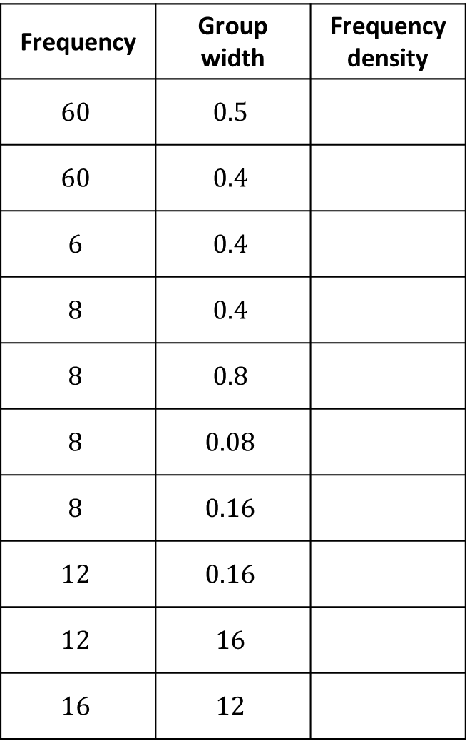
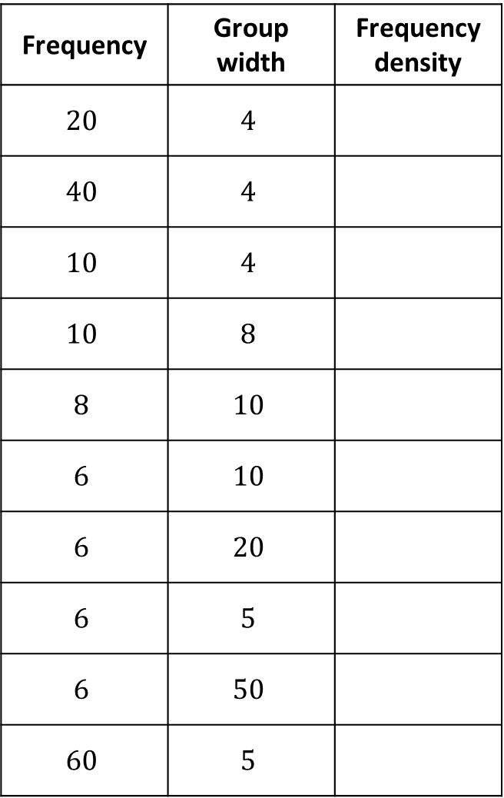
Frequency | Group width | Frequency density
$$20$$ | $$4$$
$$40$$ | $$4$$
$$10$$ | $$4$$
$$10$$ | $$8$$
$$8$$ | $$10$$
$$6$$ | $$10$$
$$6$$ | $$20$$
$$6$$ | $$5$$
$$6$$ | $$50$$
$$60$$ | $$5$$
Frequency | Group width | Frequency density
$$60$$ | $$0.5$$
$$60$$ | $$0.4$$
$$6$$ | $$0.4$$
$$8$$ | $$0.4$$
$$8$$ | $$0.8$$
$$8$$ | $$0.08$$
$$8$$ | $$0.16$$
$$12$$ | $$0.16$$
$$12$$ | $$16$$
$$16$$ | $$12$$

Slide 4
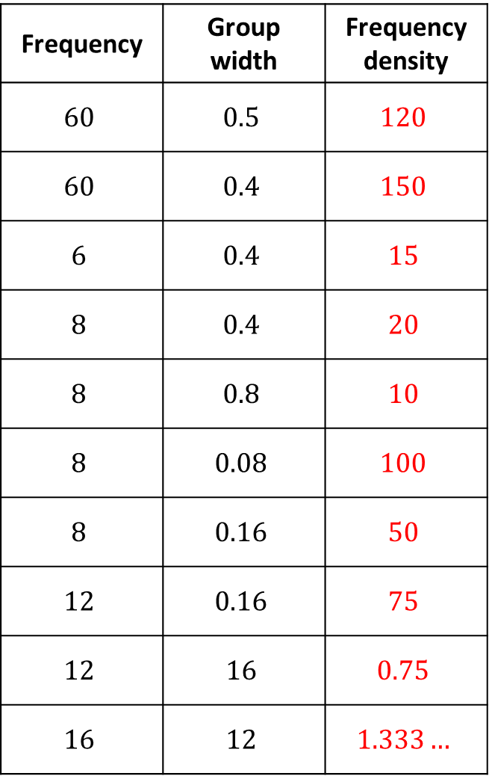
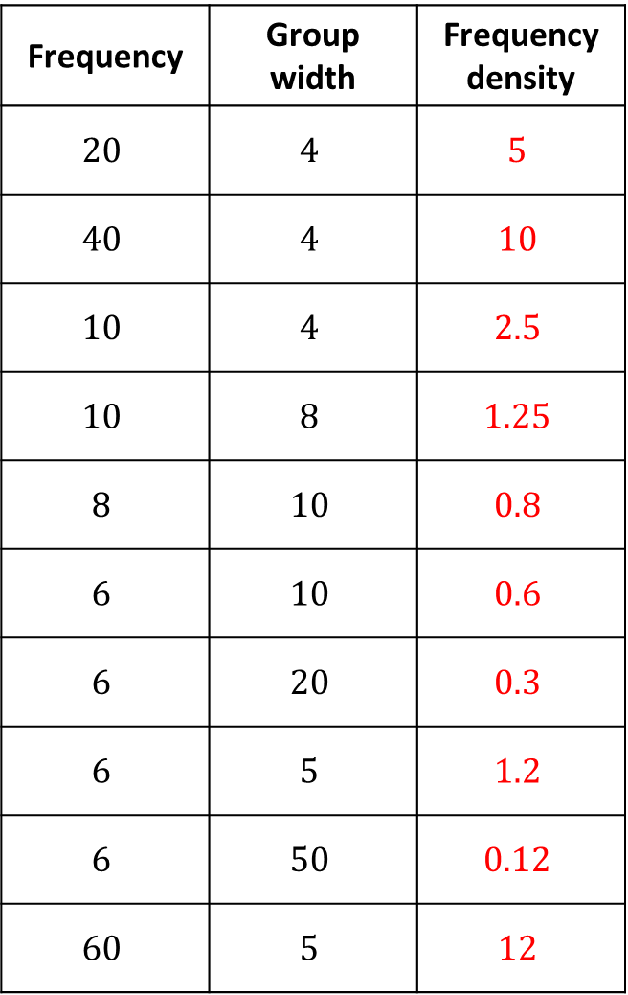
Frequency | Group width | Frequency density
$$20$$ | $$4$$ | $$5$$
$$40$$ | $$4$$ | $$10$$
$$10$$ | $$4$$ | $$2.5$$
$$10$$ | $$8$$ | $$1.25$$
$$8$$ | $$10$$ | $$0.8$$
$$6$$ | $$10$$ | $$0.6$$
$$6$$ | $$20$$ | $$0.3$$
$$6$$ | $$5$$ | $$1.2$$
$$6$$ | $$50$$ | $$0.12$$
$$60$$ | $$5$$ | $$12$$
Frequency | Group width | Frequency density
$$60$$ | $$0.5$$ | $$120$$
$$60$$ | $$0.4$$ | $$150$$
$$6$$ | $$0.4$$ | $$15$$
$$8$$ | $$0.4$$ | $$20$$
$$8$$ | $$0.8$$ | $$10$$
$$8$$ | $$0.08$$ | $$100$$
$$8$$ | $$0.16$$ | $$50$$
$$12$$ | $$0.16$$ | $$75$$
$$12$$ | $$16$$ | $$0.75$$
$$16$$ | $$12$$ | $$1.333…$$

Slide 5
Frequency | Group width | Frequency density
$$20$$ | $$4$$ | $$5$$
$$40$$ | $$4$$ | $$10$$
$$10$$ | $$4$$ | $$2.5$$
$$10$$ | $$8$$ | $$1.25$$
$$8$$ | $$10$$ | $$0.8$$
$$6$$ | $$10$$ | $$0.6$$
$$6$$ | $$20$$ | $$0.3$$
$$6$$ | $$5$$ | $$1.2$$
$$6$$ | $$50$$ | $$0.12$$
$$60$$ | $$5$$ | $$12$$
Frequency | Group width | Frequency density
$$60$$ | $$0.5$$ | $$120$$
$$60$$ | $$0.4$$ | $$150$$
$$6$$ | $$0.4$$ | $$15$$
$$8$$ | $$0.4$$ | $$20$$
$$8$$ | $$0.8$$ | $$10$$
$$8$$ | $$0.08$$ | $$100$$
$$8$$ | $$0.16$$ | $$50$$
$$12$$ | $$0.16$$ | $$75$$
$$12$$ | $$16$$ | $$0.75$$
$$16$$ | $$12$$ | $$1.333…$$

