Slide 1
Histograms: Group width
Silent
Teacher
Intelligent Practice
Narration
Your Turn
Practice

Slide 2
Worked Example
Your Turn
Group | Group width
$$10<h≤25$$
Group | Group width
$$5<h≤25$$
@mrbartonmaths

Slide 3
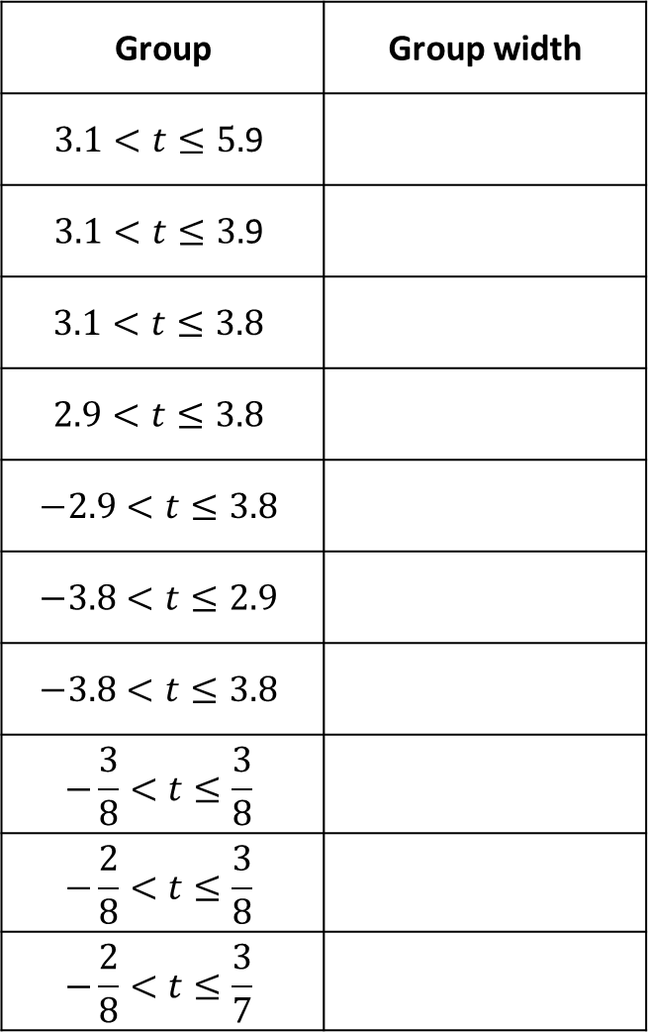
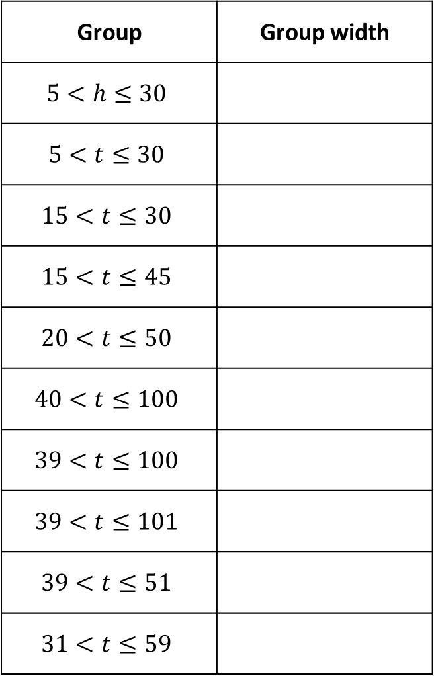
Group | Group width
$$5<h≤30$$
$$5<t≤30$$
$$15<t≤30$$
$$15<t≤45$$
$$20<t≤50$$
$$40<t≤100$$
$$39<t≤100$$
$$39<t≤101$$
$$39<t≤51$$
$$31<t≤59$$
Group | Group width
$$3.1<t≤5.\text{9}$$
$$3.1<t≤3.\text{9}$$
$$3.1<t≤3.\text{8}$$
$$2.9<t≤3.\text{8}$$
$$−2.9<t≤3.\text{8}$$
$$−3.8<t≤2.9$$
$$−3.8<t≤3.8$$
$$−\frac{3}{8}<t≤\frac{3}{8}$$
$$−\frac{2}{8}<t≤\frac{3}{8}$$
$$−\frac{2}{8}<t≤\frac{3}{7}$$

Slide 4
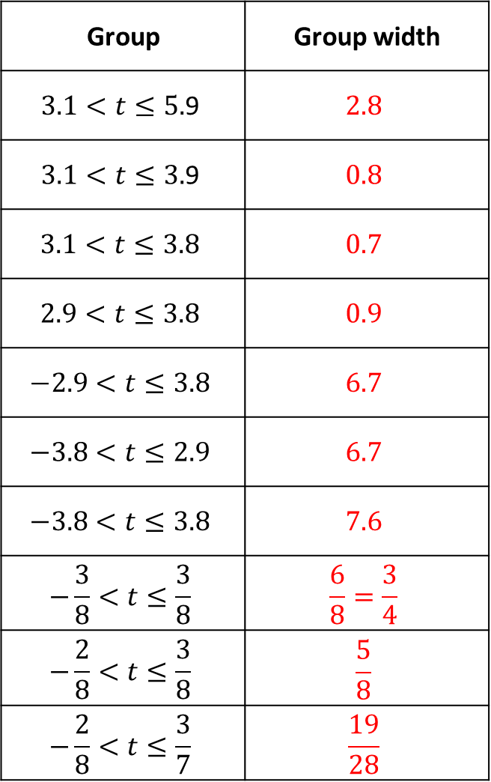
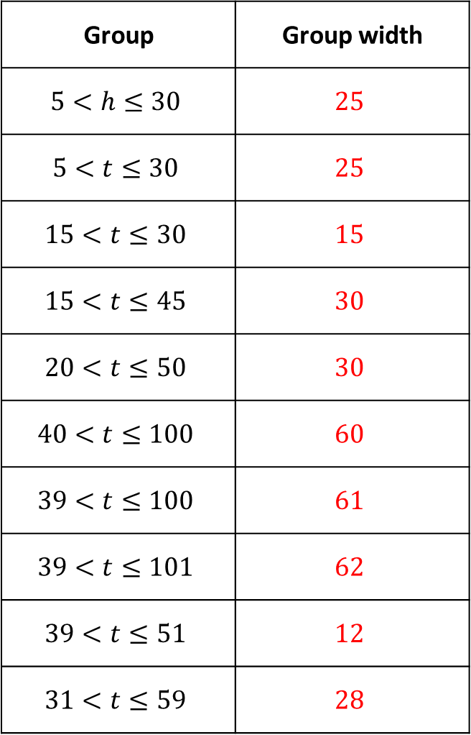
Group | Group width
$$5<h≤30$$ | $$25$$
$$5<t≤30$$ | $$25$$
$$15<t≤30$$ | $$15$$
$$15<t≤45$$ | $$30$$
$$20<t≤50$$ | $$30$$
$$40<t≤100$$ | $$60$$
$$39<t≤100$$ | $$61$$
$$39<t≤101$$ | $$62$$
$$39<t≤51$$ | $$12$$
$$31<t≤59$$ | $$28$$
Group | Group width
$$3.1<t≤5.\text{9}$$ | $$2.8$$
$$3.1<t≤3.\text{9}$$ | $$0.8$$
$$3.1<t≤3.\text{8}$$ | $$0.7$$
$$2.9<t≤3.\text{8}$$ | $$0.9$$
$$−2.9<t≤3.\text{8}$$ | $$6.7$$
$$−3.8<t≤2.9$$ | $$6.7$$
$$−3.8<t≤3.8$$ | $$7.6$$
$$−\frac{3}{8}<t≤\frac{3}{8}$$ | $$\frac{6}{8}=\frac{3}{4}$$
$$−\frac{2}{8}<t≤\frac{3}{8}$$ | $$\frac{5}{8}$$
$$−\frac{2}{8}<t≤\frac{3}{7}$$ | $$\frac{19}{28}$$

Slide 5
Group | Group width
$$5<h≤30$$ | $$25$$
$$5<t≤30$$ | $$25$$
$$15<t≤30$$ | $$15$$
$$15<t≤45$$ | $$30$$
$$20<t≤50$$ | $$30$$
$$40<t≤100$$ | $$60$$
$$39<t≤100$$ | $$61$$
$$39<t≤101$$ | $$62$$
$$39<t≤51$$ | $$12$$
$$31<t≤59$$ | $$28$$
Group | Group width
$$3.1<t≤5.\text{9}$$ | $$2.8$$
$$3.1<t≤3.\text{9}$$ | $$0.8$$
$$3.1<t≤3.\text{8}$$ | $$0.7$$
$$2.9<t≤3.\text{8}$$ | $$0.9$$
$$−2.9<t≤3.\text{8}$$ | $$6.7$$
$$−3.8<t≤2.9$$ | $$6.7$$
$$−3.8<t≤3.8$$ | $$7.6$$
$$−\frac{3}{8}<t≤\frac{3}{8}$$ | $$\frac{6}{8}=\frac{3}{4}$$
$$−\frac{2}{8}<t≤\frac{3}{8}$$ | $$\frac{5}{8}$$
$$−\frac{2}{8}<t≤\frac{3}{7}$$ | $$\frac{19}{28}$$

