Slide 1
Averages and Range: Mean from a list of data – version 2
Silent
Teacher
Intelligent Practice
Narration
Your Turn
$$2, 5, 8, 10, 10=$$
$$0, 3, 6, 8, 8 =$$
$$0, 3, 6, 8, 3=$$
Practice

Slide 2
Worked Example
Your Turn
$$2, 4, 5, 6, 13$$
$$2, 4, 5, 6, 13, 20$$
@mrbartonmaths

Slide 3

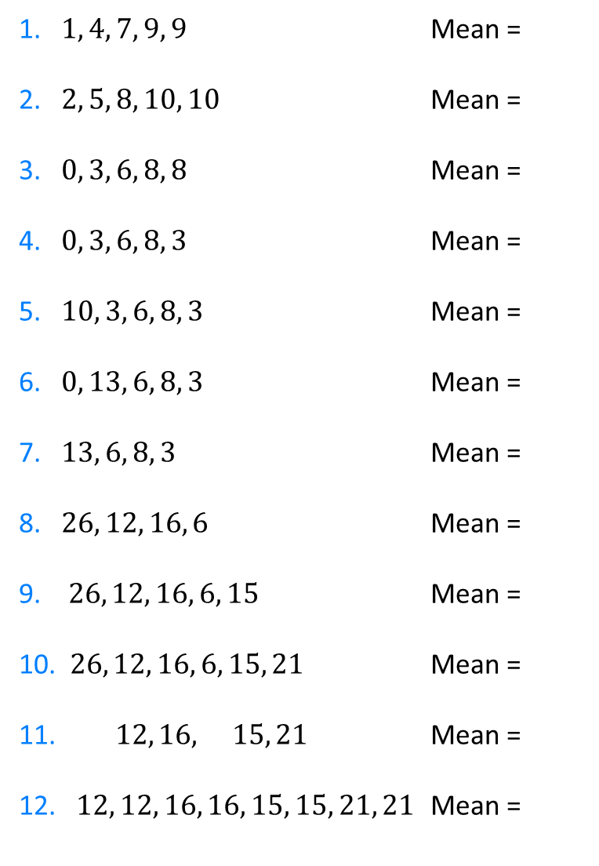
1. $1, 4, 7, 9, 9$ Mean =
2. $2, 5, 8, 10, 10$ Mean =
3. $0, 3, 6, 8, 8$ Mean =
4. $0, 3, 6, 8, 3$ Mean =
5. $10, 3, 6, 8, 3$ Mean =
6. $0, 13, 6, 8, 3$ Mean =
7. $13, 6, 8, 3$ Mean =
8. $26, 12, 16, 6$ Mean =
9. $26, 12, 16, 6, 15$ Mean =
10. $26, 12, 16, 6, 15, 21$ Mean =
11. $12, 16, 15, 21$ Mean =
12. $12, 12, 16, 16, 15, 15, 21, 21$ Mean =
13. $3.6, 4.8, 4.5, 6.3$ Mean =
14. $−6, −8, −7.5, −10.5$ Mean =
15. ${12}^{2},{16}^{2},{15}^{2},{21}^{2}$ Mean =
@mrbartonmaths

Slide 4
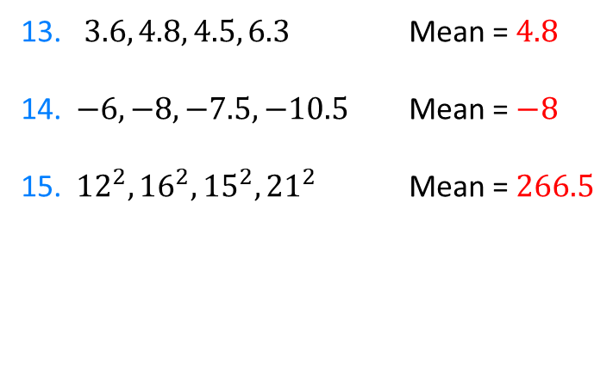
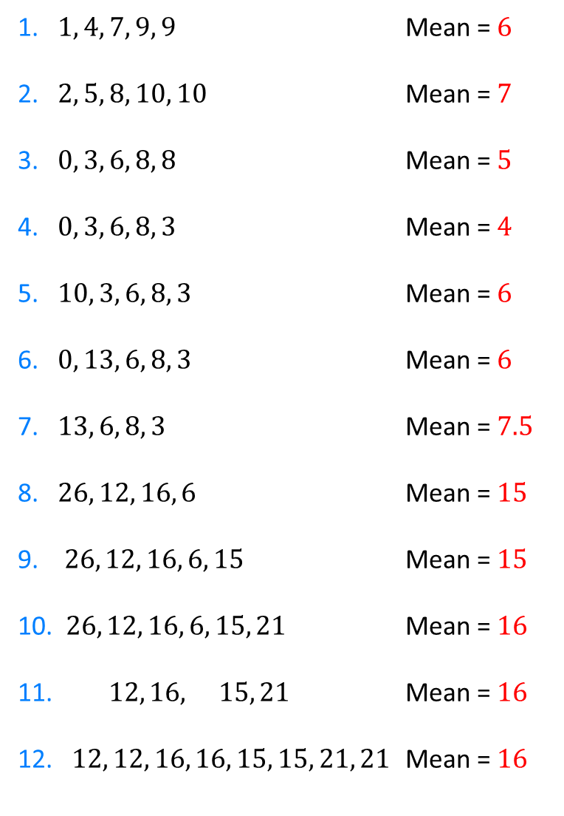
1. $1, 4, 7, 9, 9$ Mean = $6$
2. $2, 5, 8, 10, 10$ Mean = $7$
3. $0, 3, 6, 8, 8$ Mean = $5$
4. $0, 3, 6, 8, 3$ Mean = $4$
5. $10, 3, 6, 8, 3$ Mean = $6$
6. $0, 13, 6, 8, 3$ Mean = $6$
7. $13, 6, 8, 3$ Mean = $7.5$
8. $26, 12, 16, 6$ Mean = $15$
9. $26, 12, 16, 6, 15$ Mean = $15$
10. $26, 12, 16, 6, 15, 21$ Mean = $16$
11. $12, 16, 15, 21$ Mean = $16$
12. $12, 12, 16, 16, 15, 15, 21, 21$ Mean = $16$
13. $3.6, 4.8, 4.5, 6.3$ Mean = $4.8$
14. $−6, −8, −7.5, −10.5$ Mean = $−8$
15. ${12}^{2},{16}^{2},{15}^{2},{21}^{2}$ Mean = $266.5$
@mrbartonmaths

Slide 5
1. $1, 4, 7, 9, 9$ Mean = $6$
2. $2, 5, 8, 10, 10$ Mean = $7$
3. $0, 3, 6, 8, 8$ Mean = $5$
4. $0, 3, 6, 8, 3$ Mean = $4$
5. $10, 3, 6, 8, 3$ Mean = $6$
6. $0, 13, 6, 8, 3$ Mean = $6$
7. $13, 6, 8, 3$ Mean = $7.5$
8. $26, 12, 16, 6$ Mean = $15$
9. $26, 12, 16, 6, 15$ Mean = $15$
10. $26, 12, 16, 6, 15, 21$ Mean = $16$
11. $12, 16, 15, 21$ Mean = $16$
12. $12, 12, 16, 16, 15, 15, 21, 21$ Mean = $16$
13. $3.6, 4.8, 4.5, 6.3$ Mean = $4.8$
14. $−6, −8, −7.5, −10.5$ Mean = $−8$
15. ${12}^{2},{16}^{2},{15}^{2},{21}^{2}$ Mean = $266.5$
@mrbartonmaths

