Slide 1
Midpoint of two numbers
(version 2)
Silent
Teacher
Intelligent Practice
Narration
Your Turn
$$2 and 16$$
$$22 and 36$$
$$22 and 46$$
Practice

Slide 2
Worked Example
Your Turn
Numbers | Midpoint
$$40 and 60$$
Numbers | Midpoint
$$40 and 70$$
@mrbartonmaths

Slide 3
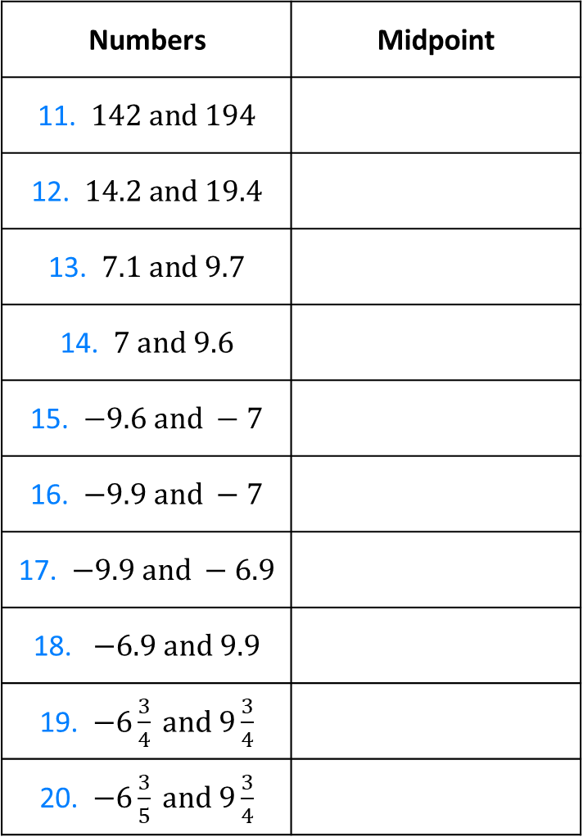
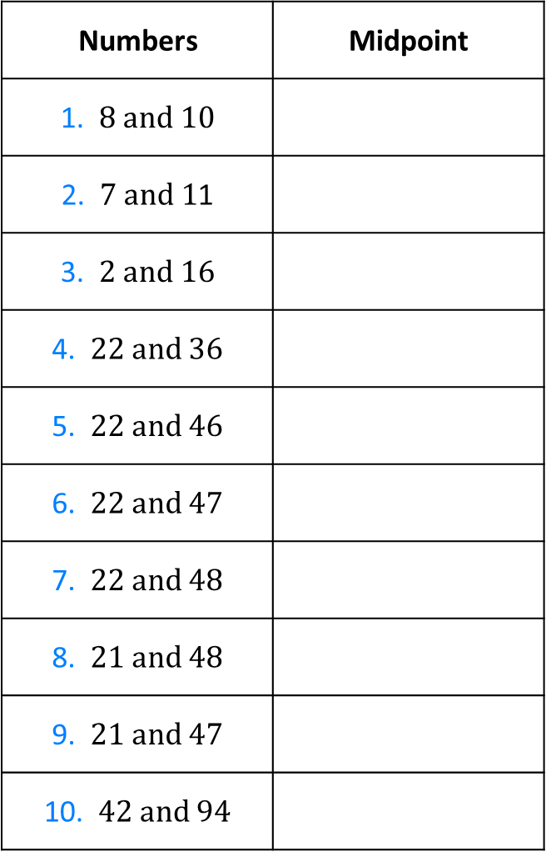
Numbers | Midpoint
1. $8 and 10$
2. $7 and 1$1
3. $2 and 16$
4. $22 and 36$
5. $22 and 46$
6. $22 and 47$
7. $22 and 48$
8. $21 and 48$
9. $21 and 47$
10. $42 and 94$
Numbers | Midpoint
11. $142 and 194$
12. $14.2 and 19.4$
13. $7.1 and 9.7$
14. $7 and 9.6$
15. $−9.6 and −7$
16. $−9.9 and −7$
17. $−9.9 and −6.9$
18. $−6.9 and 9.9$
19. $−6\frac{3}{4} and 9\frac{3}{4}$
20. $−6\frac{3}{5} and 9\frac{3}{4}$

Slide 4
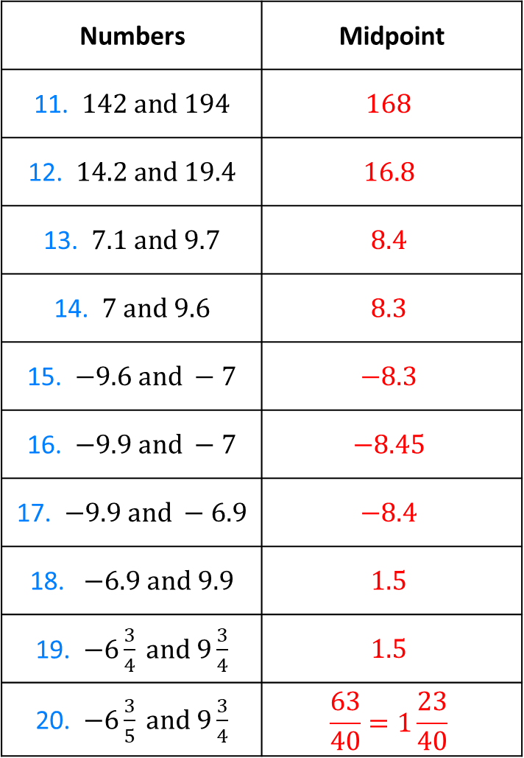
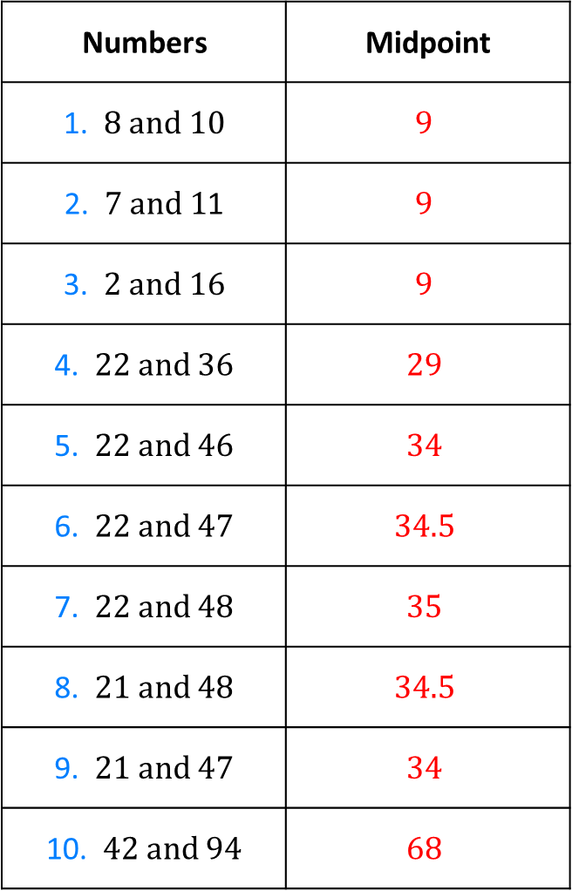
Numbers | Midpoint
1. $8 and 10$ | $$9$$
2. $7 and 1$1 | $$9$$
3. $2 and 16$ | $$9$$
4. $22 and 36$ | $$29$$
5. $22 and 46$ | $$34$$
6. $22 and 47$ | $$34.5$$
7. $22 and 48$ | $$35$$
8. $21 and 48$ | $$34.5$$
9. $21 and 47$ | $$34$$
10. $42 and 94$ | $$68$$
Numbers | Midpoint
11. $142 and 194$ | $$168$$
12. $14.2 and 19.4$ | $$16.8$$
13. $7.1 and 9.7$ | $$8.4$$
14. $7 and 9.6$ | $$8.3$$
15. $−9.6 and −7$ | $$−8.3$$
16. $−9.9 and −7$ | $$−8.45$$
17. $−9.9 and −6.9$ | $$−8.4$$
18. $−6.9 and 9.9$ | $$1.5$$
19. $−6\frac{3}{4} and 9\frac{3}{4}$ | $$1.5$$
20. $−6\frac{3}{5} and 9\frac{3}{4}$ | $$\frac{63}{40}=1\frac{23}{40}$$

Slide 5
Numbers | Midpoint
1. $8 and 10$ | $$9$$
2. $7 and 1$1 | $$9$$
3. $2 and 16$ | $$9$$
4. $22 and 36$ | $$29$$
5. $22 and 46$ | $$34$$
6. $22 and 47$ | $$34.5$$
7. $22 and 48$ | $$35$$
8. $21 and 48$ | $$34.5$$
9. $21 and 47$ | $$34$$
10. $42 and 94$ | $$68$$
Numbers | Midpoint
11. $142 and 194$ | $$168$$
12. $14.2 and 19.4$ | $$16.8$$
13. $7.1 and 9.7$ | $$8.4$$
14. $7 and 9.6$ | $$8.3$$
15. $−9.6 and −7$ | $$−8.3$$
16. $−9.9 and −7$ | $$−8.45$$
17. $−9.9 and −6.9$ | $$−8.4$$
18. $−6.9 and 9.9$ | $$1.5$$
19. $−6\frac{3}{4} and 9\frac{3}{4}$ | $$1.5$$
20. $−6\frac{3}{5} and 9\frac{3}{4}$ | $$\frac{63}{40}=1\frac{23}{40}$$

