Slide 1
Normal Distribution: Finding Probabilities
Silent
Teacher
Intelligent Practice
Narration
Your Turn
$$For X\sim N\left({100,10}^{2}\right), find p such that:$$
$P\left(85<X<115\right)=p$
$P\left(X<110\right)=p$
Practice

Slide 2
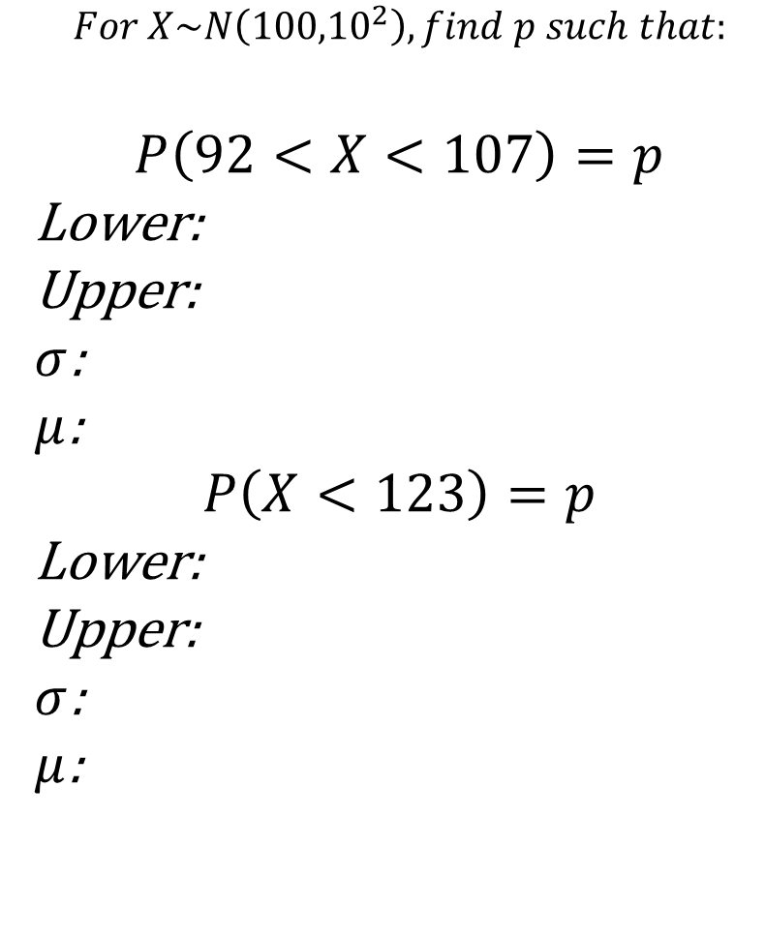
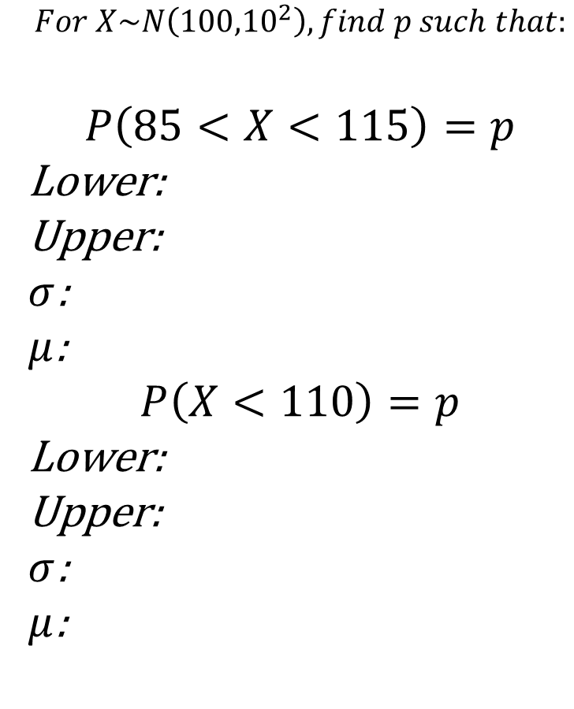
Worked Examples
Your Turn
$$For X\sim N\left({100,10}^{2}\right), find p such that:$$
$$P\left(85<X<115\right)=p$$
Lower:
Upper:
$σ$:
$μ$:
$$P\left(X<110\right)=p$$
Lower:
Upper:
$σ$:
$μ$:
$$For X\sim N\left({100,10}^{2}\right), find p such that:$$
$$P\left(92<X<107\right)=p$$
Lower:
Upper:
$σ$:
$μ$:
$$P\left(X<123\right)=p$$
Lower:
Upper:
$σ$:
$μ$:

Slide 3
$$All answers to 4.d.p$$
$$For X\sim N\left({100,10}^{2}\right), find p such that:$$
$$For X\sim N\left({100,20}^{2}\right), find p such that:$$
$$P\left(95<X<105\right)=p$$
$$P\left(95<X<105\right)=p$$
$$P\left(90<X<110\right)=p$$
$$P\left(90<X<110\right)=p$$
$$P\left(90<X<100\right)=p$$
$$P\left(50<X<100\right)=p$$
$$P\left(50<X<100\right)=p$$
$$For X\sim N\left({90,20}^{2}\right), find p such that:$$
$$P\left(40<X<100\right)=p$$
$$P\left(95<X<105\right)=p$$
$$P\left(80<X<140\right)=p$$
$$P\left(90<X<110\right)=p$$
$$P\left(100<X<160\right)=p$$

Slide 4
$$All answers to 4.d.p$$
$$For X\sim N\left({100,10}^{2}\right), find p such that:$$
$$For X\sim N\left({100,20}^{2}\right), find p such that:$$
$$P\left(95<X<105\right)=p$$
$$P\left(95<X<105\right)=p$$
$$p=0.3829$$
$$p=0.1974$$
$$P\left(90<X<110\right)=p$$
$$P\left(90<X<110\right)=p$$
$$p=0.6827$$
$$p=0.3829$$
$$P\left(90<X<100\right)=p$$
$$P\left(50<X<100\right)=p$$
$p=0.$3413
$$p=0.4937$$
$$P\left(50<X<100\right)=p$$
$$For X\sim N\left({90,20}^{2}\right), find p such that:$$
$$p=0.5000$$
$$P\left(40<X<100\right)=p$$
$$P\left(95<X<105\right)=p$$
$$p=0.5000$$
$$p=0.1746$$
$$P\left(80<X<140\right)=p$$
$$P\left(90<X<110\right)=p$$
$$p=9772$$
$$p=0.3413$$
$$P\left(100<X<160\right)=p$$
$$p=0.5000$$

Slide 5
$$All answers to 4.d.p$$
$$For X\sim N\left({100,10}^{2}\right), find p such that:$$
$$For X\sim N\left({100,5}^{2}\right), find p such that:$$
$$P\left(X<105\right)=p$$
$$P\left(X<105\right)=p$$
$$P\left(X<110\right)=p$$
$$P\left(X<90\right)=p$$
$$P\left(X<150\right)=p$$
$$P\left(X<75\right)=p$$
$$For X\sim N\left(100,100\right), find p such that:$$
$$For X\sim N\left({105,5}^{2}\right), find p such that:$$
$$P\left(X<105\right)=p$$
$$P\left(X<105\right)=p$$
$$P\left(X<90\right)=p$$
$$P\left(X<110\right)=p$$
$$P\left(X≤90\right)=p$$
$$P\left(X<130\right)=p$$

Slide 6
$$All answers to 4.d.p$$
$$For X\sim N\left({100,10}^{2}\right), find p such that:$$
$$For X\sim N\left({100,5}^{2}\right), find p such that:$$
$$P\left(X<105\right)=p$$
$$P\left(X<105\right)=p$$
$$p=0.6915$$
$$p=0.8413$$
$$P\left(X<110\right)=p$$
$$P\left(X<90\right)=p$$
$$p=0.8413$$
$$p=0.0227$$
$$P\left(X<150\right)=p$$
$$P\left(X<75\right)=p$$
$$p=1.0000$$
$$p=0.0000$$
$$For X\sim N\left(100,100\right), find p such that:$$
$$For X\sim N\left({105,5}^{2}\right), find p such that:$$
$$P\left(X<105\right)=p$$
$$P\left(X<105\right)=p$$
$$p=0.6915$$
$$p=0.5000$$
$$P\left(X<90\right)=p$$
$$P\left(X<110\right)=p$$
$$p=0.1587$$
$$p=0.8413$$
$$P\left(X≤90\right)=p$$
$$P\left(X<130\right)=p$$
$$p=0.1587$$
$$p=1.0000$$

Slide 7
$$All answers to 4.d.p$$
$$For X\sim N\left({100,10}^{2}\right), find p such that:$$
$$For X\sim N\left(100,35\right), find p such that:$$
$$P\left(X>105\right)=p$$
$$P\left(X>105\right)=p$$
$$P\left(X<95\right)=p$$
$$P\left(X<95\right)=p$$
$$P\left(X≥95\right)=p$$
$$P\left(X>64\right)=p$$
$$For X\sim N\left(100,25\right), find p such that:$$
$$For X\sim N\left({95,5}^{2}\right), find p such that:$$
$$P\left(X>105\right)=p$$
$$P\left(X>105\right)=p$$
$$P\left(X<95\right)=p$$
$$P\left(X<95\right)=p$$
$$P\left(X≥80\right)=p$$
$$P\left(X>100\right)=p$$

Slide 8
$$All answers to 4.d.p$$
$$For X\sim N\left({100,10}^{2}\right), find p such that:$$
$$For X\sim N\left(100,35\right), find p such that:$$
$$P\left(X>105\right)=p$$
$$P\left(X>105\right)=p$$
$$p=0.3085$$
$$p=0.1990$$
$$P\left(X<95\right)=p$$
$$P\left(X<95\right)=p$$
$$p=0.3085$$
$$p=0.1990$$
$$P\left(X≥95\right)=p$$
$$P\left(X>64\right)=p$$
$$p=0.6915$$
$$p=1.0000$$
$$For X\sim N\left(100,25\right), find p such that:$$
$$For X\sim N\left({95,5}^{2}\right), find p such that:$$
$$P\left(X>105\right)=p$$
$$P\left(X>105\right)=p$$
$$p=0.1587$$
$$p=0.0227$$
$$P\left(X<95\right)=p$$
$$P\left(X<95\right)=p$$
$$p=0.1587$$
$$p=0.5000$$
$$P\left(X≥81\right)=p$$
$$P\left(X>100\right)=p$$
$$p=0.9999$$
$$p=0.1587$$

