Slide 1
Decimals: Ordering decimals – version 2
True/false
Reflect
Your Turn
$$0.6$$
$$0.7$$
$$0.67$$
Rule

Slide 2
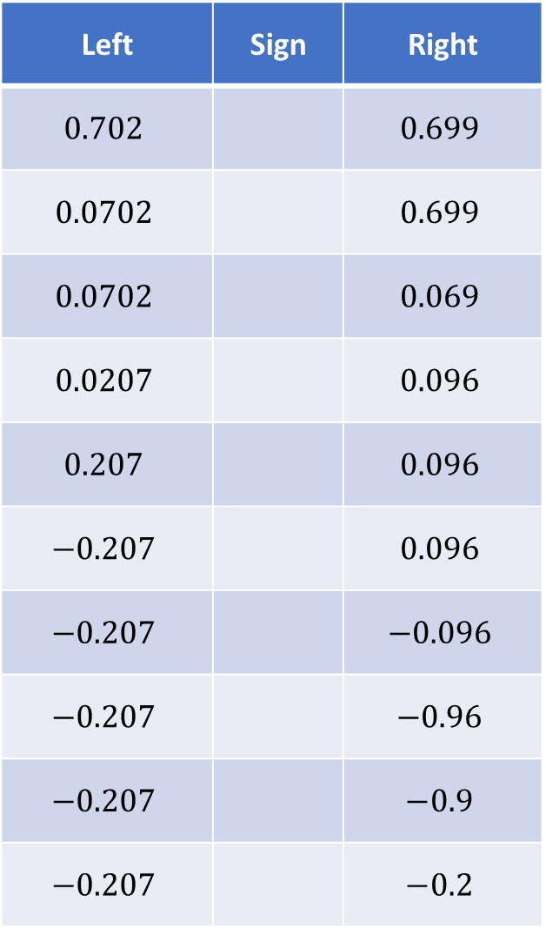
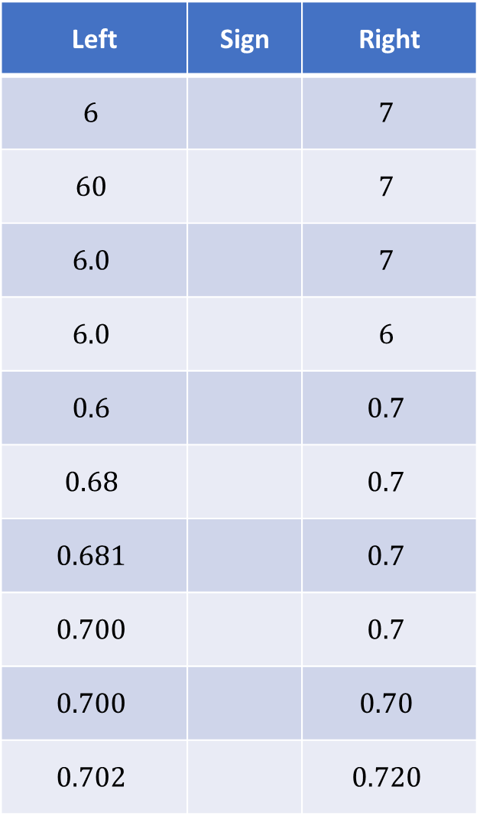
Left | Sign | Right
$$6$$ |  | $$7$$
$$60$$ |  | $$7$$
$$6.0$$ |  | $$7$$
$$6.0$$ |  | $$6$$
$$0.6$$ |  | $$0.7$$
$$0.68$$ |  | $$0.7$$
$$0.681$$ |  | $$0.7$$
$$0.700$$ |  | $$0.7$$
$$0.700$$ |  | $$0.70$$
$$0.702$$ |  | $$0.720$$
Left | Sign | Right
$$0.702$$ |  | $$0.699$$
$$0.0702$$ |  | $$0.699$$
$$0.0702$$ |  | $$0.069$$
$$0.0207$$ |  | $$0.096$$
$$0.207$$ |  | $$0.096$$
$$−0.207$$ |  | $$0.096$$
$$−0.207$$ |  | $$−0.096$$
$$−0.207$$ |  | $$−0.96$$
$$−0.207$$ |  | $$−0.9$$
$$−0.207$$ |  | $$−0.2$$

Slide 3
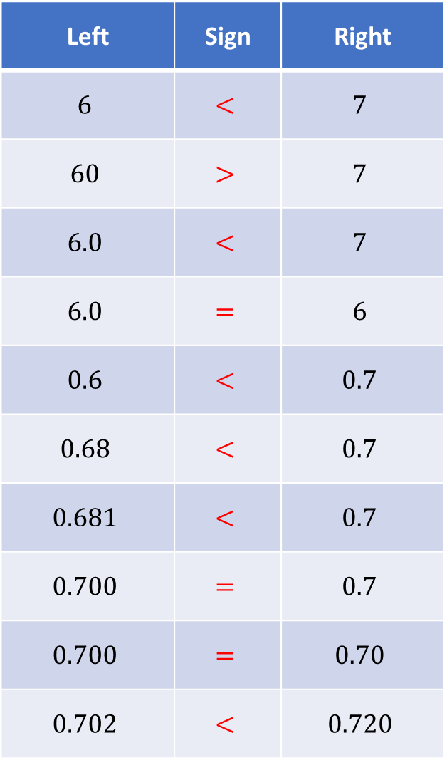
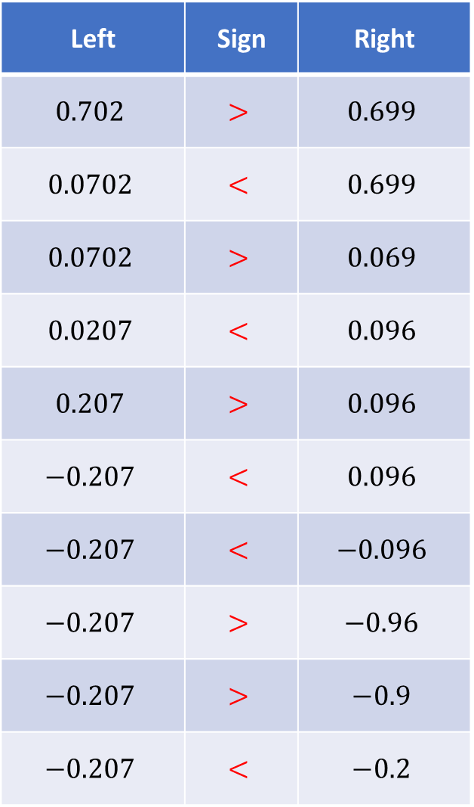
Left | Sign | Right
$$6$$ | $$<$$ | $$7$$
$$60$$ | $$>$$ | $$7$$
$$6.0$$ | $$<$$ | $$7$$
$$6.0$$ | $$=$$ | $$6$$
$$0.6$$ | $$<$$ | $$0.7$$
$$0.68$$ | $$<$$ | $$0.7$$
$$0.681$$ | $$<$$ | $$0.7$$
$$0.700$$ | $$=$$ | $$0.7$$
$$0.700$$ | $$=$$ | $$0.70$$
$$0.702$$ | $$<$$ | $$0.720$$
Left | Sign | Right
$$0.702$$ | $$>$$ | $$0.699$$
$$0.0702$$ | $$<$$ | $$0.699$$
$$0.0702$$ | $$>$$ | $$0.069$$
$$0.0207$$ | $$<$$ | $$0.096$$
$$0.207$$ | $$>$$ | $$0.096$$
$$−0.207$$ | $$<$$ | $$0.096$$
$$−0.207$$ | $$<$$ | $$−0.096$$
$$−0.207$$ | $$>$$ | $$−0.96$$
$$−0.207$$ | $$>$$ | $$−0.9$$
$$−0.207$$ | $$<$$ | $$−0.2$$

Slide 4
Left | Sign | Right
$$6$$ | $$<$$ | $$7$$
$$60$$ | $$>$$ | $$7$$
$$6.0$$ | $$<$$ | $$7$$
$$6.0$$ | $$=$$ | $$6$$
$$0.6$$ | $$<$$ | $$0.7$$
$$0.68$$ | $$<$$ | $$0.7$$
$$0.681$$ | $$<$$ | $$0.7$$
$$0.700$$ | $$=$$ | $$0.7$$
$$0.700$$ | $$=$$ | $$0.70$$
$$0.702$$ | $$<$$ | $$0.720$$
Left | Sign | Right
$$0.702$$ | $$>$$ | $$0.699$$
$$0.0702$$ | $$<$$ | $$0.699$$
$$0.0702$$ | $$>$$ | $$0.069$$
$$0.0207$$ | $$<$$ | $$0.096$$
$$0.207$$ | $$>$$ | $$0.096$$
$$−0.207$$ | $$<$$ | $$0.096$$
$$−0.207$$ | $$<$$ | $$−0.096$$
$$−0.207$$ | $$>$$ | $$−0.96$$
$$−0.207$$ | $$>$$ | $$−0.9$$
$$−0.207$$ | $$<$$ | $$−0.2$$

Slide 5
Your Turn
Arrange these decimals in ascending order
$$0.5021, 0.5, 0.52, 0.521, 0.502, 0.0521, 0.50012$$
@mrbartonmaths

Slide 6
Your Turn - answers
Arrange these decimals in ascending order
$$0.5021, 0.5, 0.52, 0.521, 0.502, 0.0521, 0.50012$$
$$0.0521$$
$$0.5$$
$$0.50012$$
$$0.502$$
$$0.5021$$
$$0.52$$
$$0.521$$
@mrbartonmaths

