Slide 1
Revision: Fraction operations
Silent
Teacher
Intelligent Practice
Narration
Your Turn
$$\frac{3}{4}÷\frac{1}{3}=$$
$$\frac{1}{3}÷\frac{3}{4}=$$
$$\frac{1}{3}−\frac{3}{4}=$$
Practice

Slide 2
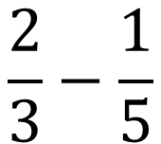
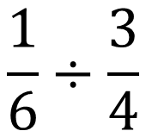
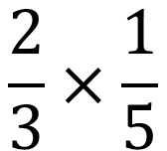
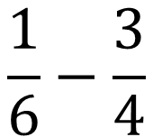
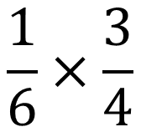
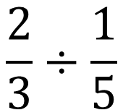
Worked Example
Your Turn
$$\frac{2}{3}×\frac{1}{5}$$
$$\frac{1}{6}×\frac{3}{4}$$
$$\frac{2}{3}−\frac{1}{5}$$
$$\frac{1}{6}−\frac{3}{4}$$
$$\frac{2}{3}÷\frac{1}{5}$$
$$\frac{1}{6}÷\frac{3}{4}$$
@mrbartonmaths

Slide 3
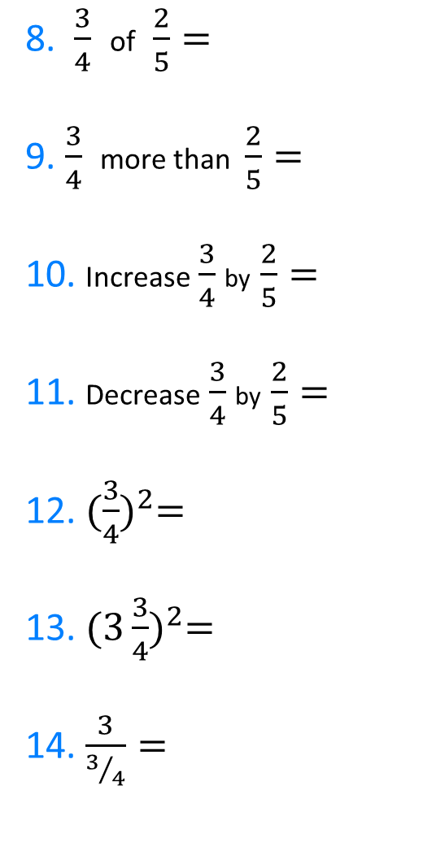
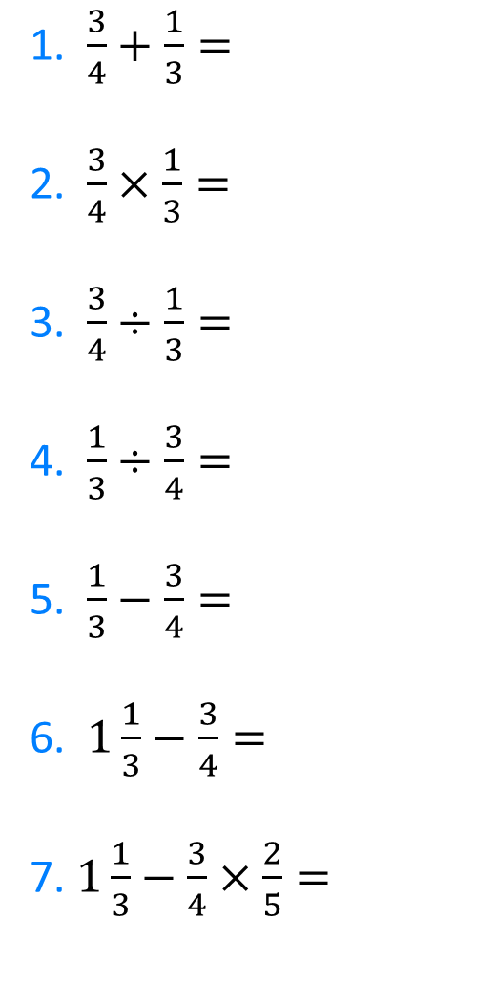
1. $\frac{3}{4}+\frac{1}{3}=$
2. $\frac{3}{4}×\frac{1}{3}=$
3. $\frac{3}{4}÷\frac{1}{3}=$
4. $\frac{1}{3}÷\frac{3}{4}=$
5. $\frac{1}{3}−\frac{3}{4}=$
6. $1\frac{1}{3}−\frac{3}{4}=$
7. $1\frac{1}{3}−\frac{3}{4}×\frac{2}{5}=$
8. $\frac{3}{4}$ of $\frac{2}{5}=$
9. $\frac{3}{4}$ more than $\frac{2}{5}=$
10. Increase $\frac{3}{4}$ by $\frac{2}{5}=$
11. Decrease $\frac{3}{4}$ by $\frac{2}{5}=$
12. ${(\frac{3}{4})}^{2}=$
13. ${(3\frac{3}{4})}^{2}=$
14. $\frac{3}{3/4}=$
@mrbartonmaths

Slide 4
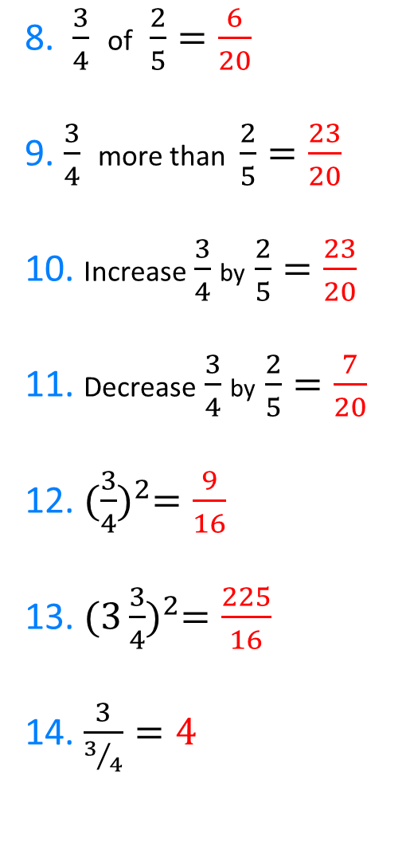
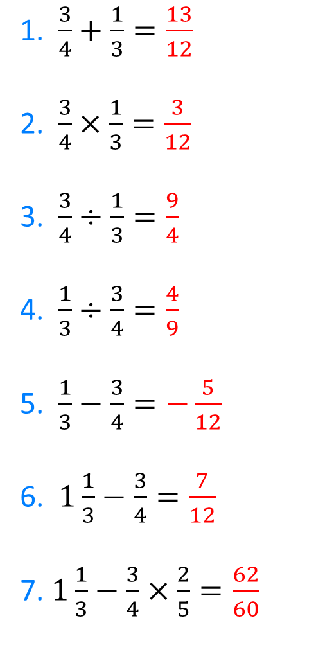
1. $\frac{3}{4}+\frac{1}{3}=\frac{13}{12}$
2. $\frac{3}{4}×\frac{1}{3}=\frac{3}{12}$
3. $\frac{3}{4}÷\frac{1}{3}=\frac{9}{4}$
4. $\frac{1}{3}÷\frac{3}{4}=\frac{4}{9}$
5. $\frac{1}{3}−\frac{3}{4}=−\frac{5}{12}$
6. $1\frac{1}{3}−\frac{3}{4}=\frac{7}{12}$
7. $1\frac{1}{3}−\frac{3}{4}×\frac{2}{5}=\frac{62}{60}$
8. $\frac{3}{4}$ of $\frac{2}{5}=\frac{6}{20}$
9. $\frac{3}{4}$ more than $\frac{2}{5}=\frac{23}{20}$
10. Increase $\frac{3}{4}$ by $\frac{2}{5}=\frac{23}{20}$
11. Decrease $\frac{3}{4}$ by $\frac{2}{5}=\frac{7}{20}$
12. ${(\frac{3}{4})}^{2}=\frac{9}{16}$
13. ${(3\frac{3}{4})}^{2}=\frac{225}{16}$
14. $\frac{3}{3/4}=4$
@mrbartonmaths

