Slide 1
Revision: Percentage operations
Silent
Teacher
Intelligent Practice
Narration
Your Turn
Increase £60 by 35%
Increase £35 by 60%
What is 100% of £35?
Practice

Slide 2
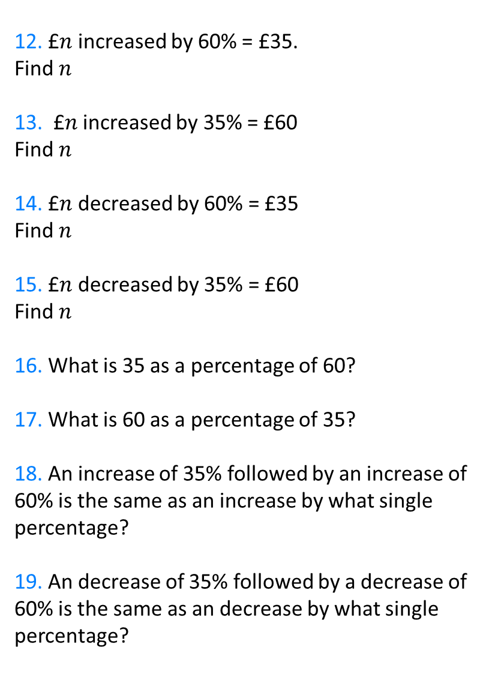
12. £$n$ increased by 60% = £35.
Find $n$
13. £$n$ increased by 35% = £60
Find $n$
14. £$n$ decreased by 60% = £35
Find $n$
15. £$n$ decreased by 35% = £60
Find $n$
16. What is 35 as a percentage of 60?
17. What is 60 as a percentage of 35?
18. An increase of 35% followed by an increase of 60% is the same as an increase by what single percentage?
19. An decrease of 35% followed by a decrease of 60% is the same as an decrease by what single percentage?
1. Find 35% of £60
2. What is 60% of £35?
3. Increase £60 by 35%
4. Increase £35 by 60%
5. What is 100% of £35?
6. Increase £35 by 100%
7. Find 160% of £35
8. Increase £35 by 160%
9. Decrease £60 by 35%
10. Decrease £35 by 60%
11. Decrease £35 by 100%

Slide 3
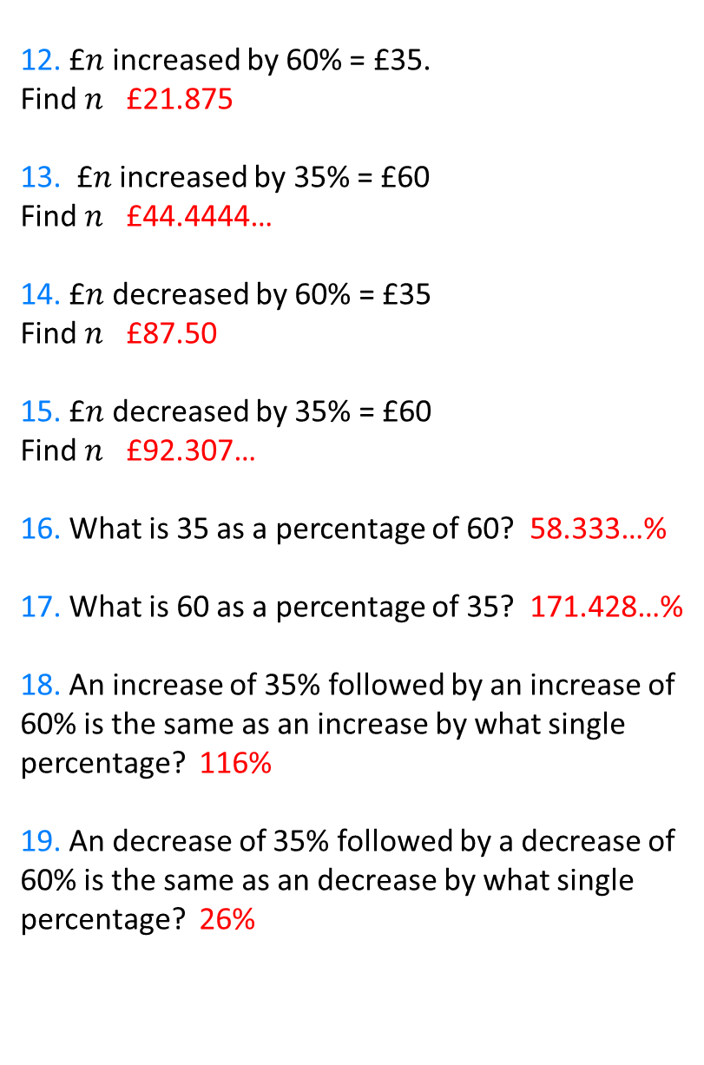
12. £$n$ increased by 60% = £35.
Find $n$ £21.875
13. £$n$ increased by 35% = £60
Find $n$ £44.4444…
14. £$n$ decreased by 60% = £35
Find $n$ £87.50
15. £$n$ decreased by 35% = £60
Find $n$ £92.307…
16. What is 35 as a percentage of 60? 58.333…%
17. What is 60 as a percentage of 35? 171.428…%
18. An increase of 35% followed by an increase of 60% is the same as an increase by what single percentage? 116%
19. An decrease of 35% followed by a decrease of 60% is the same as an decrease by what single percentage? 26%
1. Find 35% of £60 £21
2. What is 60% of £35? £21
3. Increase £60 by 35% £81
4. Increase £35 by 60% £56
5. What is 100% of £35? £35
6. Increase £35 by 100% £70
7. Find 160% of £35 £56
8. Increase £35 by 160% £91
9. Decrease £60 by 35% £39
10. Decrease £35 by 60% £14
11. Decrease £35 by 100% £0

