Slide 1
Revision: Expanding brackets
Silent
Teacher
Intelligent Practice
Narration
Your Turn
$3(x−1)(x+4)=$
$$x(x−1)(x+4)=$$
$x(x−2)(x+4)=$
Practice

Slide 2
Worked Example
Your Turn
$$(x−2)(x+3)=$$
$$(x+2)(x−3)=$$
@mrbartonmaths

Slide 3
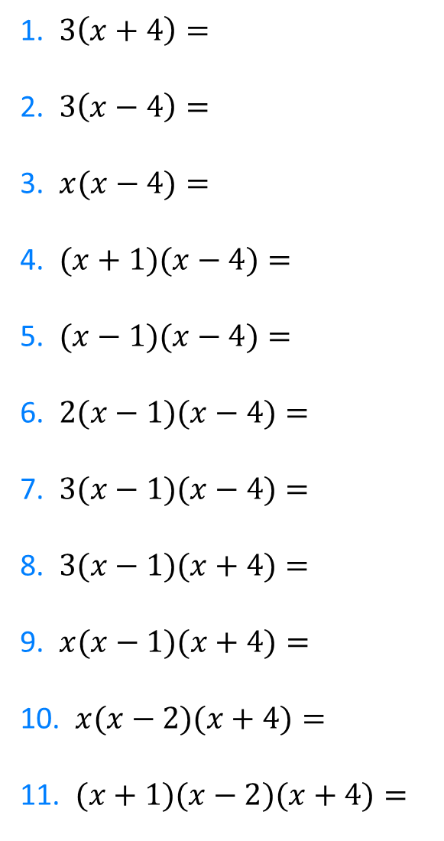
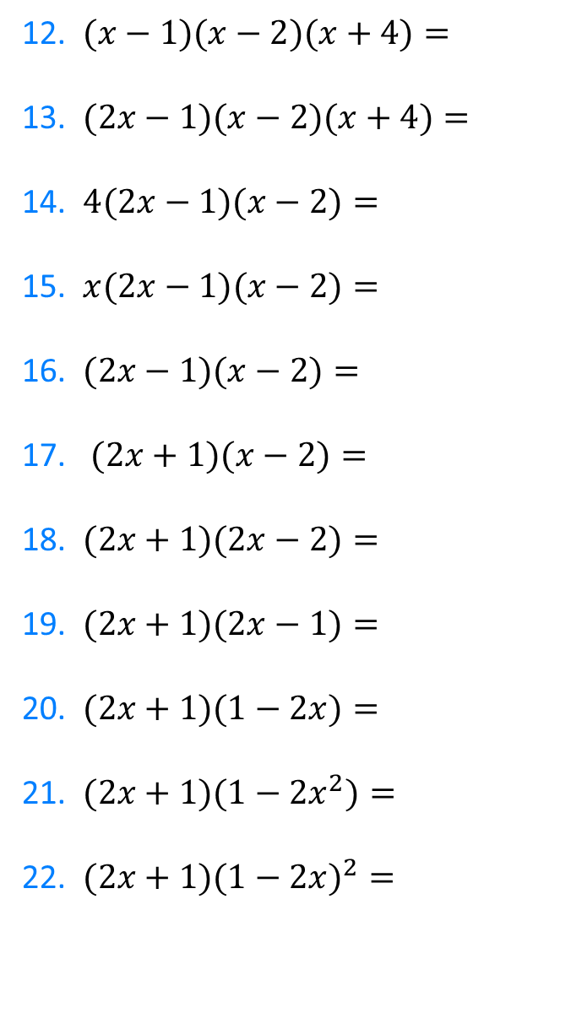
1. $3\left(x+4\right)=$
2. $3\left(x−4\right)=$
3. $x(x−4)=$
4. $(x+1)(x−4)=$
5. $(x−1)(x−4)=$
6. $2(x−1)(x−4)=$
7. $3(x−1)(x−4)=$
8. $3(x−1)(x+4)=$
9. $x(x−1)(x+4)=$
10. $x(x−2)(x+4)=$
11. $(x+1)(x−2)(x+4)=$
12. $(x−1)(x−2)(x+4)=$
13. $(2x−1)(x−2)(x+4)=$
14. $4(2x−1)(x−2)=$
15. $x(2x−1)(x−2)=$
16. $(2x−1)(x−2)=$
17. $(2x+1)(x−2)=$
18. $(2x+1)(2x−2)=$
19. $(2x+1)(2x−1)=$
20. $(2x+1)(1−2x)=$
21. $(2x+1)(1−{2x}^{2})=$
22. $(2x+1)(1−{2x)}^{2}=$
@mrbartonmaths

Slide 4
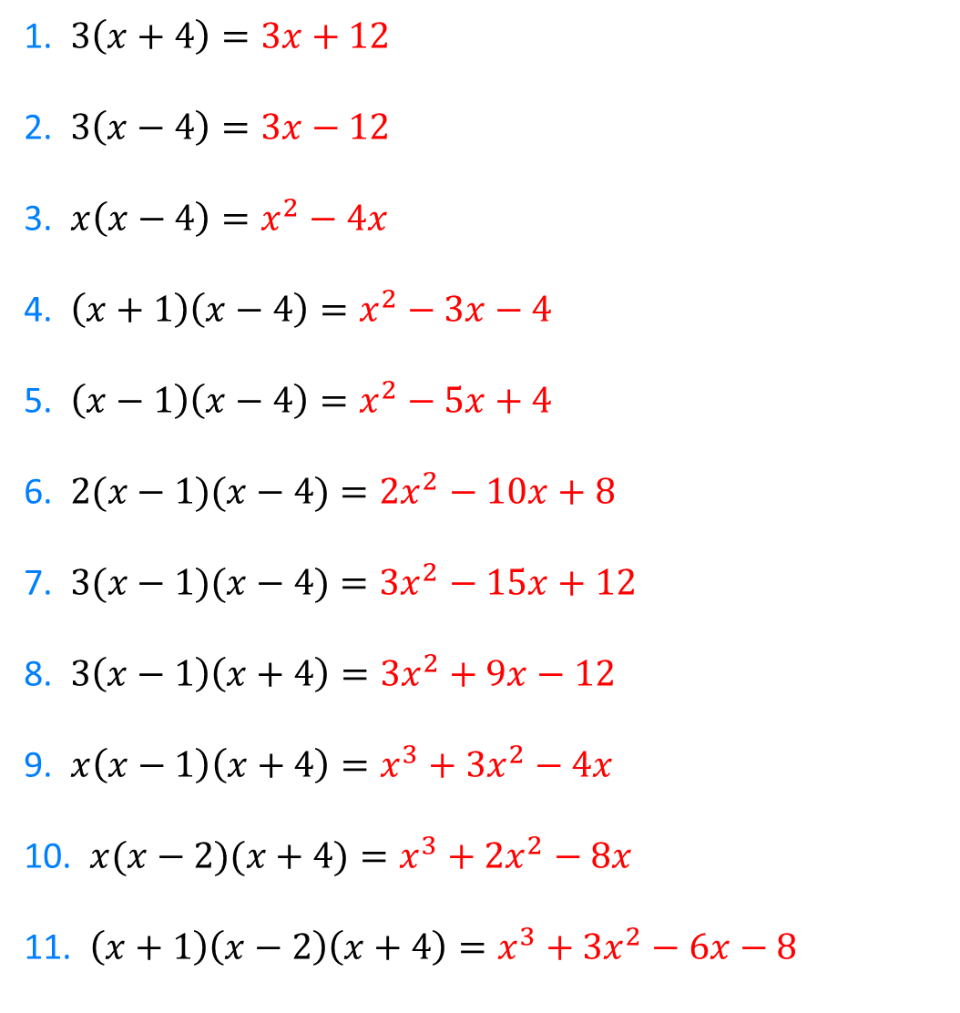
1. $3\left(x+4\right)=3x+12$
2. $3\left(x−4\right)=3x−12$
3. $x\left(x−4\right)=x^{2}−4x$
4. $\left(x+1\right)\left(x−4\right)=x^{2}−3x−4$
5. $\left(x−1\right)\left(x−4\right)=x^{2}−5x+4$
6. $2(x−1)(x−4)={2x}^{2}−10x+8$
7. $3(x−1)(x−4)={3x}^{2}−15x+12$
8. $3\left(x−1\right)\left(x+4\right)={3x}^{2}+9x−12$
9. $x\left(x−1\right)\left(x+4\right)=x^{3}+3x^{2}−4x$
10. $x(x−2)(x+4)=x^{3}+2x^{2}−8x$
11. $\left(x+1\right)\left(x−2\right)\left(x+4\right)=x^{3}+3x^{2}−6x−8$
@mrbartonmaths

Slide 5
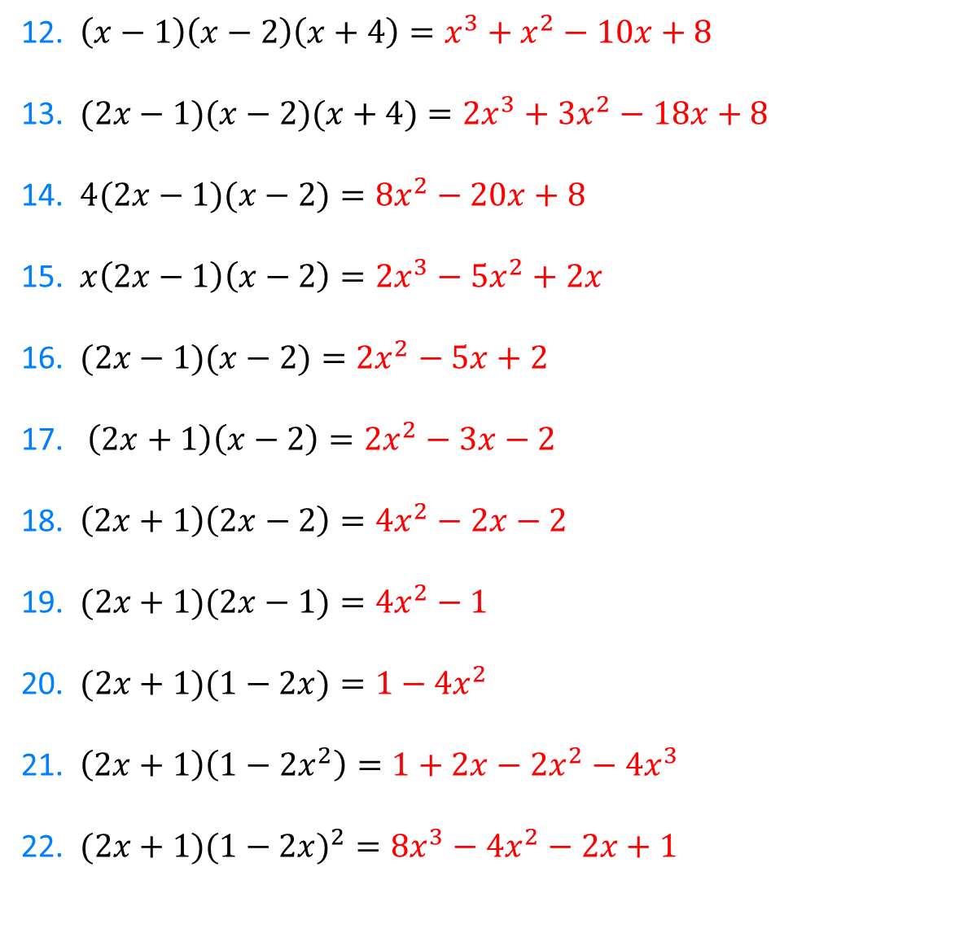
12. $\left(x−1\right)\left(x−2\right)\left(x+4\right)=x^{3}+x^{2}−10x+8$
13. $(2x−1)(x−2)(x+4)={2x}^{3}+{3x}^{2}−18x+8$
14. $4(2x−1)(x−2)={8x}^{2}−20x+8$
15. $x\left(2x−1\right)\left(x−2\right)={2x}^{3}−5x^{2}+2x$
16. $(2x−1)(x−2)={2x}^{2}−5x+2$
17. $\left(2x+1\right)\left(x−2\right)={2x}^{2}−3x−2$
18. $\left(2x+1\right)\left(2x−2\right)={4x}^{2}−2x−2$
19. $(2x+1)(2x−1)={4x}^{2}−1$
20. $(2x+1)(1−2x)={1−4x}^{2}$
21. $\left(2x+1\right)\left(1−{2x}^{2}\right)={1+2x−2x}^{2}−{4x}^{3}$
22. $(2x+1)(1−{2x)}^{2}={8x}^{3}−4x^{2}−2x+1$
@mrbartonmaths

