Slide 1
Fractions: Subtracting fractions with different denominators
Silent
Teacher
Intelligent Practice
Narration
Your Turn
$$\frac{2}{5} − \frac{1}{7}$$
$$\frac{2}{3} − \frac{1}{4}$$
$$\frac{3}{4} − \frac{3}{5}$$
Practice

Slide 2
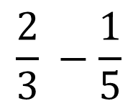
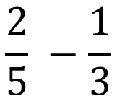
Worked Example
Your Turn
$$\frac{2}{5} −\frac{1}{3}$$
$$\frac{2}{3} −\frac{1}{5}$$

Slide 3


$$\frac{2}{5}− \frac{1}{7}$$
$$\frac{1}{7}− \frac{2}{5}$$
$$\frac{2}{5}− \frac{2}{7}$$
$$\frac{2}{3}− \frac{2}{5}$$
$$\frac{2}{3}− \frac{1}{4}$$
$$\frac{2}{3}− \frac{3}{4}$$
$$\frac{3}{4}− \frac{2}{3}$$
$$\frac{3}{4}− \frac{2}{30}$$
$$\frac{3}{4}− \frac{3}{5}$$
$$\frac{3}{4}− \frac{9}{15}$$
6.
1.
7.
2.
8.
3.
9.
4.
10.
5.

Slide 4
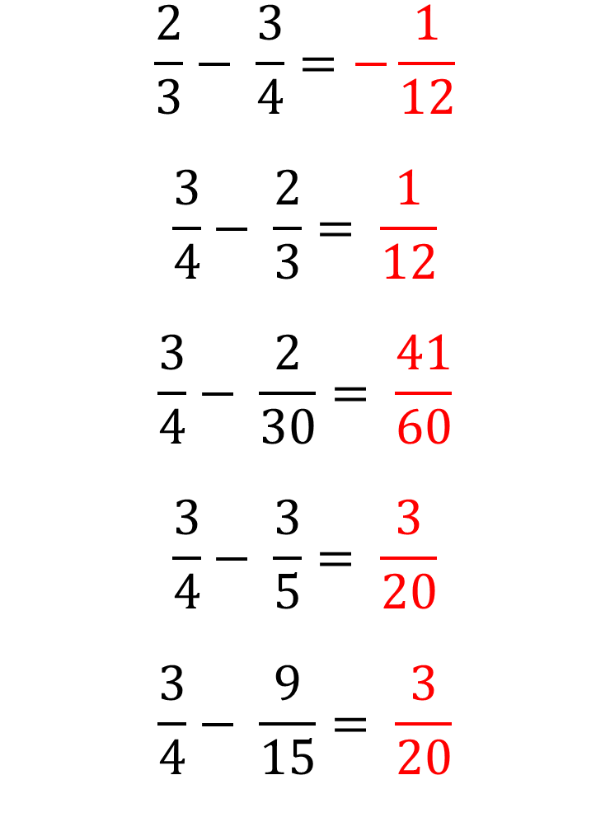
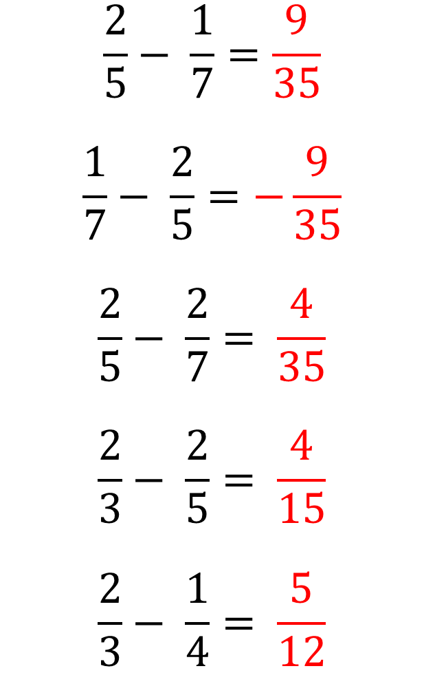
$$\frac{2}{5}− \frac{1}{7}=\frac{9}{35}$$
$$\frac{1}{7}− \frac{2}{5}=−\frac{9}{35}$$
$$\frac{2}{5}− \frac{2}{7}= \frac{4}{35}$$
$$\frac{2}{3}− \frac{2}{5}= \frac{4}{15}$$
$$\frac{2}{3}− \frac{1}{4}= \frac{5}{12}$$
$$\frac{2}{3}− \frac{3}{4}=−\frac{1}{12}$$
$$\frac{3}{4}− \frac{2}{3}= \frac{1}{12}$$
$$\frac{3}{4}− \frac{2}{30}= \frac{41}{60}$$
$$\frac{3}{4}− \frac{3}{5}= \frac{3}{20}$$
$$\frac{3}{4}− \frac{9}{15}= \frac{3}{20}$$
1.
6.
2.
7.
3.
8.
4.
9.
5.
10.

