Slide 1
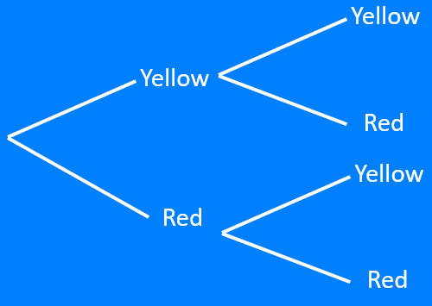
Tree Diagrams:
no replacement – version 2
Silent
Teacher
Intelligent Practice
Narration
Your Turn
Practice

Slide 2
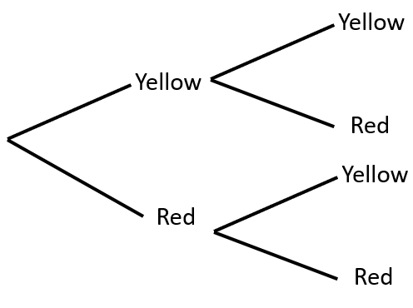
Worked Example
Your Turn
There are 4 yellow and 5 red balls in a bag.
A ball is picked and not replaced.
A second ball is then picked.
Complete the tree diagram showing the probabilities on each branch.
There are 3 yellow and 5 red balls in a bag.
A ball is picked and not replaced.
A second ball is then picked.
Complete the tree diagram showing the probabilities on each branch.
@mrbartonmaths

Slide 3
The numbers of coloured balls in a bag and the number of picks are given in each question.
Each time a ball is picked, it is not replaced.
Draw a tree diagram showing the probabilities on each branch
1. 5 yellow and 5 red balls
Two picks
2. 4 yellow and 4 red balls
Two picks
3. 4 yellow and 3 red balls
Two picks
4. 3 yellow and 4 red balls
Two picks
5. 2 yellow and 5 red balls
Two picks
6. 1 yellow and 6 red balls
Two picks
7. 1 yellow and 2 red balls
Two picks
8. 3 yellow and 6 red balls
Two picks
9. 3 yellow and 6 red balls
Three picks
10. 3 yellow and 7 red balls
Three picks
11. 2 yellow and 7 red balls
Three picks
12. 2 yellow and 7 red balls
Two picks
13. 2 yellow, 7 red and 3 green balls
Two picks
14. 4 yellow, 7 red and 3 green balls
Two picks
15. 4 yellow, 7 red and 3 green balls
Three picks
@mrbartonmaths

Slide 4
1. 5 yellow and 5 red balls
Two picks
3. 4 yellow and 3 red balls
Two picks
$$\frac{4}{9}$$
$$\frac{3}{6}$$
$$\frac{5}{10}$$
$$\frac{4}{7}$$
$$\frac{5}{9}$$
$$\frac{3}{6}$$
$$\frac{5}{9}$$
$$\frac{4}{6}$$
$$\frac{5}{10}$$
$$\frac{3}{7}$$
$$\frac{4}{9}$$
$$\frac{2}{6}$$
2. 4 yellow and 4 red balls
Two picks
4. 3 yellow and 4 red balls
Two picks
$$\frac{3}{7}$$
$$\frac{2}{6}$$
$$\frac{4}{8}$$
$$\frac{3}{7}$$
$$\frac{4}{7}$$
$$\frac{4}{6}$$
$$\frac{4}{7}$$
$$\frac{3}{6}$$
$$\frac{4}{8}$$
$$\frac{4}{7}$$
$$\frac{3}{7}$$
$$\frac{3}{6}$$

Slide 5
5. 2 yellow and 5 red balls
Two picks
7. 1 yellow and 2 red balls
Two picks
$$\frac{1}{6}$$
$$\frac{0}{2}$$
$$\frac{2}{7}$$
$$\frac{1}{3}$$
$$\frac{5}{6}$$
$$\frac{2}{2}$$
$$\frac{2}{6}$$
$$\frac{1}{2}$$
$$\frac{5}{7}$$
$$\frac{2}{3}$$
$$\frac{4}{6}$$
$$\frac{1}{2}$$
6. 1 yellow and 6 red balls
Two picks
8. 3 yellow and 6 red balls
Two picks
$$\frac{0}{6}$$
$$\frac{2}{8}$$
$$\frac{1}{7}$$
$$\frac{3}{9}$$
$$\frac{6}{6}$$
$$\frac{6}{8}$$
$$\frac{1}{6}$$
$$\frac{3}{8}$$
$$\frac{6}{7}$$
$$\frac{6}{9}$$
$$\frac{5}{6}$$
$$\frac{5}{8}$$

Slide 6
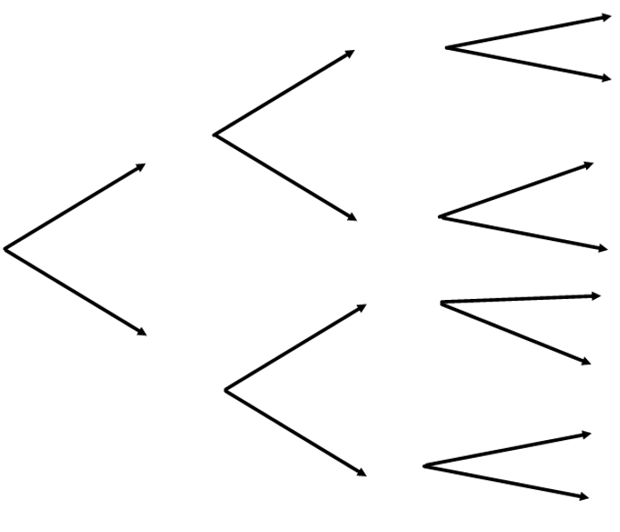
9. 3 yellow and 6 red balls
Three picks
$$\frac{1}{7}$$
Yellow
Yellow
$$\frac{2}{8}$$
Red
$$\frac{6}{7}$$
$$\frac{3}{9}$$
Yellow
$$\frac{2}{7}$$
Yellow
$$\frac{6}{8}$$
Red
$$\frac{5}{7}$$
Red
$$\frac{2}{7}$$
Yellow
Yellow
$$\frac{6}{9}$$
$$\frac{3}{8}$$
Red
Red
$$\frac{5}{7}$$
$$\frac{3}{7}$$
Yellow
$$\frac{5}{8}$$
Red
$$\frac{4}{7}$$
Red

Slide 7
10. 3 yellow and 7 red balls
Three picks
$$\frac{1}{8}$$
Yellow
Yellow
$$\frac{2}{9}$$
Red
$$\frac{7}{8}$$
$$\frac{3}{10}$$
Yellow
$$\frac{2}{8}$$
Yellow
$$\frac{7}{9}$$
Red
$$\frac{6}{8}$$
Red
$$\frac{2}{8}$$
Yellow
Yellow
$$\frac{7}{10}$$
$$\frac{3}{9}$$
Red
Red
$$\frac{6}{8}$$
$$\frac{3}{8}$$
Yellow
$$\frac{6}{9}$$
Red
$$\frac{5}{8}$$
Red

Slide 8
11. 2 yellow and 7 red balls
Three picks
$$\frac{0}{7}$$
Yellow
Yellow
$$\frac{1}{8}$$
Red
$$\frac{7}{7}$$
$$\frac{2}{9}$$
Yellow
$$\frac{1}{7}$$
Yellow
$$\frac{7}{8}$$
Red
$$\frac{6}{7}$$
Red
$$\frac{1}{7}$$
Yellow
Yellow
$$\frac{7}{9}$$
$$\frac{2}{8}$$
Red
Red
$$\frac{6}{7}$$
$$\frac{2}{7}$$
Yellow
$$\frac{6}{8}$$
Red
$$\frac{5}{7}$$
Red

Slide 9
12. 2 yellow and 7 red balls
Two picks
$$\frac{1}{8}$$
$$\frac{2}{9}$$
$$\frac{7}{8}$$
$$\frac{2}{8}$$
$$\frac{7}{9}$$
$$\frac{6}{8}$$

Slide 10
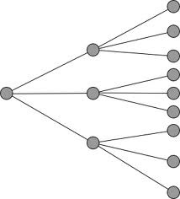
13. 2 yellow, 7 red and 3 green balls
Two picks
Y
$$\frac{1}{11}$$
$$\frac{7}{11}$$
R
Y
$$\frac{3}{11}$$
$$\frac{2}{12}$$
G
$$\frac{2}{11}$$
Y
$$\frac{7}{12}$$
$$\frac{6}{11}$$
R
R
$$\frac{3}{11}$$
G
$$\frac{3}{12}$$
$$\frac{2}{11}$$
Y
G
$$\frac{7}{11}$$
R
$$\frac{2}{11}$$
G

Slide 11
14. 4 yellow, 7 red and 3 green balls
Two picks
Y
$$\frac{3}{13}$$
$$\frac{7}{13}$$
R
Y
$$\frac{3}{13}$$
$$\frac{4}{14}$$
G
$$\frac{4}{13}$$
Y
$$\frac{7}{14}$$
$$\frac{7}{13}$$
R
R
$$\frac{3}{13}$$
G
$$\frac{3}{14}$$
$$\frac{4}{13}$$
Y
G
$$\frac{7}{13}$$
R
$$\frac{2}{13}$$
G

