Slide 1
Fractions, Decimals, Percentages: Converting a decimal to a fraction
Silent
Teacher
Intelligent Practice
Narration
Your Turn
$$0.3=$$
$$0.03=$$
$$0.003=$$
$$3.3=$$
Practice

Slide 2
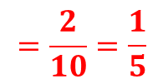
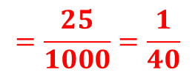
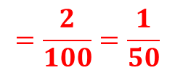
Worked Example
Your Turn
Convert to a fraction in its simplest form
Convert to a fraction in its simplest form
$$0.8$$
$$0.2$$
$$=\frac{2}{10}=\frac{1}{5}$$
$$0.08$$
$$0.02$$
$$=\frac{2}{100}=\frac{1}{50}$$
$$0.085$$
$$0.025$$
$$=\frac{25}{1000}=\frac{1}{40}$$

Slide 3
Convert to a fraction in its simplest form
$$0.6$$
$$0.06$$
$$0.66$$
$$0.65$$
$$0.56$$
$$0.55$$
$$0.006$$
$$0.055$$
$$0.065$$
$$0.605$$
$$6.5$$
$$6.05$$
$$6.005$$
$$5.06$$

Slide 4
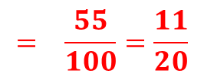
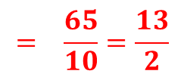
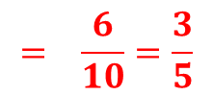
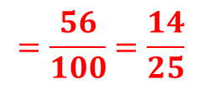
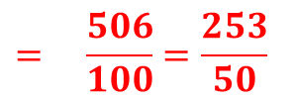
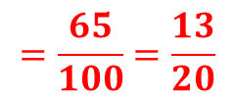
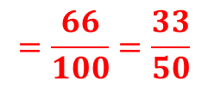
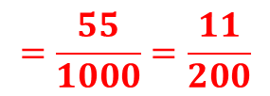
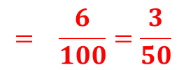
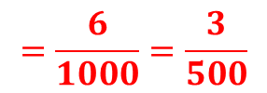
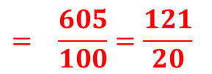
Convert to a fraction in its simplest form
$$0.6$$
$$0.06$$
$$0.66$$
$$0.65$$
$$0.56$$
$$0.55$$
$$0.006$$
$$0.055$$
$$0.065$$
$$0.605$$
$$6.5$$
$$6.05$$
$$6.005$$
$$5.06$$
$$=\frac{55}{1000}=\frac{11}{200}$$
$$= \frac{6}{10}=\frac{3}{5}$$
$$= \frac{65}{1000}=\frac{13}{200}$$
$$= \frac{6}{100}=\frac{3}{50}$$
$$=\frac{66}{100}=\frac{33}{50}$$
$$= \frac{605}{1000}=\frac{121}{200}$$
$$=\frac{65}{100}=\frac{13}{20}$$
$$= \frac{65}{10}=\frac{13}{2}$$
$$=\frac{56}{100}=\frac{14}{25}$$
$$= \frac{605}{100}=\frac{121}{20}$$
$$= \frac{55}{100}=\frac{11}{20}$$
$$= \frac{6005}{1000}=\frac{1201}{200}$$
$$=\frac{6}{1000}=\frac{3}{500}$$
$$= \frac{506}{100}=\frac{253}{50}$$

