Slide 1
Fractions: Multiplying with mixed numbers
Silent
Teacher
Intelligent Practice
Narration
Your Turn
$$2\frac{1}{2} × \frac{3}{4}$$
$$4\frac{1}{5} ×1\frac{4}{5}$$
$$4\frac{1}{3} × \frac{4}{5}$$
Practice

Slide 2
Worked Example
Your Turn
$$Calculate:1\frac{1}{3} × \frac{2}{5}$$
$$Calculate:\frac{1}{3} ×1\frac{2}{5}$$

Slide 3
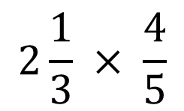
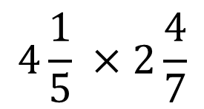
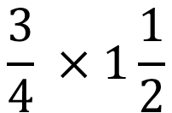
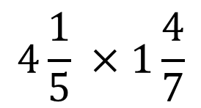
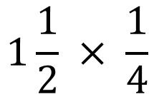
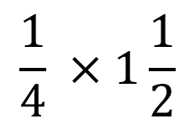
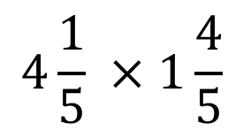
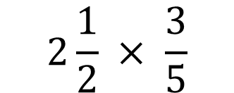
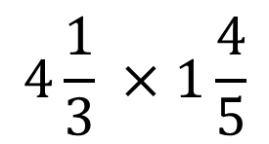
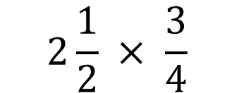
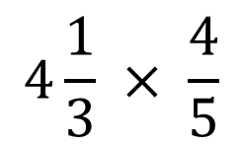
$$1\frac{1}{2} × \frac{1}{4}$$
$$2\frac{1}{3} × \frac{4}{5}$$
$$\frac{1}{4} ×1\frac{1}{2}$$
$$4\frac{1}{3} × \frac{4}{5}$$
$$\frac{3}{4} ×1\frac{1}{2}$$
$$4\frac{1}{3} ×1\frac{4}{5}$$
$$2\frac{1}{2} × \frac{3}{4}$$
$$4\frac{1}{5} ×1\frac{4}{5}$$
$$2\frac{1}{2} × \frac{3}{5}$$
$$4\frac{1}{5} ×1\frac{4}{7}$$
$$2\frac{1}{2} × \frac{4}{5}$$
$$4\frac{1}{5} ×2\frac{4}{7}$$

Slide 4
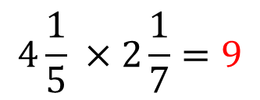
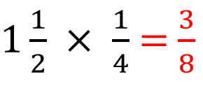
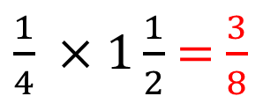
$1\frac{1}{2} × \frac{1}{4}$ = $\frac{3}{8}$
$2\frac{1}{3} × \frac{4}{5}$ =$\frac{28}{15}=1\frac{13}{15}$
$\frac{1}{4} ×1\frac{1}{2}$ = $\frac{3}{8}$
$4\frac{1}{3} × \frac{4}{5}$ =$\frac{52}{15}=3\frac{7}{15}$
$\frac{3}{4} ×1\frac{1}{2}$ = $\frac{9}{8}=1\frac{1}{8}$
$$4\frac{1}{3} ×1\frac{4}{5}=\frac{39}{5}=7\frac{4}{5}$$
$4\frac{1}{5} ×1\frac{4}{5}$ = $\frac{189}{25}=7\frac{14}{25}$
$2\frac{1}{2} × \frac{3}{4}$ = $\frac{15}{8}=1\frac{7}{8}$
$$4\frac{1}{5} ×1\frac{4}{7}= \frac{33}{5}=6\frac{3}{5}$$
$2\frac{1}{2} × \frac{3}{5}$ = $\frac{3}{2}$ = $1\frac{1}{2}$
$$4\frac{1}{5} ×2\frac{1}{7}=9$$
$2\frac{1}{2} × \frac{4}{5}$ = 2

