Slide 1
Fractions, Decimals, Percentages: Converting a percentage to a fraction
Silent
Teacher
Intelligent Practice
Narration
Your Turn
$3\%$ =
$30\%$=
$300\%$ =
Practice

Slide 2
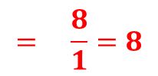
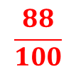
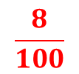

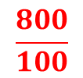

Worked Example
Your Turn
Convert to a fraction in its simplest form
6%
66%
600%
Convert to a fraction in its simplest form
8%
88%
800%
$$÷4$$
$$\frac{8}{100}$$
$$= \frac{2}{25}$$
$$÷4$$
$$÷4$$
$$\frac{88}{100}$$
$$= \frac{22}{25}$$
$$÷4$$
$$÷100$$
$$\frac{800}{100}$$
$$= \frac{8}{1}=8$$
$$÷100$$

Slide 3
Convert to a fraction in its simplest form
4%
40%
44%
400%
440%
444%
44.4%
45%
450%
4.5%
0.45%
4.55%
45.5%
455.5%

Slide 4
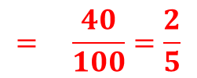
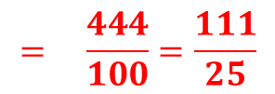
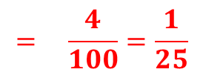
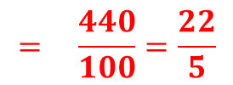
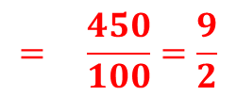
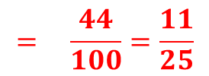
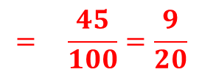
Convert to a fraction in its simplest form
4%
40%
44%
400%
440%
444%
44.4%
$$= \frac{4}{100}=\frac{1}{25}$$
45%
450%
4.5%
0.45%
4.55%
45.5%
455.5%
$$= \frac{45}{100}=\frac{9}{20}$$
$$= \frac{40}{100}=\frac{2}{5}$$
$$= \frac{450}{100}=\frac{9}{2}$$
$$= \frac{44}{100}=\frac{11}{25}$$
$$= \frac{4.5}{100}=\frac{45}{1000}=\frac{9}{200}$$
$$= \frac{400}{100}=\frac{4}{1}=4$$
$$= \frac{0.45}{100}=\frac{45}{10000}=\frac{9}{2000}$$
$$= \frac{440}{100}=\frac{22}{5}$$
$$= \frac{4.55}{100}=\frac{455}{10000}=\frac{91}{2000}$$
$$= \frac{444}{100}=\frac{111}{25}$$
$$= \frac{45.5}{100}=\frac{455}{1000}=\frac{91}{200}$$
$$= \frac{44.4}{100}=\frac{444}{1000}=\frac{111}{250}$$
$$= \frac{455.5}{100}=\frac{4555}{1000}=\frac{911}{200}$$

