Slide 1
Standard form: Standard form to small numbers
Silent
Teacher
Intelligent Practice
Narration
Your Turn
$2.3 × {10}^{−3}$
$2.3 × {10}^{−3}$
$2.37 × {10}^{−3}$
Practice

Slide 2
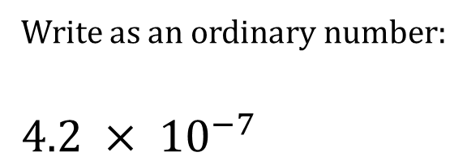
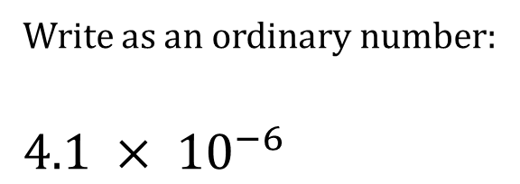
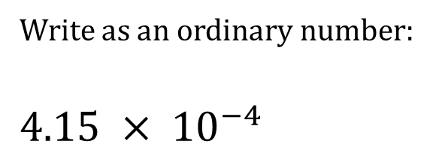
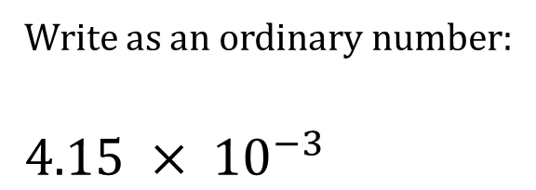
Worked Example
Your Turn
Write as an ordinary number:
$4.1 × {10}^{−6}$
Write as an ordinary number:
$4.2 × {10}^{−7}$
Write as an ordinary number:
$4.15 × {10}^{−3}$
Write as an ordinary number:
$4.15 × {10}^{−4}$
@jplmaths

Slide 3




Write as an ordinary number:
$4.2 × {10}^{−3}$
$4.2378 × {10}^{−6}$
$4.3 × {10}^{−3}$
$4.2378 × {10}^{−9}$
$4.37 × {10}^{−3}$
$4.02378 × {10}^{−9}$
$4.37 × {10}^{−6}$
$4 × {10}^{−11}$
$4.378 × {10}^{−6}$
$4.002378 × {10}^{−11}$
@jplmaths

Slide 4
$4.2 × {10}^{−3}$
$4.2378 × {10}^{−6}$
$$=0.0042$$
=$0.0000042378$
$4.3 × {10}^{−3}$
$4.2378 × {10}^{−9}$
$$=0.0043$$
$$=0.0000000042378$$
$4.37 × {10}^{−3}$
$4.02378 × {10}^{−9}$
$$=0.00437$$
$$=0.00000000402378$$
$4.37 × {10}^{−6}$
$4× {10}^{−11}$
$$=0.00000437$$
$$=0.00000000004$$
$4.378 × {10}^{−6}$
$4.002378 × {10}^{−11}$
$$=0.000004378$$
=$0.00000000004002378$
@mrbartonmaths
@jplmaths

