Slide 1
Solving Quadratics: Completing the square
Silent
Teacher
Intelligent Practice
Narration
Your Turn
$$x^{2}+4x+3=0$$
$$x^{2}−8x+3=0$$
$$x^{2}+3x+1=0$$
Practice

Slide 2
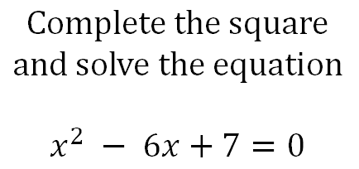
Worked Example
Your Turn
$$Complete the square$$
$$and solve the equation$$
$$x^{2}+10x+7=0$$
$$Complete the square$$
$$and solve the equation$$
$$x^{2} − 6x+7=0$$

Slide 3
$$Complete the square and solve the equation$$
$$x^{2}+4x+3=0$$
$$x^{2}+8x+3=0$$
$$x^{2}+12x+3=0$$
$$x^{2}−4x+3=0$$
$$x^{2}−8x+3=0$$
$$x^{2}−12x+3=0$$
$$x^{2}+3x+1=0$$
$$x^{2}+5x+1=0$$
$$x^{2}−7x+14=0$$

Slide 4
$$Complete the square and solve the equation$$
$$x^{2}+4x+3=0 ({x+2)}^{2} −1=0 x=−1, −3$$
$$x^{2}+8x+3=0 (x+4)^{2 }−13=0 x=−4+ \sqrt{13, } −4 − \sqrt{13}$$
$$x^{2}+12x+3=0 (x+6)^{2} −33=0 x=−6+\sqrt{33}, −6 −\sqrt{33}$$
$$x^{2}−4x+3=0 (x −2)^{2} −1=0 x=1, x=3$$
$x^{2}−8x+3=0 (x −4)^{2} −13=0 x=4+ \sqrt{13} , 4 − \sqrt{13}$
$$x^{2}−12x+3=0 (x −6)^{2} −33=0 x=6+ \sqrt{33}, 6 − \sqrt{33}$$
$$x^{2}+3x+1=0 (x+1.5)^{2} −1.25=0 x=−1.5+ \sqrt{1.25} , −1.5 −\sqrt{1.25}$$
$$x^{2}+5x+1=0 (x+2.5)^{2}−5.25=0 x=−2.5+ \sqrt{5.25} , −2.5− \sqrt{5.25}$$
$$x^{2}−7x+14=0 (x −3.5)^{2 }+1.75=0 NO SOLUTIONS!$$

