Slide 1
Decimals: Subtracting decimals – carry
Silent
Teacher
Intelligent Practice
Narration
Your Turn
$$3.56−0.35=$$
$$3.56−0.36=$$
$$3.56−0.37=$$
Practice

Slide 2
Worked Example
Your Turn
$$5.54−0.32=$$
$$5.45−0.23=$$
$$5.54−0.36=$$
$$5.45−0.27=$$
$$5.54−0.036=$$
$$5.45−0.027=$$

Slide 3
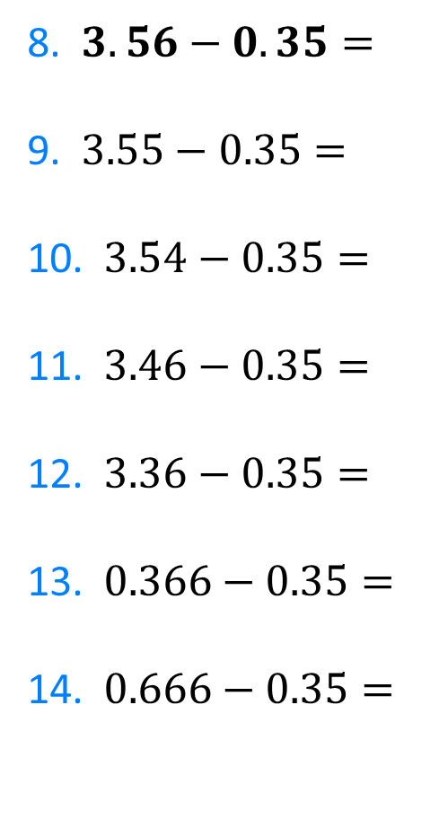
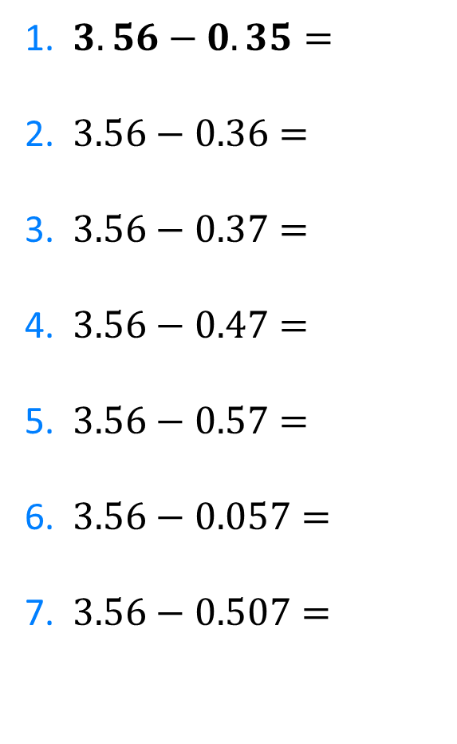
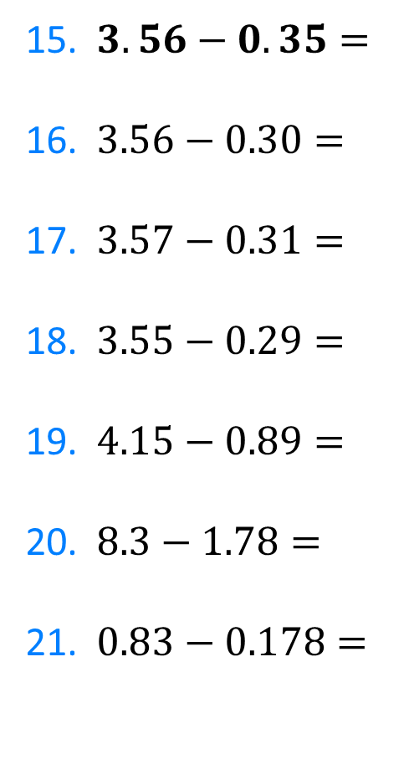
1. $3.56−0.35=$
2. $3.56−0.36=$
3. $3.56−0.37=$
4. $3.56−0.47=$
5. $3.56−0.57=$
6. $3.56−0.057=$
7. $3.56−0.507=$
8. $3.56−0.35=$
9. $3.55−0.35=$
10. $3.54−0.35=$
11. $3.46−0.35=$
12. $3.36−0.35=$
13. $0.366−0.35=$
14. $0.666−0.35=$
15. $3.56−0.35=$
16. $3.56−0.30=$
17. $3.57−0.31=$
18. $3.55−0.29=$
19. $4.15−0.89=$
20. $8.3−1.78=$
21. $0.83−0.178=$

Slide 4
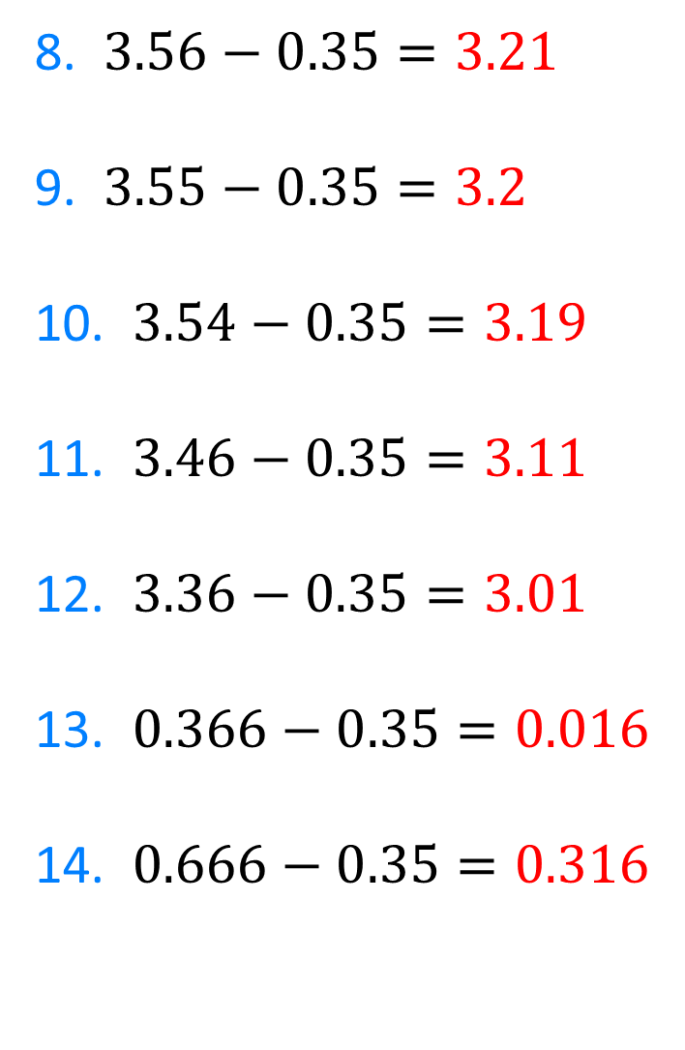
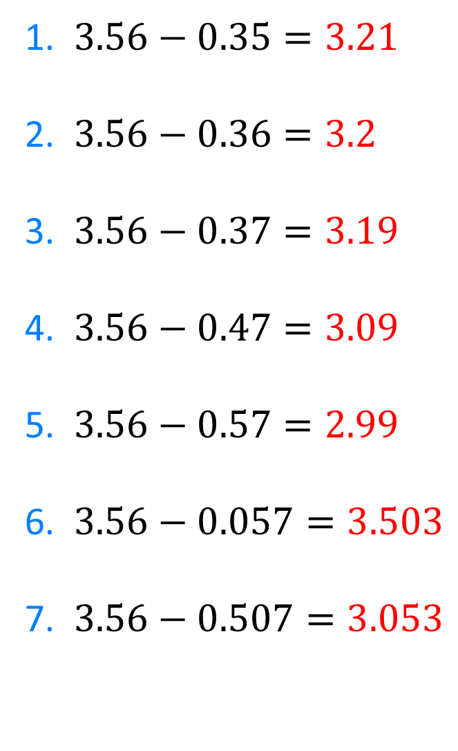
1. $3.56−0.35=3.21$
2. $3.56−0.36=3.2$
3. $3.56−0.37=3.19$
4. $3.56−0.47=3.09$
5. $3.56−0.57=2.99$
6. $3.56−0.057=3.503$
7. $3.56−0.507=3.053$
8. $3.56−0.35=3.21$
9. $3.55−0.35=3.2$
10. $3.54−0.35=3.19$
11. $3.46−0.35=3.11$
12. $3.36−0.35=3.01$
13. $0.366−0.35=0.016$
14. $0.666−0.35=0.316$

Slide 5
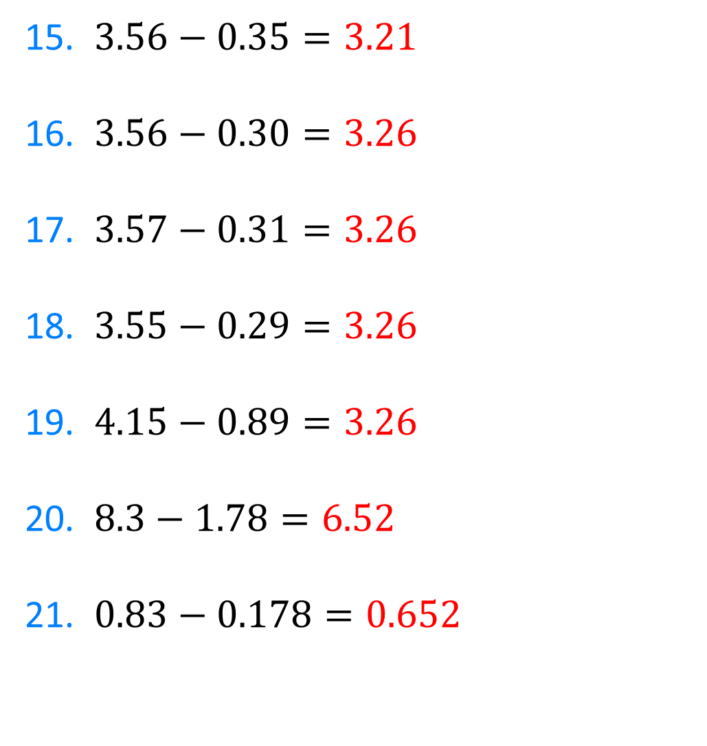
15. $3.56−0.35=3.21$
16. $3.56−0.30=3.26$
17. $3.57−0.31=3.26$
18. $3.55−0.29=3.26$
19. $4.15−0.89=3.26$
20. $8.3−1.78=6.52$
21. $0.83−0.178=0.652$

