Slide 1
Introducing first order differential equations. Applications of the product rule
Silent
Teacher
Intelligent Practice
Narration
Your Turn
$$\frac{d}{dx}\left(x^{2}y\right)=$$
$$\frac{d}{dx}\left({3x}^{2}y\right)=$$
$$\frac{d}{dx}\left(x^{3}y\right)=$$
Practice

Slide 2
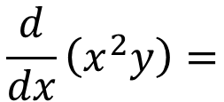
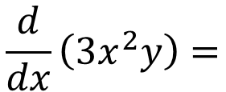
Worked Example
Your Turn
$$\frac{d}{dx}\left(x^{2}y\right)=$$
$$\frac{d}{dx}\left({3x}^{2}y\right)=$$
@billyads_47

Slide 3
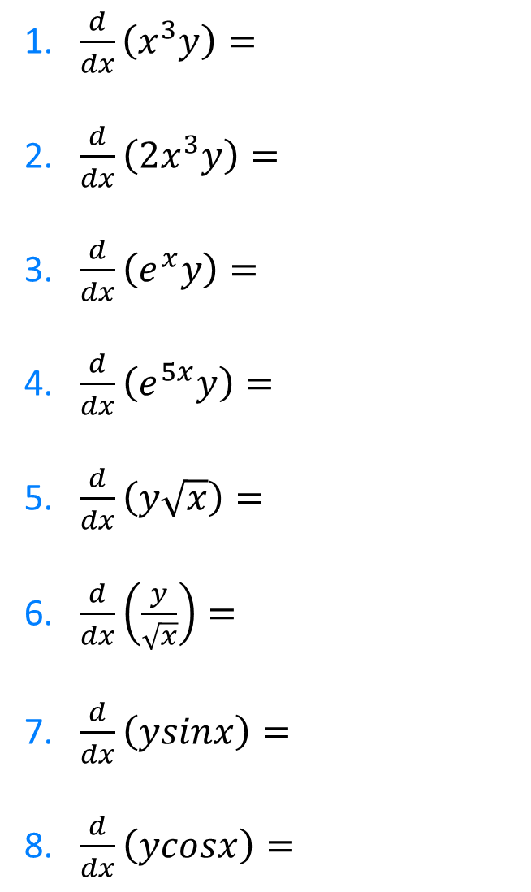
1.$\frac{d}{dx}\left(x^{3}y\right)=$
2. $\frac{d}{dx}\left({2x}^{3}y\right)=$
3. $\frac{d}{dx}\left(e^{x}y\right)=$
4. $\frac{d}{dx}\left(e^{5x}y\right)=$
5. $\frac{d}{dx}\left(y\sqrt{x}\right)=$
6. $\frac{d}{dx}\left(\frac{y}{\sqrt{x}}\right)=$
7. $\frac{d}{dx}\left(ysinx\right)=$
8. $\frac{d}{dx}\left(ycosx\right)=$
@billyads_47

Slide 4
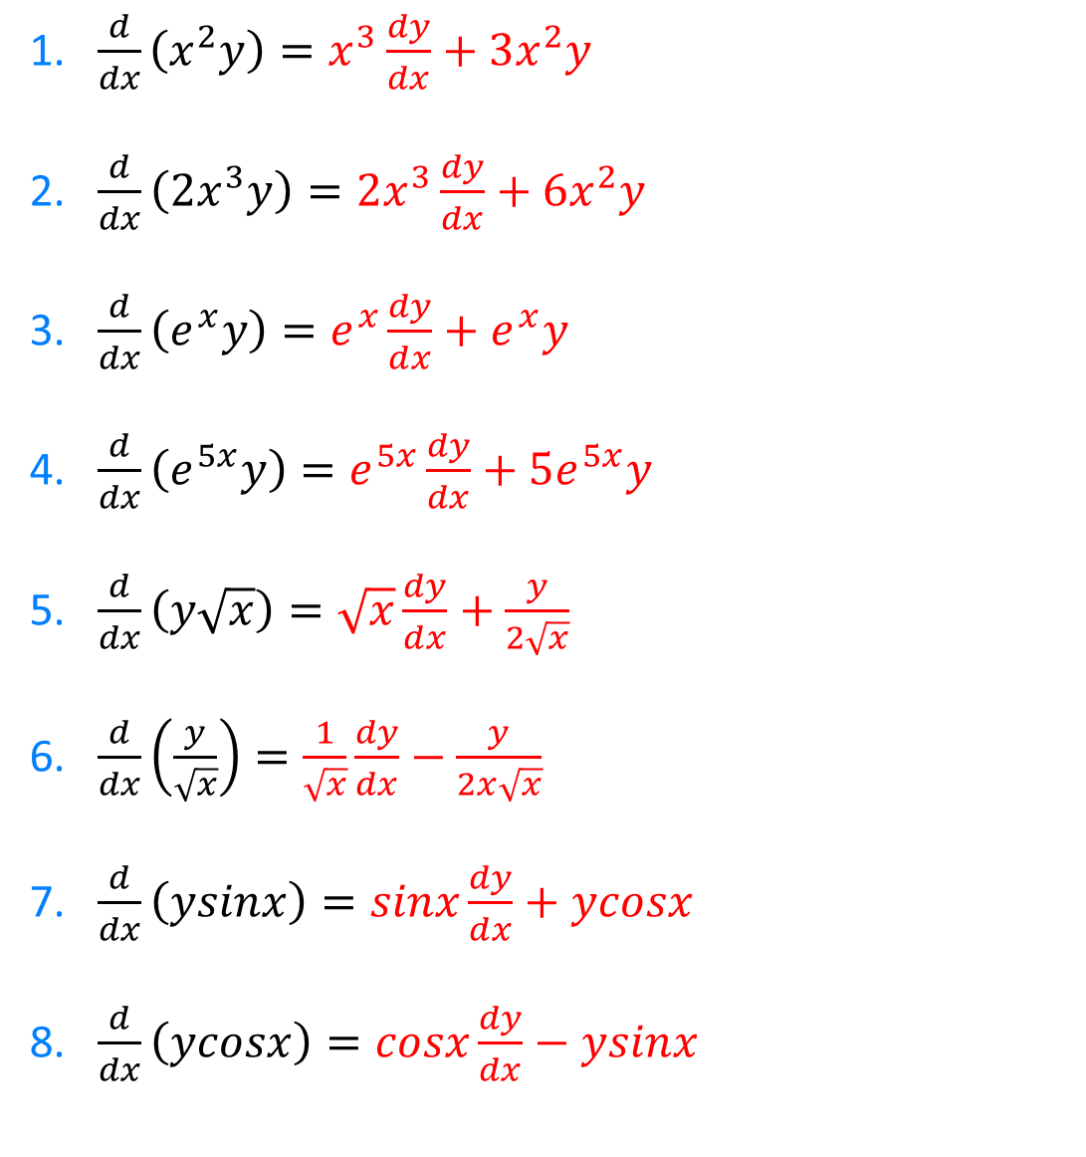
1.$\frac{d}{dx}\left(x^{2}y\right)=x^{3}\frac{dy}{dx}+3x^{2}y$
2. $\frac{d}{dx}\left({2x}^{3}y\right)={2x}^{3}\frac{dy}{dx}+6x^{2}y$
3. $\frac{d}{dx}\left(e^{x}y\right)=e^{x}\frac{dy}{dx}+e^{x}y$
4. $\frac{d}{dx}\left(e^{5x}y\right)=e^{5x}\frac{dy}{dx}+5e^{5x}y$
5. $\frac{d}{dx}\left(y\sqrt{x}\right)=\sqrt{x}\frac{dy}{dx}+\frac{y}{2\sqrt{x}}$
6. $\frac{d}{dx}\left(\frac{y}{\sqrt{x}}\right)=\frac{1}{\sqrt{x}}\frac{dy}{dx}−\frac{y}{2x\sqrt{x}}$
7. $\frac{d}{dx}\left(ysinx\right)=sinx\frac{dy}{dx}+ycosx$
8. $\frac{d}{dx}\left(ycosx\right)=cosx\frac{dy}{dx}−ysinx$
@billyads_47

