Slide 1
Changing the subject of a formula: 6 exericses
Silent
Teacher
Intelligent Practice
Narration
Your Turn
$$y=x+z$$
$$y=x−w$$
$$y=x+\sqrt{rs}$$
Practice

Slide 2
Changing the subject of a formula: Adding and subtracting
Silent
Teacher
Intelligent Practice
Narration
Your Turn
$$y=x+z$$
$$y=x−w$$
$$y=x+\sqrt{rs}$$
Practice

Slide 3
Worked Examples
Your Turn
Make $x$ the subject of the following formula:
Make $x$ the subject of the following formula:
a) $y=x+z$
a) $y=x+k$
b) $y=x−w$
b) $y=x−q$
c) $y=x+\sqrt{rs}$
c) $y=x−\sqrt{ab}$
@BerwickMaths

Slide 4
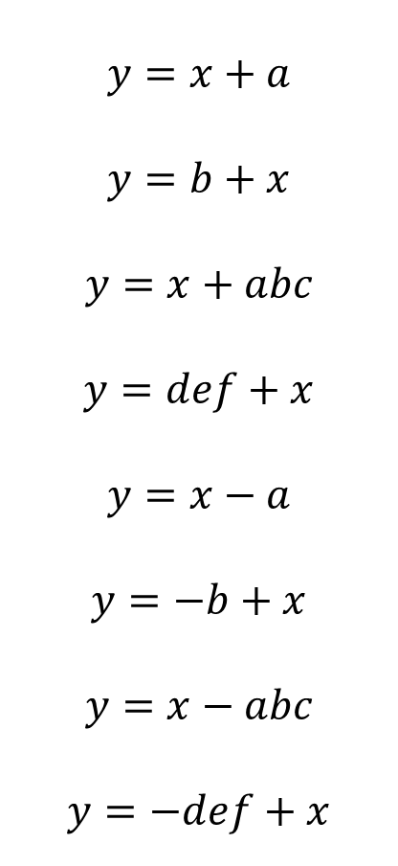
Make $x$ the subject for each of the following formulae:
$$y=x+a$$
$$y=b+x$$
$$y=x+abc$$
$$y=def+x$$
$$y=x−a$$
$$y=−b+x$$
$$y=x−abc$$
$$y=−def+x$$
@BerwickMaths
Notes:
Simplify formative assessment for teachers
Immediately demonstrate students’ level of understanding
Teachers share questions and students share explanations
Focused not on what a student got wrong but why

Slide 5

Make $x$ the subject for each of the following formulae:
$$y=x+a$$
$$y=b+x$$
$$y=x+abc$$
$$y=def+x$$
$$y=x−a$$
$$y=−b+x$$
$$y=x−abc$$
$$y=−def+x$$
$$y−a=x$$
$$y−b=x$$
$$y−abc=x$$
$$y−def=x$$
$$y+a=x$$
$$y+b=x$$
$$y+abc=x$$
$$y+def=x$$
@BerwickMaths
Notes:
Simplify formative assessment for teachers
Immediately demonstrate students’ level of understanding
Teachers share questions and students share explanations
Focused not on what a student got wrong but why

Slide 6
Changing the subject of a formula: Multiplying and dividing
Silent
Teacher
Intelligent Practice
Narration
Your Turn
$$y=ax$$
$$y=\frac{x}{abc}$$
$$y=\frac{x}{\sqrt{z}}$$
Practice

Slide 7
Worked Examples
Your Turn
Make $x$ the subject of the following formula:
Make $x$ the subject of the following formula:
a) $y=ax$
a) $y=bx$
b) $y=\frac{x}{abc}$
b) $y=\frac{x}{pq}$
c) $y=\frac{x}{\sqrt{z}}$
c) $y=\frac{x}{\sqrt{w}}$
@BerwickMaths

Slide 8

Make $x$ the subject for each of the following formulae:
$$y=ax$$
$$y=−ax$$
$$y=bcx$$
$$y=−bcx$$
$$y=\frac{x}{a}$$
$$y=−\frac{x}{\sqrt{a}}$$
$$y=\frac{x}{bc}$$
$$y=−\frac{x}{\sqrt{bc}}$$
@BerwickMaths

Slide 9

Make $x$ the subject for each of the following formulae:
$$y=ax$$
$$y=−ax$$
$$y=bcx$$
$$y=−bcx$$
$$y=\frac{x}{a}$$
$$y=−\frac{x}{\sqrt{a}}$$
$$y=\frac{x}{bc}$$
$$y=−\frac{x}{\sqrt{bc}}$$
$$y/a=x$$
$$−y/b=x$$
$$y/bc=x$$
$$−y/bc=x$$
$$y=ax$$
$$−\sqrt{a}y=x$$
$$bcy=x$$
$$−\sqrt{bc}y=x$$
@BerwickMaths

Slide 10
Changing the subject of a formula: Two step multiplication
Silent
Teacher
Intelligent Practice
Narration
Your Turn
$$y=mx+c$$
$$y=abx+c$$
Practice

Slide 11
Worked Examples
Your Turn
Make $x$ the subject of the following formula:
Make $x$ the subject of the following formula:
$$y=mx+c$$
$$y=abx+c$$
@BerwickMaths

Slide 12
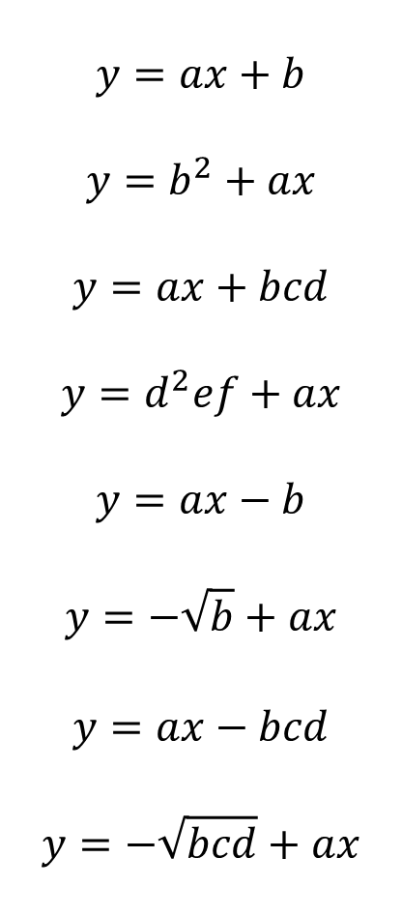
Make $x$ the subject for each of the following formulae:
$$y=ax+b$$
$$y=b^{2}+ax$$
$$y=ax+bcd$$
$$y=d^{2}ef+ax$$
$$y=ax−b$$
$$y=−\sqrt{b}+ax$$
$$y=ax−bcd$$
$$y=−\sqrt{bcd}+ax$$
@BerwickMaths
Notes:
Simplify formative assessment for teachers
Immediately demonstrate students’ level of understanding
Teachers share questions and students share explanations
Focused not on what a student got wrong but why

Slide 13
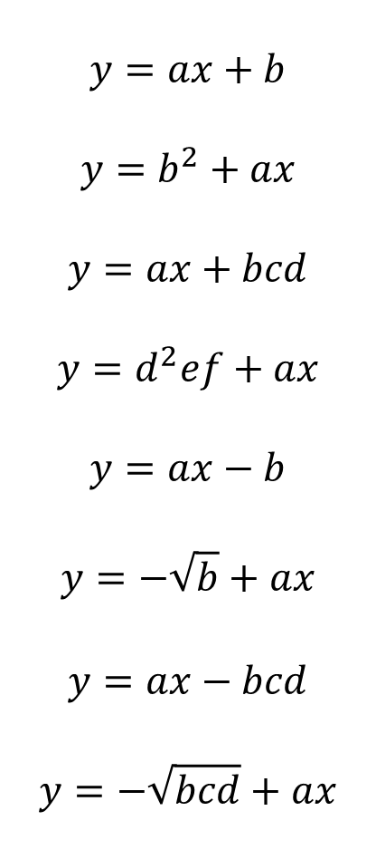
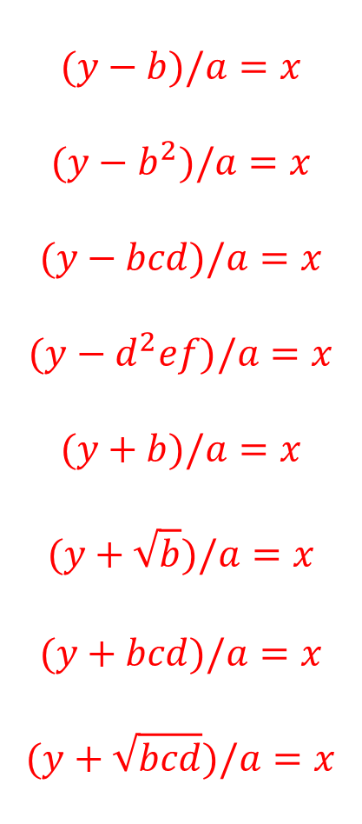
Make $x$ the subject for each of the following formulae:
$$y=ax+b$$
$$y=b^{2}+ax$$
$$y=ax+bcd$$
$$y=d^{2}ef+ax$$
$$y=ax−b$$
$$y=−\sqrt{b}+ax$$
$$y=ax−bcd$$
$$y=−\sqrt{bcd}+ax$$
$$(y−b)/a=x$$
$$(y−b^{2})/a=x$$
$$(y−bcd)/a=x$$
$$(y−d^{2}ef)/a=x$$
$$(y+b)/a=x$$
$$(y+\sqrt{b})/a=x$$
$$(y+bcd)/a=x$$
$$(y+\sqrt{bcd})/a=x$$
@BerwickMaths
Notes:
Simplify formative assessment for teachers
Immediately demonstrate students’ level of understanding
Teachers share questions and students share explanations
Focused not on what a student got wrong but why

Slide 14
Changing the subject of a formula: Two step division
Silent
Teacher
Intelligent Practice
Narration
Your Turn
$$y=\frac{x}{m}+c$$
$$y=\frac{x}{ef}+c^{2}$$
Practice

Slide 15
Worked Examples
Your Turn
Make $x$ the subject of the following formula:
Make $x$ the subject of the following formula:
a) $y=\frac{x}{m}+c$
a) $y=\frac{x}{ab}+c$
b) $y=\frac{x}{ef}+c^{2}$
b) $y=\frac{x}{cd}+e^{2}f$
@BerwickMaths

Slide 16
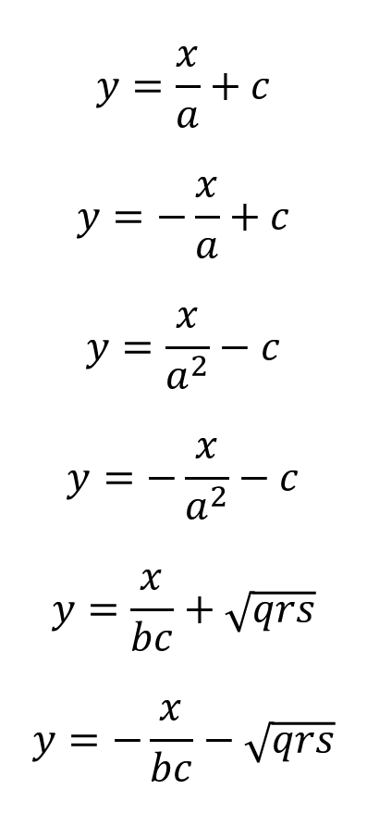
Make $x$ the subject for each of the following formulae:
$$y=\frac{x}{a}+c$$
$$y=−\frac{x}{a}+c$$
$$y=\frac{x}{a^{2}}−c$$
$$y=−\frac{x}{a^{2}}−c$$
$$y=\frac{x}{bc}+\sqrt{qrs}$$
$$y=−\frac{x}{bc}−\sqrt{qrs}$$
@BerwickMaths
Notes:
Simplify formative assessment for teachers
Immediately demonstrate students’ level of understanding
Teachers share questions and students share explanations
Focused not on what a student got wrong but why

Slide 17
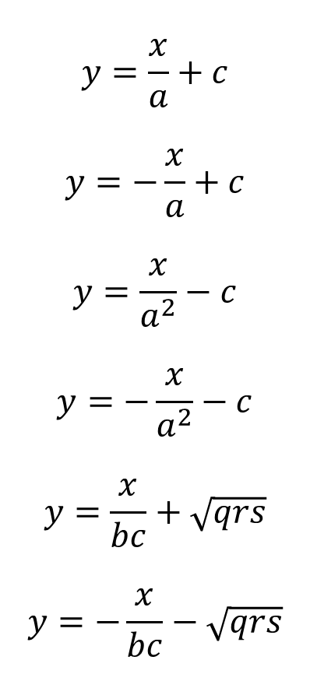
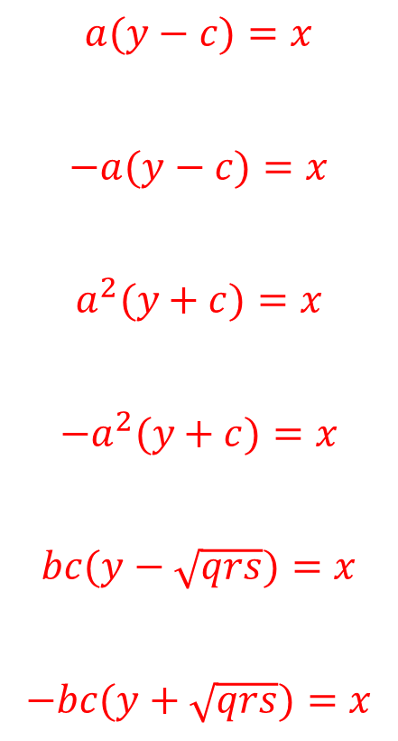
Make $x$ the subject for each of the following formulae:
$$y=\frac{x}{a}+c$$
$$y=−\frac{x}{a}+c$$
$$y=\frac{x}{a^{2}}−c$$
$$y=−\frac{x}{a^{2}}−c$$
$$y=\frac{x}{bc}+\sqrt{qrs}$$
$$y=−\frac{x}{bc}−\sqrt{qrs}$$
$$a(y−c)=x$$
$$−a(y−c)=x$$
$$a^{2}(y+c)=x$$
$$−a^{2}(y+c)=x$$
$$bc(y−\sqrt{qrs})=x$$
$$−bc(y+\sqrt{qrs})=x$$
@BerwickMaths
Notes:
Simplify formative assessment for teachers
Immediately demonstrate students’ level of understanding
Teachers share questions and students share explanations
Focused not on what a student got wrong but why

Slide 18
Changing the subject of a formula: Subject on both sides
Silent
Teacher
Intelligent Practice
Narration
Your Turn
$$ax+ay=cx+by$$
Practice

Slide 19
Worked Examples
Your Turn
Make $x$ the subject of the following formula:
Make $x$ the subject of the following formula:
$$ax+ay=cx+by$$
$$yx+yz=3xz+3yz$$
@BerwickMaths

Slide 20
Make $x$ the subject for each of the following formulae:
$$5x+b=2x+a$$
$$5(x+b)=2(x+a)$$
$$5x+bd=2x+ac$$
$$5(x+bd)=2(x+ac)$$
$$bx+5=ax+2$$
$$b(x+5)=a(x+2)$$
$$bx+5d=ax+2c$$
$$b(x+5d)=a(x+2c)$$
@BerwickMaths

Slide 21
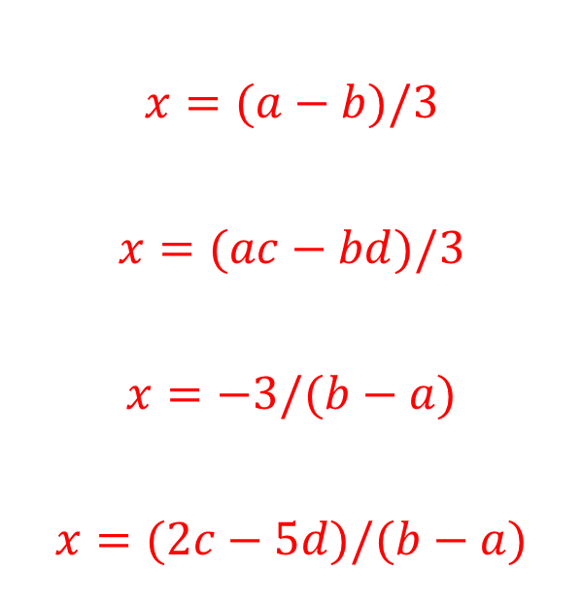
Make $x$ the subject for each of the following formulae:
$$x=(a−b)/3$$
$$x=(ac−bd)/3$$
$$x=−3/(b−a)$$
$$x=(2c−5d)/(b−a)$$
$$5x+b=2x+a$$
$$5x+bd=2x+ac$$
$$bx+5=ax+2$$
$$bx+5d=ax+2c$$
@BerwickMaths

Slide 22
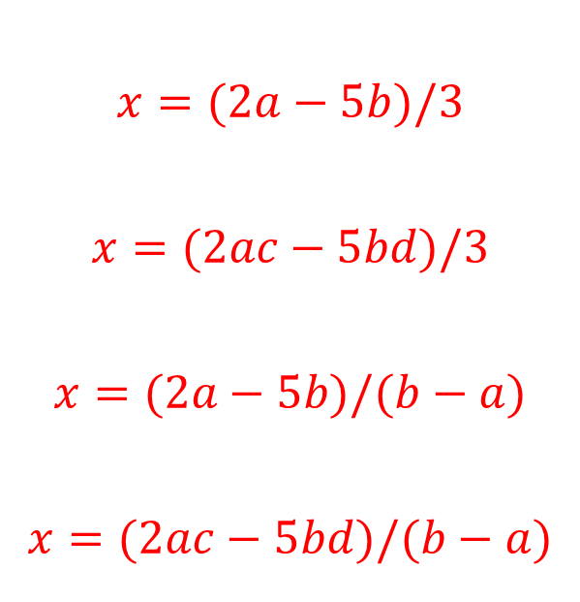
Make $x$ the subject for each of the following formulae:
$$x=(2a−5b)/3$$
$$x=(2ac−5bd)/3$$
$$x=(2a−5b)/(b−a)$$
$$x=(2ac−5bd)/(b−a)$$
$$5(x+b)=2(x+a)$$
$$5(x+bd)=2(x+ac)$$
$$b(x+5)=a(x+2)$$
$$b(x+5d)=a(x+2c)$$
@BerwickMaths

Slide 23
Changing the subject of a formula: Fractions
Silent
Teacher
Intelligent Practice
Narration
Your Turn
$$y=\frac{x+a}{x−a}$$
Practice

Slide 24
Worked Examples
Your Turn
Make $x$ the subject of the following formula:
Make $x$ the subject of the following formula:
$$y=\frac{x+a}{x−a}$$
$$y=\frac{x+bc}{x−bc}$$
@BerwickMaths

Slide 25
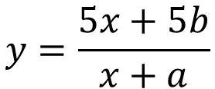
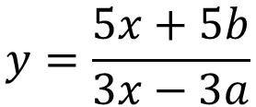
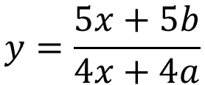
Make $x$ the subject for each of the following formulae:
$$y=\frac{5x+5b}{x+a}$$
$$y=\frac{5x+5b}{4x+4a}$$
$$y=\frac{5x+5b}{3x−3a}$$
@BerwickMaths

Slide 26
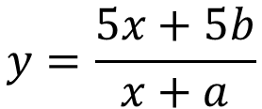
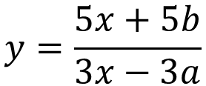
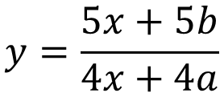
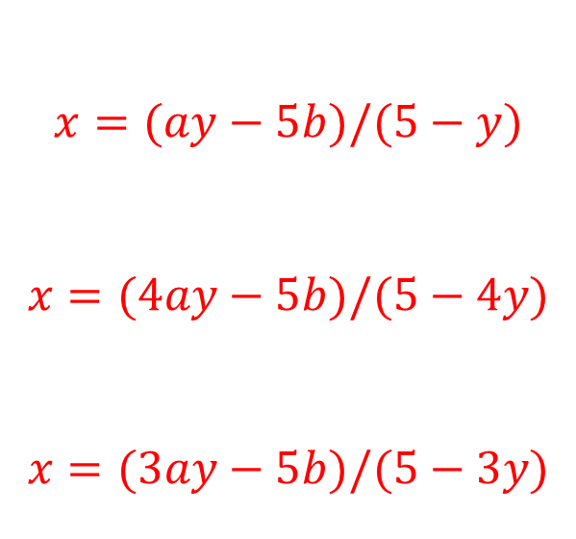
Make $x$ the subject for each of the following formulae:
$$x=(ay−5b)/(5−y)$$
$$x=(4ay−5b)/(5−4y)$$
$$x=(3ay−5b)/(5−3y)$$
$$y=\frac{5x+5b}{x+a}$$
$$y=\frac{5x+5b}{4x+4a}$$
$$y=\frac{5x+5b}{3x−3a}$$
@BerwickMaths

