Slide 1
Introducing algebra: Forming expressions
Silent
Teacher
Intelligent Practice
Narration
Your Turn
𝑥 divided by 19
𝑥 shared between 19
𝑥 less than 19
Practice

Slide 2
Worked Example
Your Turn
Write an algebraic expression for each of the following:
Write an algebraic expression for each of the following:
1) 3 more than $a$.
1) 3 less than $a$.
2) 5 lots $a$.
2) $a$ divided by 5.
3) $b$ multiplied by $a$.
3) $b$ less than $a$.

Slide 3
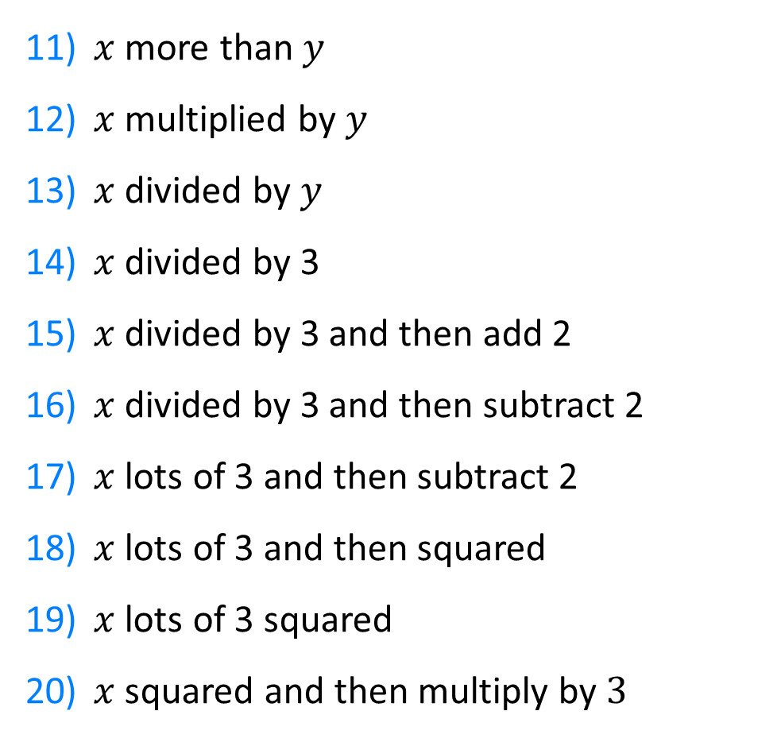
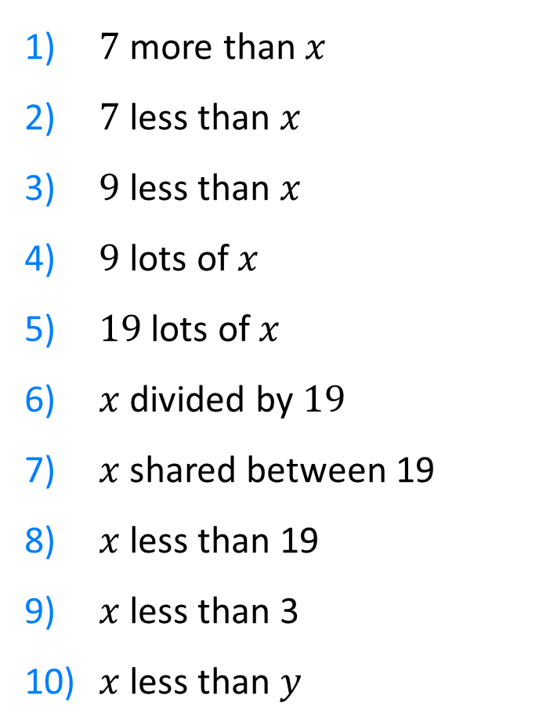
$7$ more than $x$
$7$ less than $x$
$9$ less than $x$
$9$ lots of $x$
$19$ lots of $x$
$x$ divided by $19$
$x$ shared between 19
$x$ less than 19
$x$ less than 3
$x$ less than $y$
$x$ more than $y$
$x$ multiplied by $y$
$x$ divided by $y$
$x$ divided by 3
$x$ divided by 3 and then add 2
$x$ divided by 3 and then subtract 2
$x$ lots of 3 and then subtract 2
$x$ lots of 3 and then squared
$x$ lots of 3 squared
$x$ squared and then multiply by $3$

Slide 4
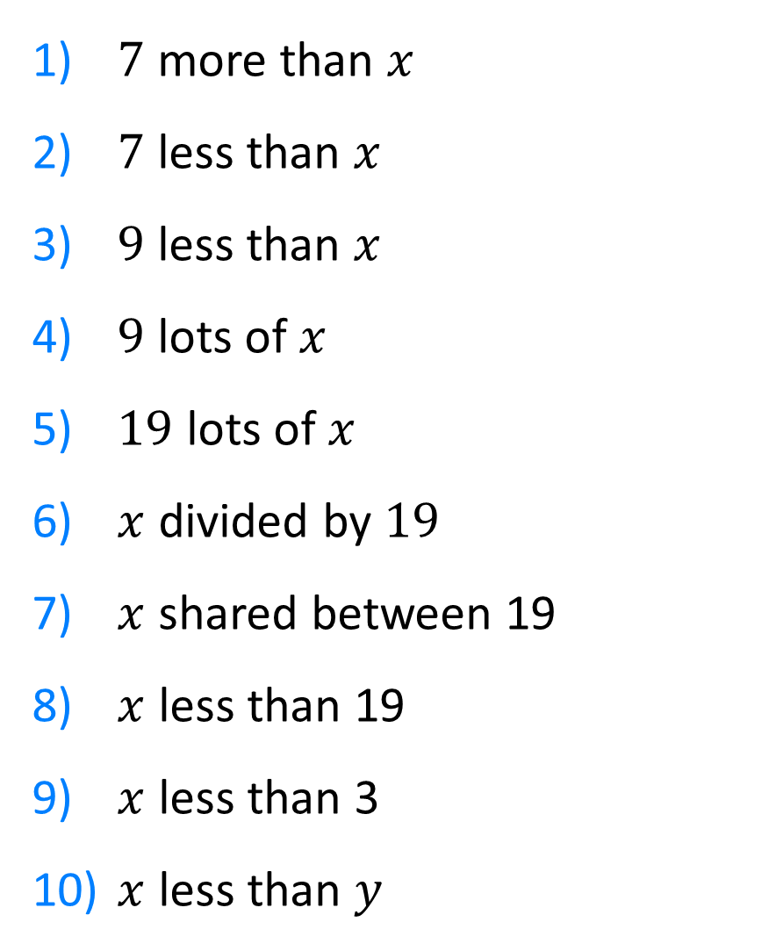
$7$ more than $x$
$7$ less than $x$
$9$ less than $x$
$9$ lots of $x$
$19$ lots of $x$
$x$ divided by $19$
$x$ shared between 19
$x$ less than 19
$x$ less than 3
$x$ less than $y$
$$x+7$$
$$x−7$$
$$x−9$$
$$9x$$
$$19x$$
$$\frac{x}{19}$$
$$\frac{x}{19}$$
$$19−x$$
$$3−x$$
$$y−x$$

Slide 5


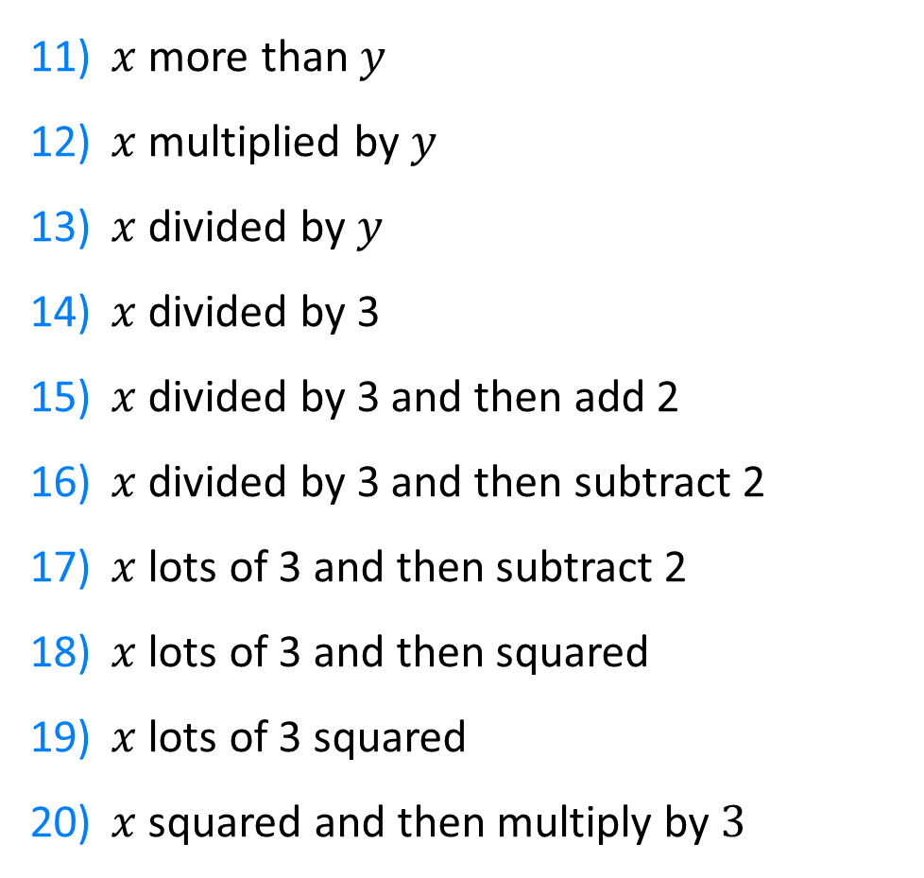
$x$ more than $y$
$x$ multiplied by $y$
$x$ divided by $y$
$x$ divided by 3
$x$ divided by 3 and then add 2
$x$ divided by 3 and then subtract 2
$x$ lots of 3 and then subtract 2
$x$ lots of 3 and then squared
$x$ lots of 3 squared
$x$ squared and then multiply by $3$
$$x+y$$
$$xy$$
$$\frac{x}{y}$$
$$\frac{x}{3}$$
$$\frac{x}{3}+2$$
$$\frac{x}{3}−2$$
$$3x−2$$
$${\left(3x\right)}^{2}=9x^{2}$$
$$x ×3^{2}=9x$$
$$x^{2}×3=3x^{2}$$

