Slide 1
Metric Unit Conversion: Metres and centimetres
Silent
Teacher
Intelligent Practice
Narration
Your Turn
7m
70m
0.70m
Practice

Slide 2
Worked Example
Your Turn
4m = cm
60cm = m
40m = cm
6cm = m
@mrbartonmaths

Slide 3
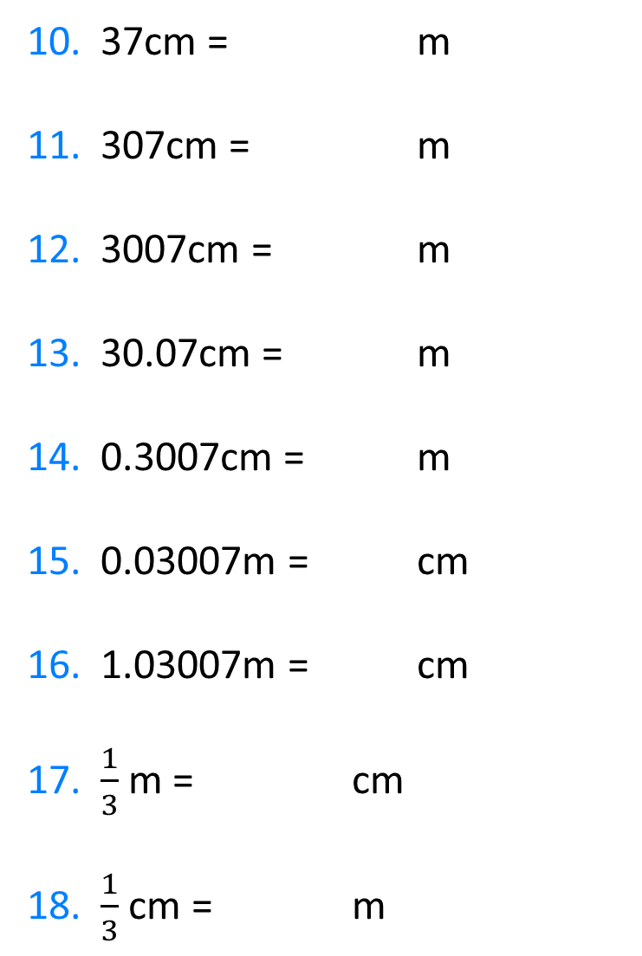
1. 7m = cm
2. 70m = cm
3. 0.70m = cm
4. 0.7m = cm
5. 0.07m = cm
6. 3.07m = cm
7. 3.7m = cm
8. 370m = cm
9. 370cm = m
10. 37cm = m
11. 307cm = m
12. 3007cm = m
13. 30.07cm = m
14. 0.3007cm = m
15. 0.03007m = cm
16. 1.03007m = cm
17. $\frac{1}{3}$m = cm
18. $\frac{1}{3}$cm = m
@mrbartonmaths

Slide 4
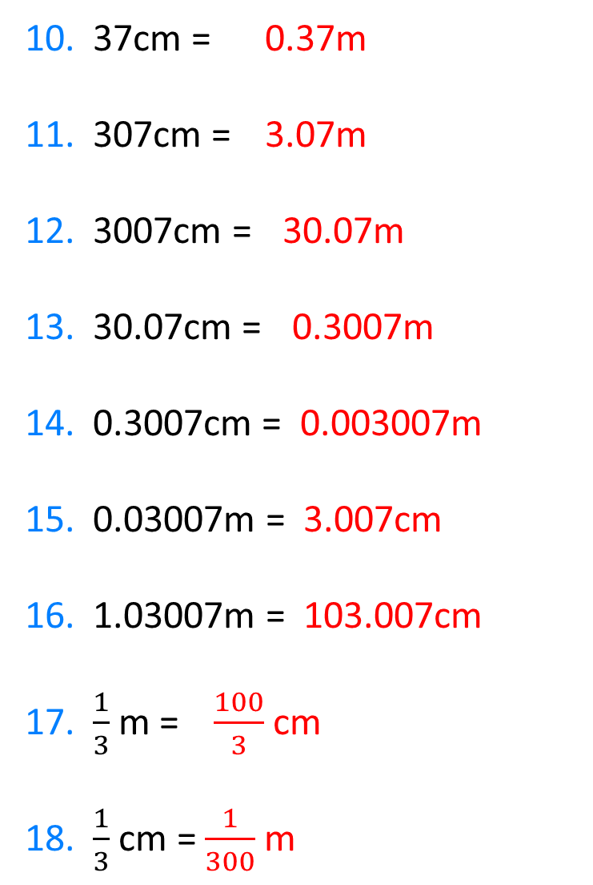
1. 7m = 700cm
2. 70m = 7000cm
3. 0.70m = 70cm
4. 0.7m = 70cm
5. 0.07m = 7cm
6. 3.07m = 307cm
7. 3.7m = 370cm
8. 370m = 37 000cm
9. 370cm = 3.7m
10. 37cm = 0.37m
11. 307cm = 3.07m
12. 3007cm = 30.07m
13. 30.07cm = 0.3007m
14. 0.3007cm = 0.003007m
15. 0.03007m = 3.007cm
16. 1.03007m = 103.007cm
17. $\frac{1}{3}$m = $\frac{100}{3}$cm
18. $\frac{1}{3}$cm = $\frac{1}{300}$m
@mrbartonmaths

