Slide 1
Equation of a line from gradient and a point
Silent
Teacher
Intelligent Practice
Narration
Your Turn
$$\left(20, 6\right) gradient is 3$$
$$\left(60, 2\right) gradient is 3$$
$$\left(−6, 20\right) gradient is 3$$
Practice

Slide 2
Worked Example
Your Turn
$$\left(6, 22\right) gradient 3$$
$$\left(4, 16\right) gradient 3$$
$$\left(22, −6\right) gradient 3$$
$$\left(16, −4\right) gradient 3$$
$$\left(−6, 22\right) gradient 3$$
$$\left(−6, 16\right) gradient 3$$
@cathowie

Slide 3
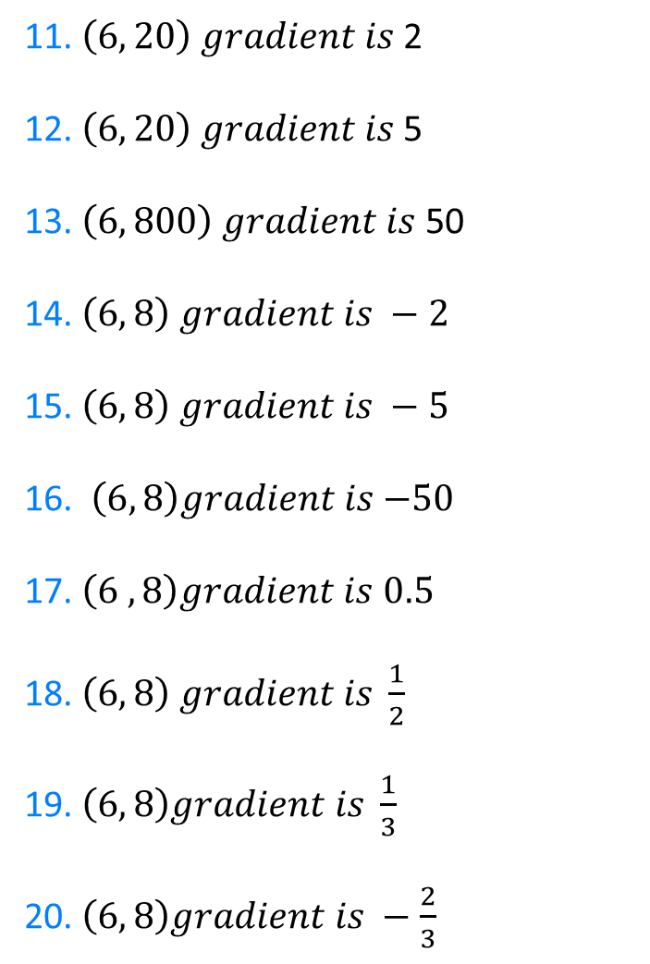
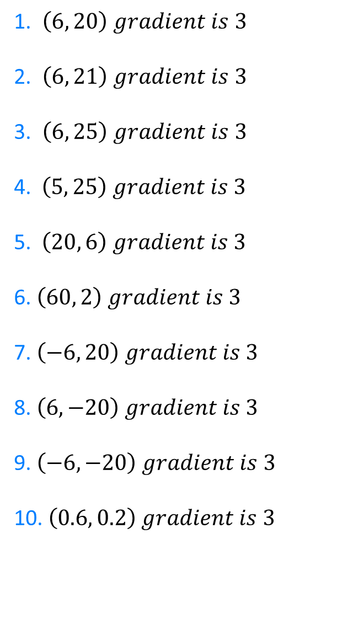
1. $\left(6, 20\right) gradient is 3$
2. $\left(6, 21\right) gradient is 3$
3. $\left(6, 25\right) gradient is 3$
4. $\left(5, 25\right) gradient is 3$
5. $\left(20, 6\right) gradient is 3$
6. $\left(60, 2\right) gradient is 3$
7. $\left(−6, 20\right) gradient is 3$
8. $\left(6, −20\right) gradient is 3$
9. $\left(−6, −20\right) gradient is 3$
10. $\left(0.6, 0.2\right) gradient is 3$
11. $\left(6, 20\right) gradient is$2
12. $\left(6, 20\right) gradient is$5
13. $\left(6, 800\right) gradient is$50
14. $\left(6, 8\right) gradient is −2$
15. $\left(6, 8\right) gradient is −5$
16. $\left(6, 8\right)gradient is$ $−50$
17. $\left(6 ,8\right)gradient is$ $0.5$
18. $\left(6, 8\right) gradient is \frac{1}{2}$
19. $\left(6, 8\right)gradient is \frac{1}{3}$
20. $\left(6, 8\right)gradient is −\frac{2}{3}$
@cathowie

Slide 4
$$y=2x+8$$
$$y=3x+2$$
11. $\left(6, 20\right) gradient is$2
12. $\left(6, 20\right) gradient is$5
13. $\left(6, 800\right) gradient is$50
14. $\left(6, 8\right) gradient is −2$
15. $\left(6, 8\right) gradient is −5$
16. $\left(6, 8\right)gradient is$ $−50$
17. $\left(6 ,8\right)gradient is$ $0.5$
18. $\left(6, 8\right) gradient is \frac{1}{2}$
19. $\left(6, 8\right)gradient is \frac{1}{3}$
20. $\left(6, 8\right)gradient is −\frac{2}{3}$
1. $\left(6, 20\right) gradient is 3$
2. $\left(6, 21\right) gradient is 3$
3. $\left(6, 25\right) gradient is 3$
4. $\left(5, 25\right) gradient is 3$
5. $\left(20, 6\right) gradient is 3$
6. $\left(60, 2\right) gradient is 3$
7. $\left(−6, 20\right) gradient is 3$
8. $\left(6, −20\right) gradient is 3$
9. $\left(−6, −20\right) gradient is 3$
10. $\left(0.6, 0.2\right) gradient is 3$
$$y=3x+3$$
$$y=5x−10$$
$$y=3x+7$$
$$y=50x+500$$
$$y=3x+10$$
$$y=−2x+20$$
$$y=3x−54$$
$$y=−5x+38$$
$$y=3x−178$$
$$y=−50x−308$$
$$y=0.5x+5$$
$$y=3x+38$$
$$y=3x−38$$
$$y=\frac{1}{2}x+5$$
$$y=3x−2$$
$$y=\frac{1}{3}x+6$$
$$y=3x−1.6$$
$$y=−\frac{2}{3}x+12$$
@cathowie

