Slide 1
Rounding: 1, 2, 3 decimal places
Silent
Teacher
Intelligent Practice
Narration
Your Turn
$$0.3456$$
$$0.4567$$
$$0.04567$$
Practice

Slide 2
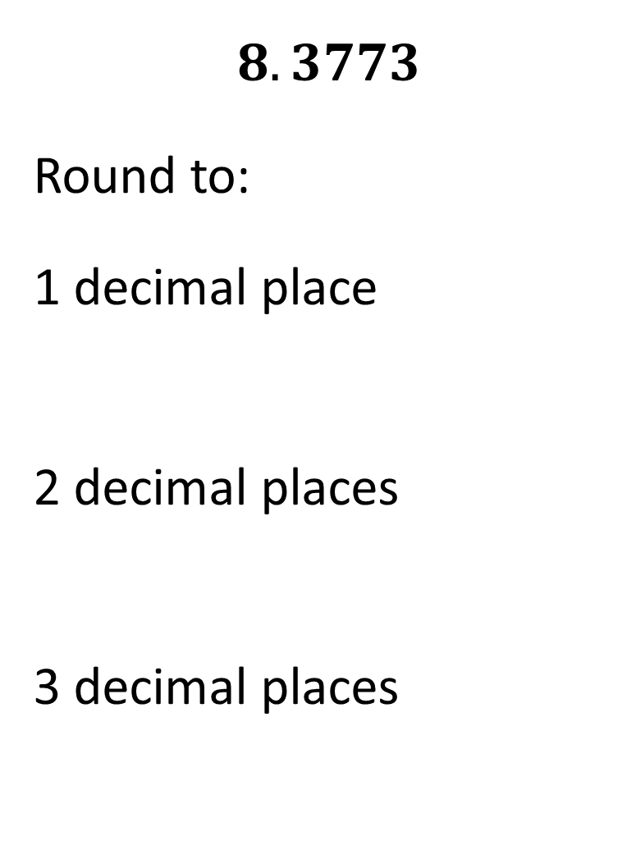
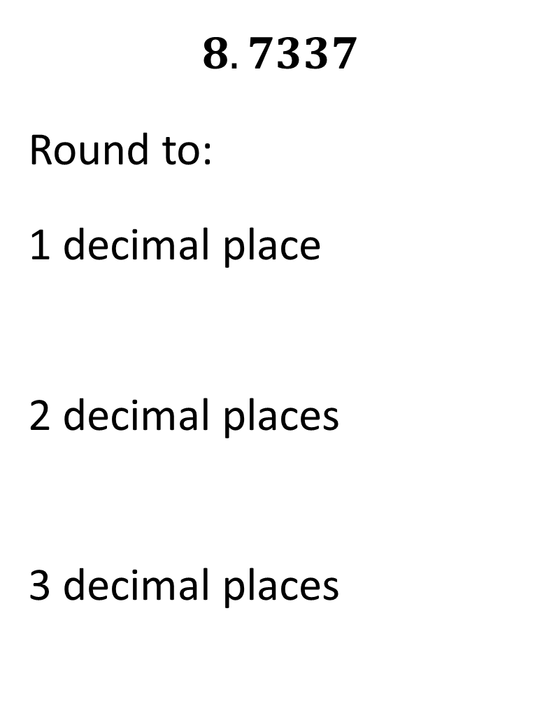
Worked Example
Your Turn
$$8.7337$$
Round to:
1 decimal place
2 decimal places
3 decimal places
$$8.3773$$
Round to:
1 decimal place
2 decimal places
3 decimal places
@mrbartonmaths

Slide 3
Number | 1 decimal place | 2 decimal places | 3 decimal places
1. 0.1234
2. 0.2345
3. 0.3456
4. 0.4567
5. 0.04567
6. 0.40567
7. 0.45067
8. 9.45067
9. 9.45967
10. 9.95967

Slide 4
Number | 1 decimal place | 2 decimal places | 3 decimal places
1. 0.1234 | 0.1 | 0.12 | 0.123
2. 0.2345 | 0.2 | 0.23 | 0.235
3. 0.3456 | 0.3 | 0.35 | 0.346
4. 0.4567 | 0.5 | 0.46 | 0.457
5. 0.04567 | 0.0 | 0.05 | 0.046
6. 0.40567 | 0.4 | 0.41 | 0.406
7. 0.45067 | 0.5 | 0.45 | 0.451
8. 9.45067 | 9.5 | 9.45 | 9.451
9. 9.45967 | 9.5 | 9.46 | 9.460
10. 9.95967 | 10.0 | 9.96 | 9.960

