Slide 1
Rounding: 1 Decimal Place – version 2
Silent
Teacher
Intelligent Practice
Narration
Your Turn
$$5.23$$
$$5.24$$
$$5.25$$
Practice

Slide 2
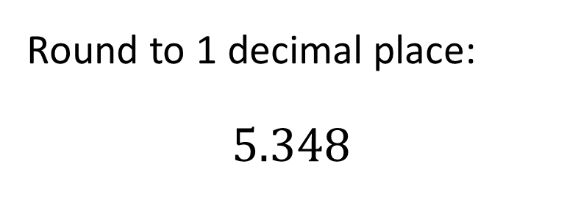
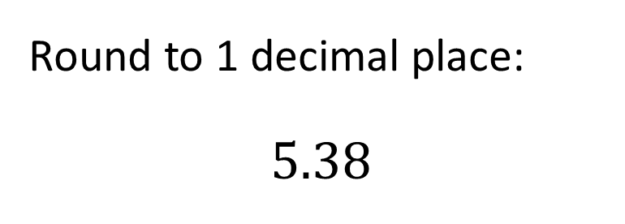
Worked Example
Your Turn
Round to 1 decimal place:
$$5.38$$
Round to 1 decimal place:
$$5.348$$
@mrbartonmaths

Slide 3


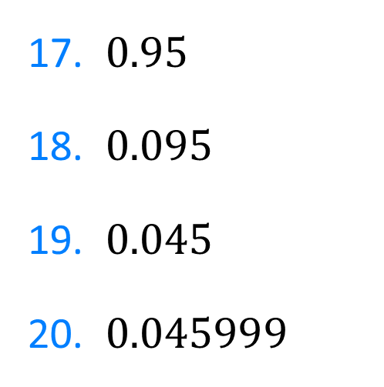
Round to 1 decimal place:
1. $5.23$
2. $5.24$
3. $5.25$
4. $5.26$
5. $5.36$
6. $6.36$
7. $67.36$
8. $67.36$4
9. $67.365$
10. $67.365891$
11. $67.325891$
12. $67.025891$
13. $67.925891$
14. $67.955891$
15. $67.95$
16. $69.95$
17. $0.95$
18. $0.095$
19. $0.045$
20. $0.045999$
@mrbartonmaths

Slide 4

Round to 1 decimal place:
1. $5.23$ $5.2$
2. $5.24$ $5.2$
3. $5.25$ $5.3$
4. $5.26$ $5.3$
5. $5.36$ $5.4$
6. $6.36$ $6.4$
7. $67.36$ $67.4$
8. $67.36$4 $67.4$
@mrbartonmaths

Slide 5

9. $67.365$ $67.4$
10. $67.365891$ $67.4$
11. $67.325891$ $67.3$
12. $67.025891$ $67.0$
13. $67.925891$ $67.9$
14. $67.955891$ $68.0$
15. $67.95$ $68.0$
16. $69.95$ $70.0$
@mrbartonmaths

Slide 6
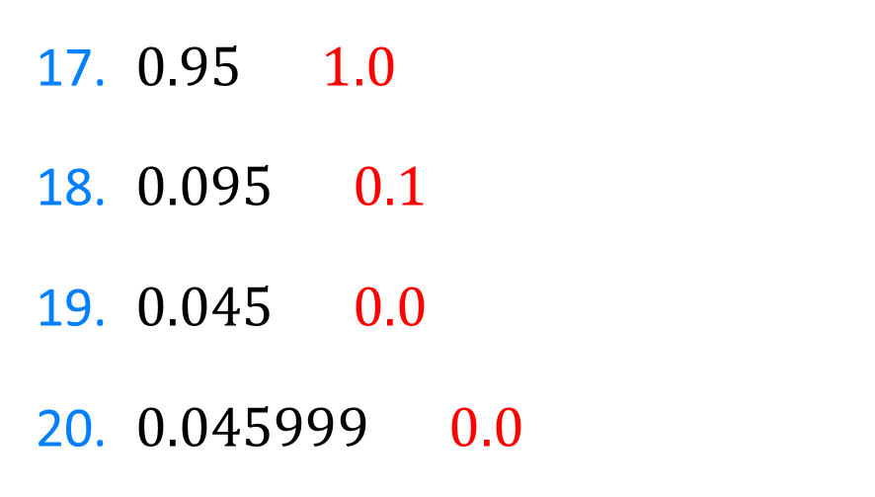
17. $0.95$ $1.0$
18. $0.095$ $0.1$
19. $0.045$ $0.0$
20. $0.045999$ $0.0$
@mrbartonmaths

