Slide 1
Exchange Rates
Silent
Teacher
Intelligent Practice
Narration
Your Turn
$$\$4=£1$$
$$\$1=£??$$
$$\$1=£5$$
$$£1=\$??$$
$$\$x=£5$$
$$\$1=£??$$
Practice

Slide 2
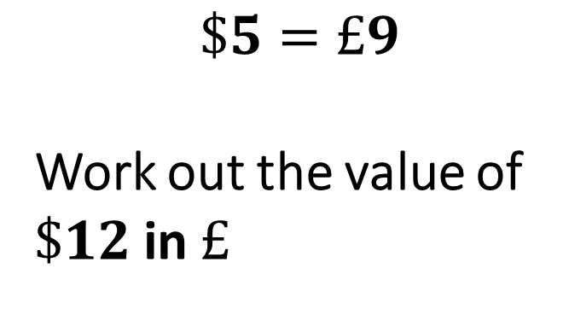
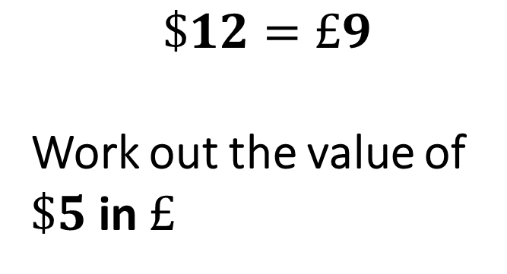
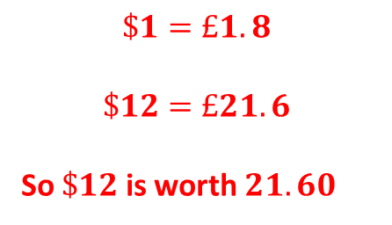
Worked Example
Your Turn
$$\$12=£9$$
Work out the value of $\$5$ in $£$
$$\$5=£9$$
Work out the value of $\$12$in $£$
$$\$1=£1.8$$
$$\$12=£21.6$$
So $\$12$ is worth $21.60$

Slide 3
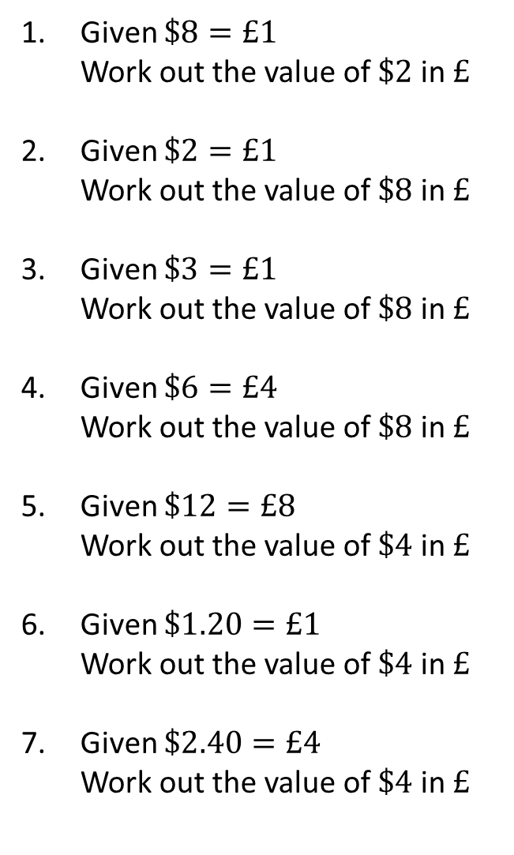
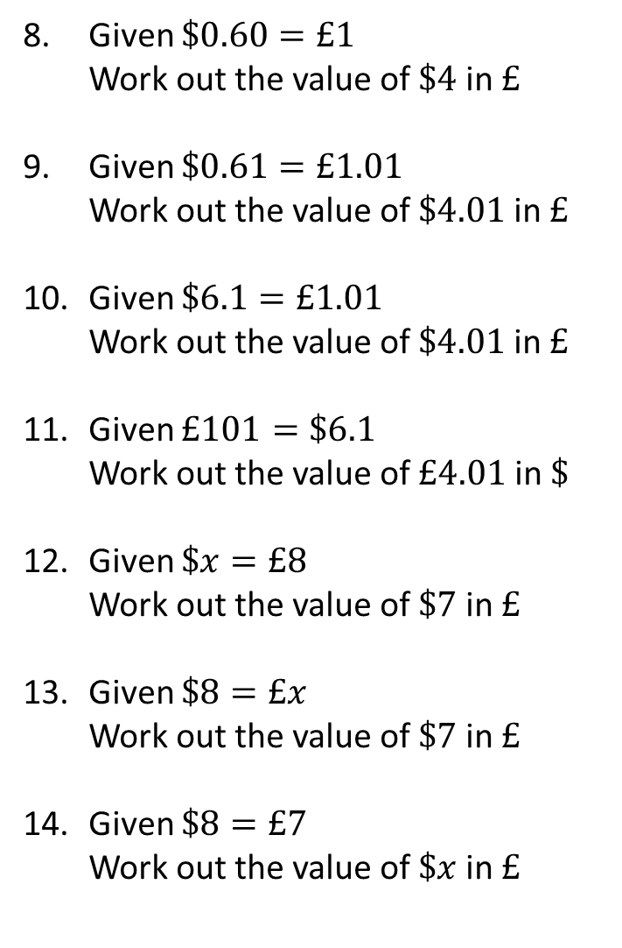
Given $\$8=£1$ Work out the value of $\$2$ in $£$
Given $\$2=£1$ Work out the value of $\$8$ in $£$
Given $\$3=£1$ Work out the value of $\$8$ in $£$
Given $\$6=£4$ Work out the value of $\$8$ in $£$
Given $\$12=£8$ Work out the value of $\$4$ in $£$
Given $\$1.20=£1$ Work out the value of $\$4$ in $£$
Given $\$2.40=£4$ Work out the value of $\$4$ in $£$
Given $\$0.60=£1$ Work out the value of $\$4$ in $£$
Given $\$0.61=£1.01$ Work out the value of $\$4.01$ in $£$
Given $\$6.1=£1.01$ Work out the value of $\$4.01$ in $£$
Given $£101=\$6.1$ Work out the value of $£4.01$ in $\$$
Given $\$x=£8$ Work out the value of $\$7$ in $£$
Given $\$8=£x$ Work out the value of $\$7$ in $£$
Given $\$8=£7$ Work out the value of $\$x$ in $£$

Slide 4
Given $\$8=£1$ Work out the value of $\$2$ in $£$
Given $\$2=£1$ Work out the value of $\$8$ in $£$
Given $\$3=£1$ Work out the value of $\$8$ in $£$
Given $\$6=£4$ Work out the value of $\$8$ in $£$
Given $\$12=£8$ Work out the value of $\$4$ in $£$
Given $\$1.20=£1$ Work out the value of $\$4$ in $£$
Given $\$2.40=£4$ Work out the value of $\$4$ in $£$
Given $\$0.60=£1$ Work out the value of $\$4$ in $£$
Given $\$0.61=£1.01$ Work out the value of $\$4.01$ in $£$
Given $\$6.1=£1.01$ Work out the value of $\$4.01$ in $£$
Given $£101=\$6.1$ Work out the value of $£4.01$ in $\$$
Given $\$x=£8$ Work out the value of $\$7$ in $£$
Given $\$8=£x$ Work out the value of $\$7$ in $£$
Given $\$8=£7$ Work out the value of $\$x$ in $£$
$$\$2=£0.25$$
$$\$4=£6.67 (2dp)$$
$$\$8=£4$$
$$\$4.01=£6.64(2dp)$$
$$\$8=£2.67 (2dp)$$
$$\$4.01=£0.66(2dp)$$
$$\$8=£5.33 (2dp)$$
$$£4.01=\$0.24(2dp)$$
$$\$4=£2.67 (2dp)$$
$$\$7=£\frac{56}{x}$$
$$\$4=£3.33 (2dp)$$
$$\$7=\$\frac{7x}{8}$$
$$\$4=£6.67 (2dp)$$
$$\$x=\$\frac{7x}{8}$$

