Slide 1
What is Frequency?
True/false
Reflect
Your Turn
Minutes | Frequency
0 | 1
4 | 0
5 | 1
6 | 2
9 | 0
Rule

Slide 2
This is the time a selection of students spent doing their maths homework:
1. 4 mins, 5 mins, 6 mins, 7 mins Frequency = 22 True / False
2. 4 mins, 5 mins, 6 mins, 7 mins Frequency = 4 True / False
3. 4 mins, 5 mins, 6 mins, 6 mins Frequency = 4 True / False
4. 0 mins, 4 mins, 5 mins, 6 mins, 6 mins Frequency = 4 True / False
5. 0 mins, 4 mins, 5 mins, 6 mins, 6 mins Frequency = 5 True / False
6.
Time (mins)
0
4
5
6
6
7.
8.
Time (mins) | Frequency
0 | 1
4 | 1
5 | 1
6 | 2
Time (mins) | Frequency
0 | 1
4 | 1
5 | 1
6 | 2
Frequency = 4
True / False
Frequency = 5
True / False
Frequency = 5
True / False

Slide 3
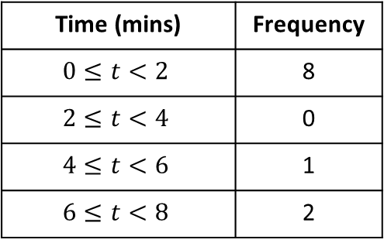
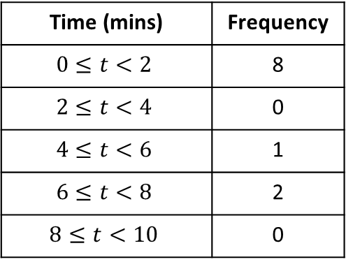
This is the time a selection of students spent doing their maths homework:
9.
Time (mins) | Frequency
0 | 1
4 | 0
5 | 1
6 | 2
10.
Time (mins) | Frequency
0 | 1
4 | 0
5 | 1
6 | 2
9 | 0
11.
Time (mins) | Frequency
0 | 8
4 | 0
5 | 1
6 | 2
9 | 0
Frequency = 4
True / False
Frequency = 4
True / False
Frequency = 11
True / False
12.
Time (mins) | Frequency
$$0≤t<2$$ | 8
$$2≤t<4$$ | 0
$$4≤t<6$$ | 1
$$6≤t<8$$ | 2
$$8≤t<10$$ | 0
13.
Time (mins) | Frequency
$$0≤t<2$$ | 8
$$2≤t<4$$ | 0
$$4≤t<6$$ | 1
$$6≤t<8$$ | 2
Frequency = 11
True / False
Frequency = 4
True / False

Slide 4
This is the time a selection of students spent doing their maths homework:
1. 4 mins, 5 mins, 6 mins, 7 mins Frequency = 22 True / False
2. 4 mins, 5 mins, 6 mins, 7 mins Frequency = 4 True / False
3. 4 mins, 5 mins, 6 mins, 6 mins Frequency = 4 True / False
4. 0 mins, 4 mins, 5 mins, 6 mins, 6 mins Frequency = 4 True / False
5. 0 mins, 4 mins, 5 mins, 6 mins, 6 mins Frequency = 5 True / False
6.
Time (mins)
0
4
5
6
6
7.
8.
Time (mins) | Frequency
0 | 1
4 | 1
5 | 1
6 | 2
Time (mins) | Frequency
0 | 1
4 | 1
5 | 1
6 | 2
Frequency = 4
True / False
Frequency = 5
True / False
Frequency = 5
True / False

Slide 5
This is the time a selection of students spent doing their maths homework:
9.
Time (mins) | Frequency
0 | 1
4 | 0
5 | 1
6 | 2
10.
Time (mins) | Frequency
0 | 1
4 | 0
5 | 1
6 | 2
9 | 0
11.
Time (mins) | Frequency
0 | 8
4 | 0
5 | 1
6 | 2
9 | 0
Frequency = 4
True / False
Frequency = 4
True / False
Frequency = 11
True / False
12.
Time (mins) | Frequency
$$0≤t<2$$ | 8
$$2≤t<4$$ | 0
$$4≤t<6$$ | 1
$$6≤t<8$$ | 2
$$8≤t<10$$ | 0
13.
Time (mins) | Frequency
$$0≤t<2$$ | 8
$$2≤t<4$$ | 0
$$4≤t<6$$ | 1
$$6≤t<8$$ | 2
Frequency = 11
True / False
Frequency = 4
True / False

Slide 6
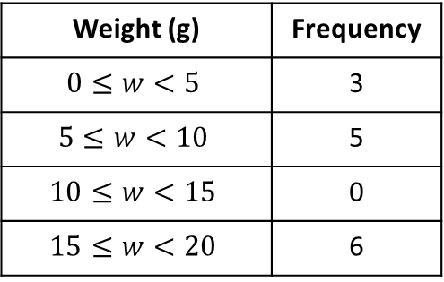
Your turn
This is the weight of a selection of sweets:
1. 10g, 15g, 18g, 18g, 20g Frequency =
2.
Weight (g) | Frequency
12 | 3
15 | 1
20 | 0
22 | 5
Frequency =
3.
Weight (g) | Frequency
$$0≤w<5$$ | 3
$$5≤w<10$$ | 5
$$10≤w<15$$ | 0
$$15≤w<20$$ | 6
Frequency =

Slide 7
Your turn - answers
This is the weight of a selection of sweets:
1. 10g, 15g, 18g, 18g, 20g Frequency = 5
2.
Weight (g) | Frequency
12 | 3
15 | 1
20 | 0
22 | 5
Frequency = 9
3.
Weight (g) | Frequency
$$0≤w<5$$ | 3
$$5≤w<10$$ | 5
$$10≤w<15$$ | 0
$$15≤w<20$$ | 6
Frequency = 14

