Slide 1
Rearranging formula: Is $a$ the subject?
True/false
Reflect
Your Turn
$$a=bc−6$$
$$a=bc−x$$
$$a=bc−a$$
Rule

Slide 2
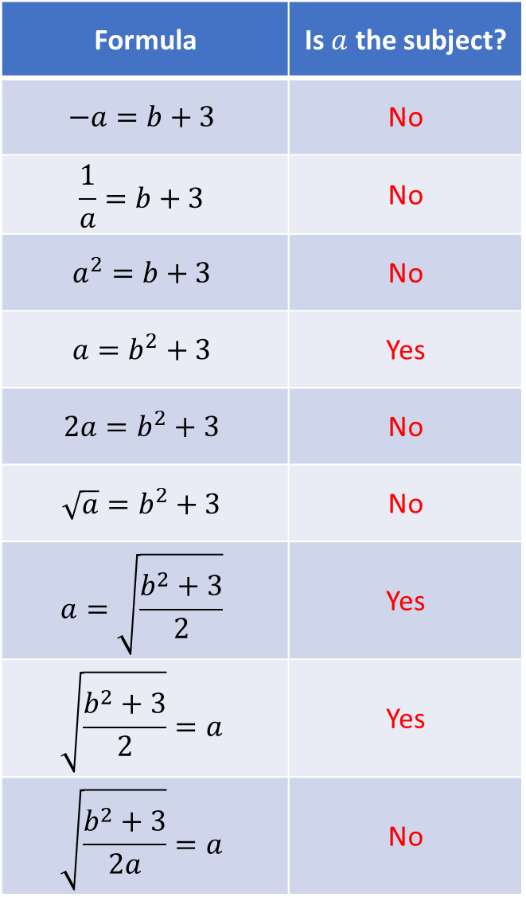
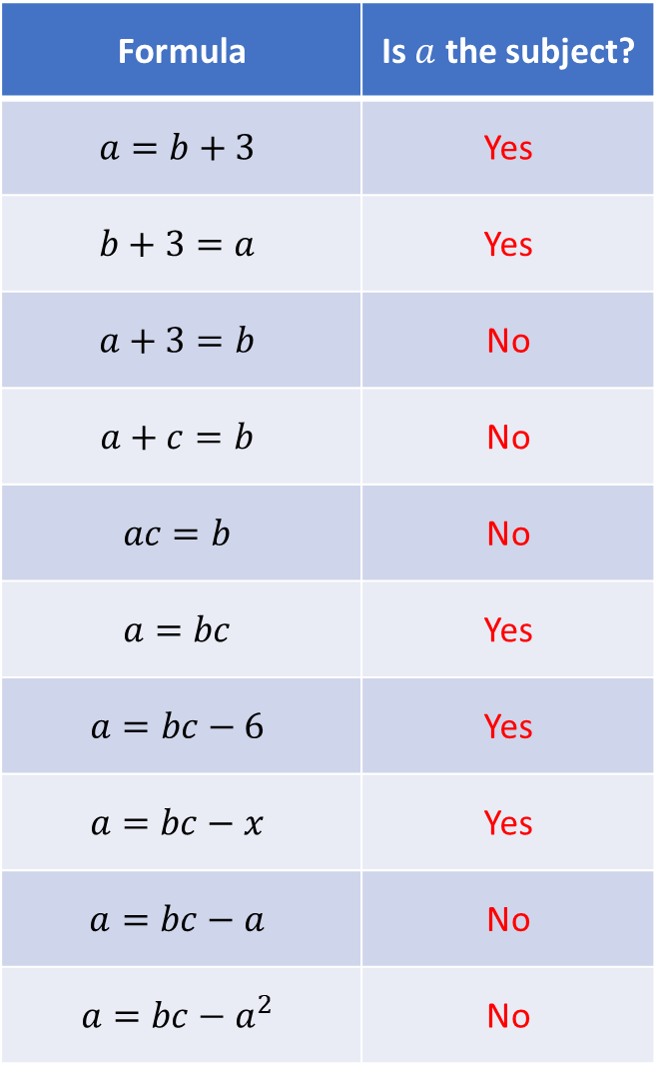
Formula | Is $a$ the subject?
$$a=b+3$$ | Yes
$$b+3=a$$ | Yes
$$a+3=b$$ | No
$$a+c=b$$ | No
$$ac=b$$ | No
$$a=bc$$ | Yes
$$a=bc−6$$ | Yes
$$a=bc−x$$ | Yes
$$a=bc−a$$ | No
$$a=bc−a^{2}$$ | No
Formula | Is $a$ the subject?
$$−a=b+3$$ | No
$$\frac{1}{a}=b+3$$ | No
$$a^{2}=b+3$$ | No
$$a=b^{2}+3$$ | Yes
$$2a=b^{2}+3$$ | No
$$\sqrt{a}=b^{2}+3$$ | No
$$a=\sqrt{\frac{b^{2}+3}{2}}$$ | Yes
$$\sqrt{\frac{b^{2}+3}{2}}=a$$ | Yes
$$\sqrt{\frac{b^{2}+3}{2a}}=a$$ | No

Slide 3
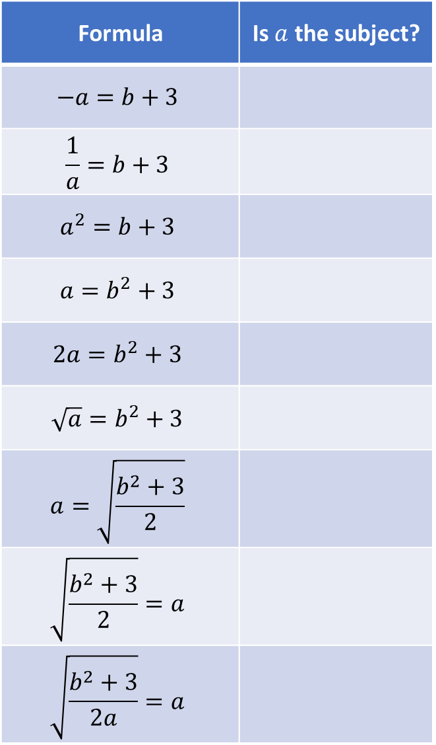
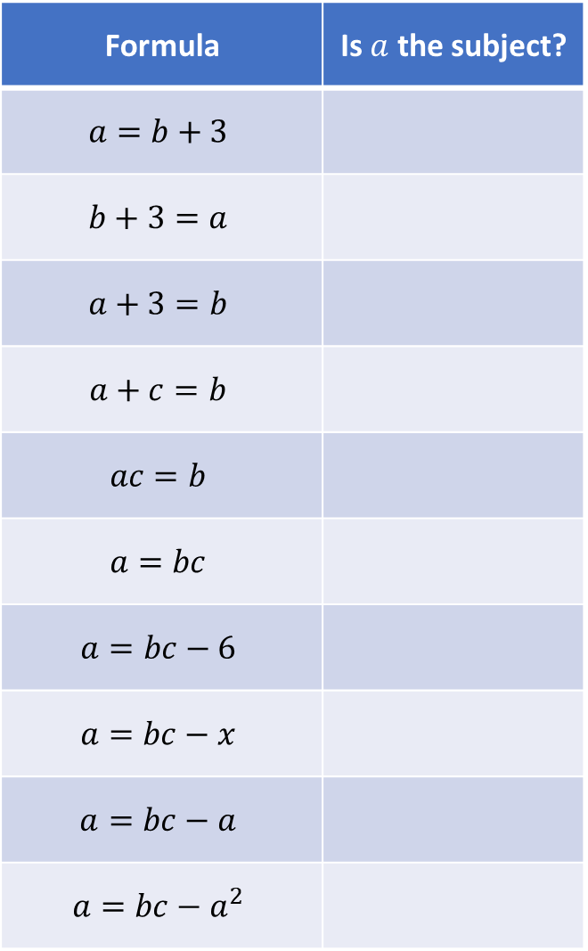
Formula | Is $a$ the subject?
$$a=b+3$$
$$b+3=a$$
$$a+3=b$$
$$a+c=b$$
$$ac=b$$
$$a=bc$$
$$a=bc−6$$
$$a=bc−x$$
$$a=bc−a$$
$$a=bc−a^{2}$$
Formula | Is $a$ the subject?
$$−a=b+3$$
$$\frac{1}{a}=b+3$$
$$a^{2}=b+3$$
$$a=b^{2}+3$$
$$2a=b^{2}+3$$
$$\sqrt{a}=b^{2}+3$$
$$a=\sqrt{\frac{b^{2}+3}{2}}$$
$$\sqrt{\frac{b^{2}+3}{2}}=a$$
$$\sqrt{\frac{b^{2}+3}{2a}}=a$$

Slide 4
Formula | Is $a$ the subject?
$$a=b+3$$ | Yes
$$b+3=a$$ | Yes
$$a+3=b$$ | No
$$a+c=b$$ | No
$$ac=b$$ | No
$$a=bc$$ | Yes
$$a=bc−6$$ | Yes
$$a=bc−x$$ | Yes
$$a=bc−a$$ | No
$$a=bc−a^{2}$$ | No
Formula | Is $a$ the subject?
$$−a=b+3$$ | No
$$\frac{1}{a}=b+3$$ | No
$$a^{2}=b+3$$ | No
$$a=b^{2}+3$$ | Yes
$$2a=b^{2}+3$$ | No
$$\sqrt{a}=b^{2}+3$$ | No
$$a=\sqrt{\frac{b^{2}+3}{2}}$$ | Yes
$$\sqrt{\frac{b^{2}+3}{2}}=a$$ | Yes
$$\sqrt{\frac{b^{2}+3}{2a}}=a$$ | No

Slide 5
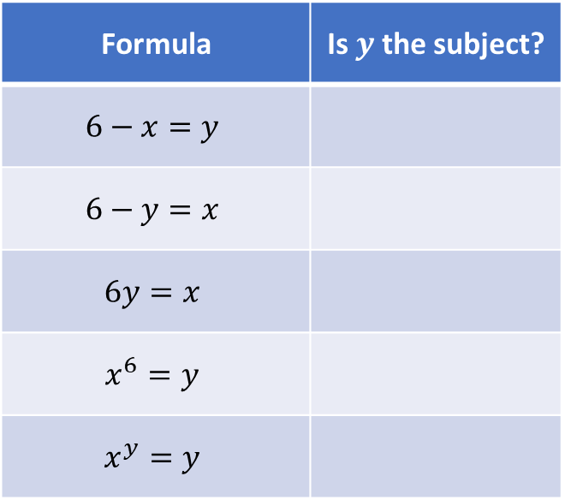
Your Turn
Formula | Is $y$ the subject?
$$6−x=y$$
$$6−y=x$$
$$6y=x$$
$$x^{6}=y$$
$$x^{y}=y$$
@mrbartonmaths

Slide 6
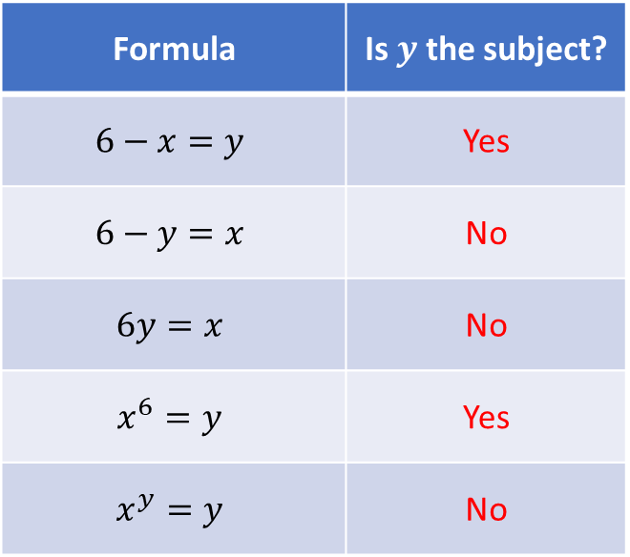
Your Turn - answers
Formula | Is $y$ the subject?
$$6−x=y$$ | Yes
$$6−y=x$$ | No
$$6y=x$$ | No
$$x^{6}=y$$ | Yes
$$x^{y}=y$$ | No
@mrbartonmaths

