Slide 1
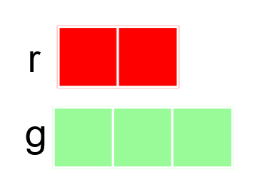
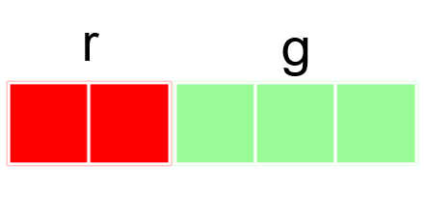
Ratio, Fractions and Equations

Slide 2
r:g = 2:3
r is of g
g is of r

Slide 3
r:g = 2:3
r is of g
g is of r

Slide 4
r:g = 2:3
r is of the whole
g is of the whole

Slide 5
r:g = 2:3
r is of the whole
g is of the whole

Slide 6
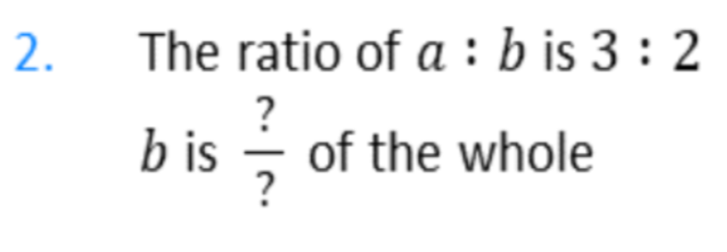
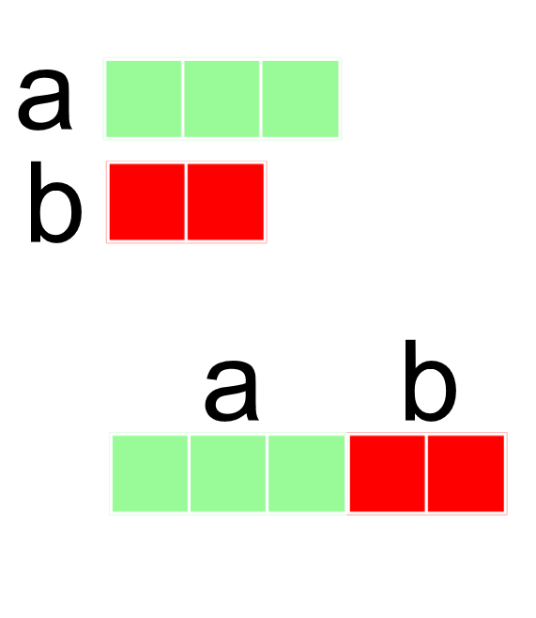
3
5
2
5

Slide 7
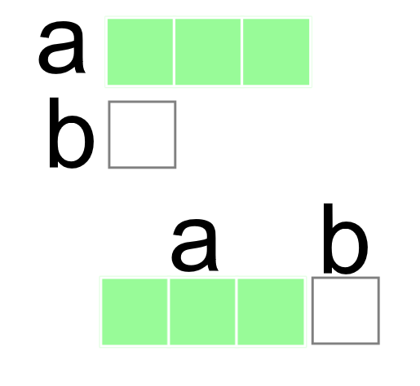
1
4
1
3

Slide 8
1
4
4
1

Slide 9
8
2
2
8

Slide 10
1
3
3
9
1
3

Slide 11
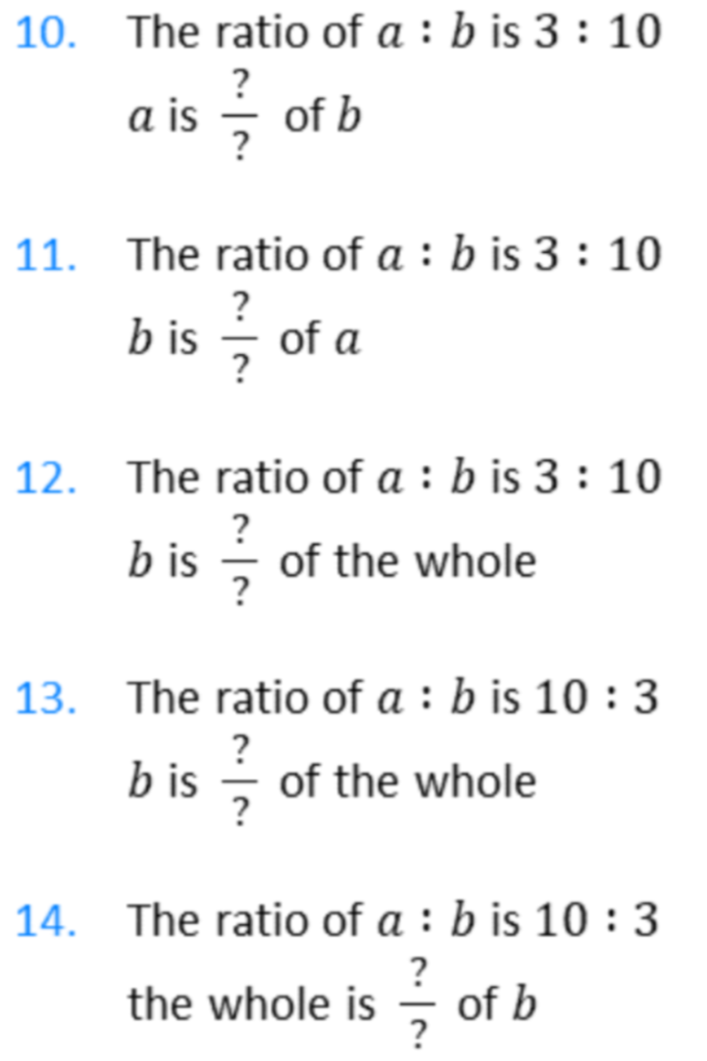
3
10
10
3
10
13
3
13
13
3

Slide 12
3:4
3:1

Slide 13
p
p+q
p
q

Slide 14
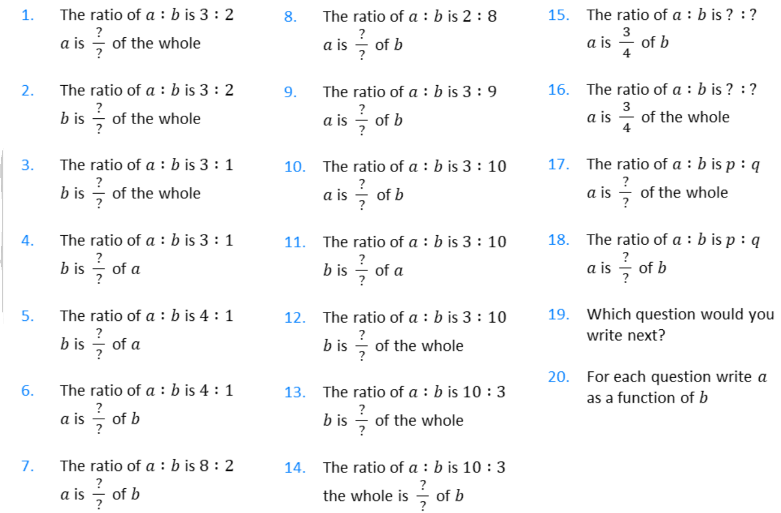

Slide 16
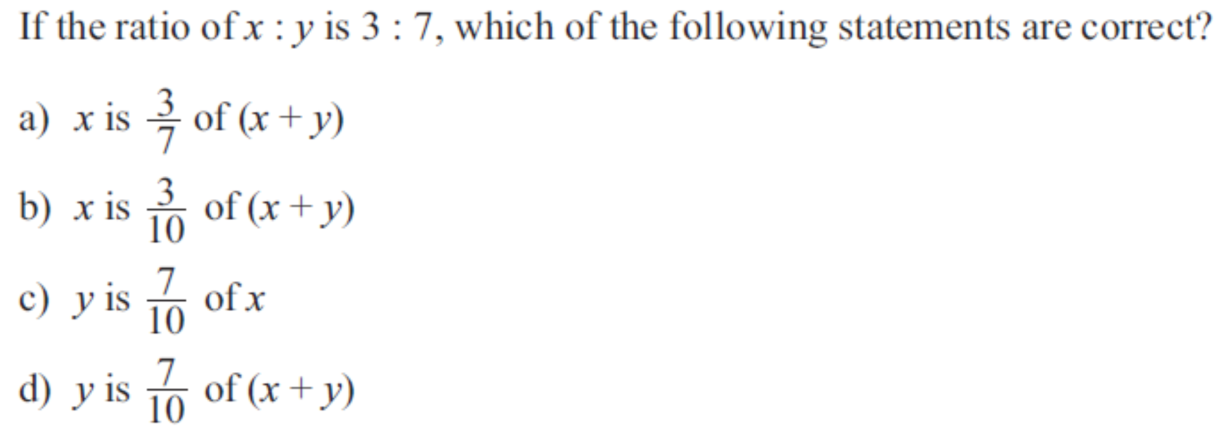
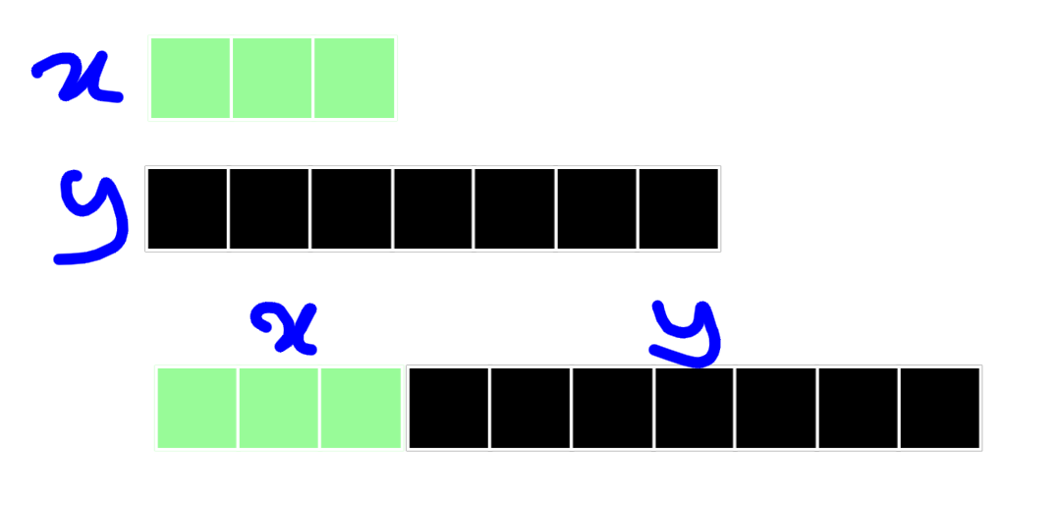

Slide 17
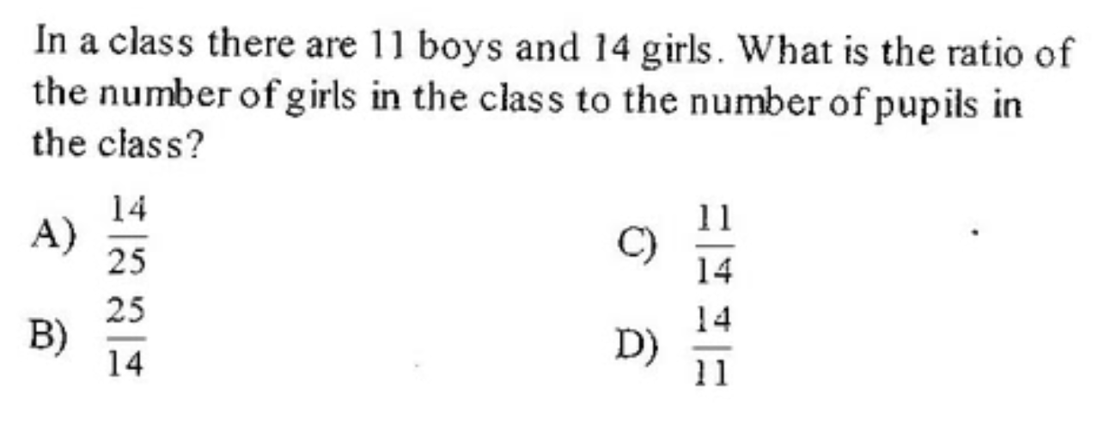
Part:Part or Part:Whole
https://www.youtube.com/watch?v=pTuVs-dfnoA

Slide 18
x is of y
y is of x
x = y

Slide 19
x is of y
y is of x
x = y

Slide 20
x = y
y = x
x = y

Slide 21
x = y
y = x
x = y

Slide 22
x = y
y = x
x = y

Slide 23
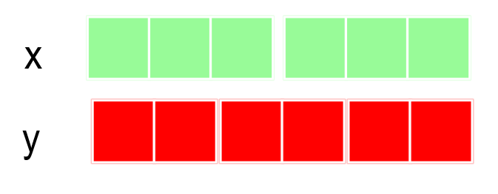
x = y
y = x
x = y

Slide 24
x = y
y = x
x = y

Slide 25
x = y
y = x
x = y

Slide 26
x = y
y = x
x = y

Slide 27
x = y
y = x
x = y

Slide 28
x = y
y = x
x = y

Slide 29
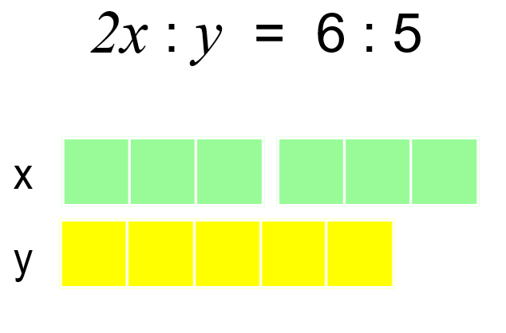
x = y
y = x
x = y

Slide 30
x = y
y = x
x = y

Slide 31
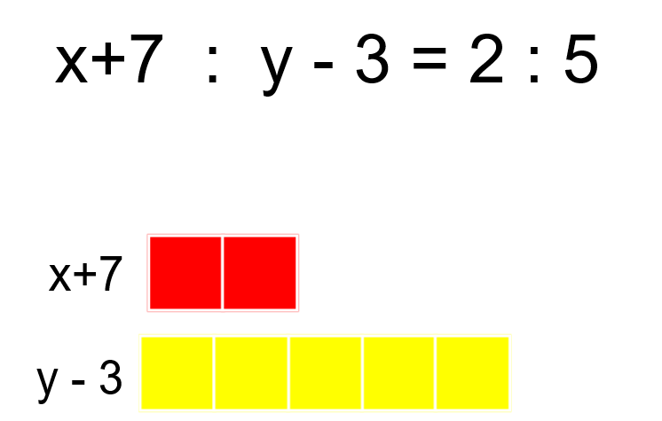
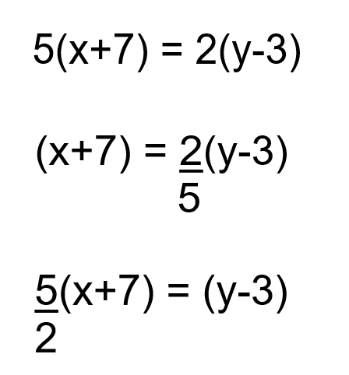

Slide 32
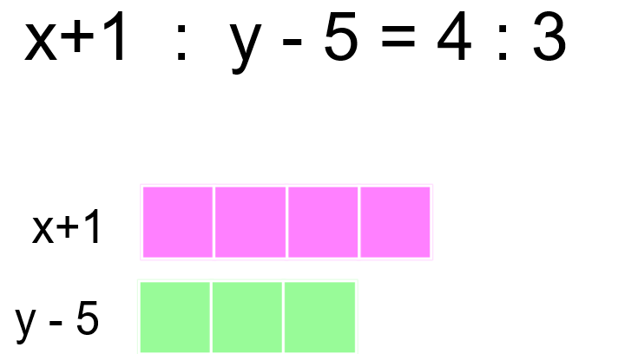
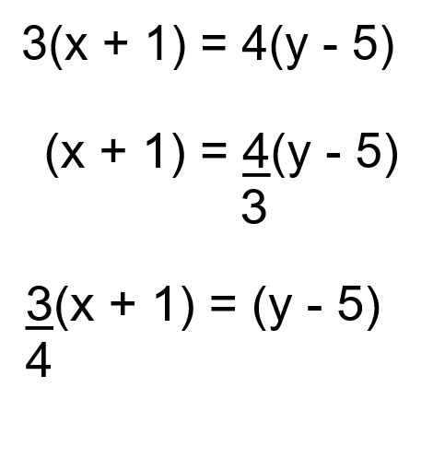

Slide 33
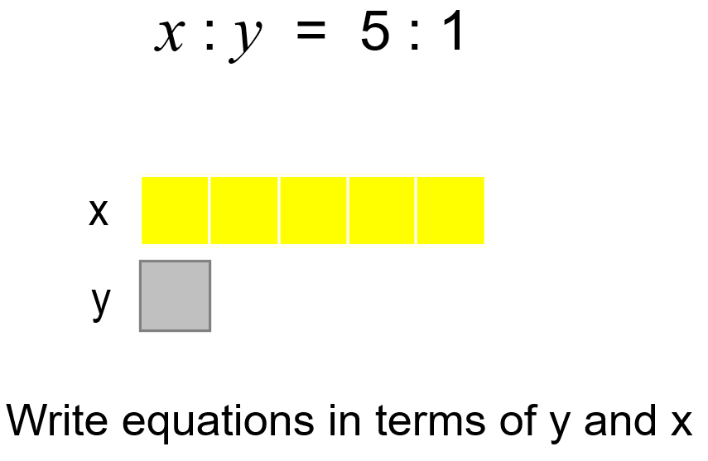

Slide 34
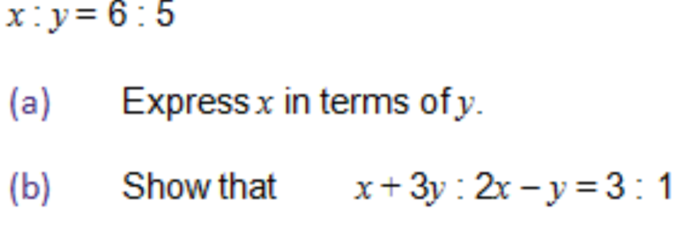
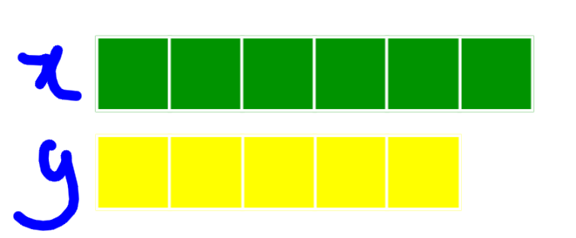

Slide 35
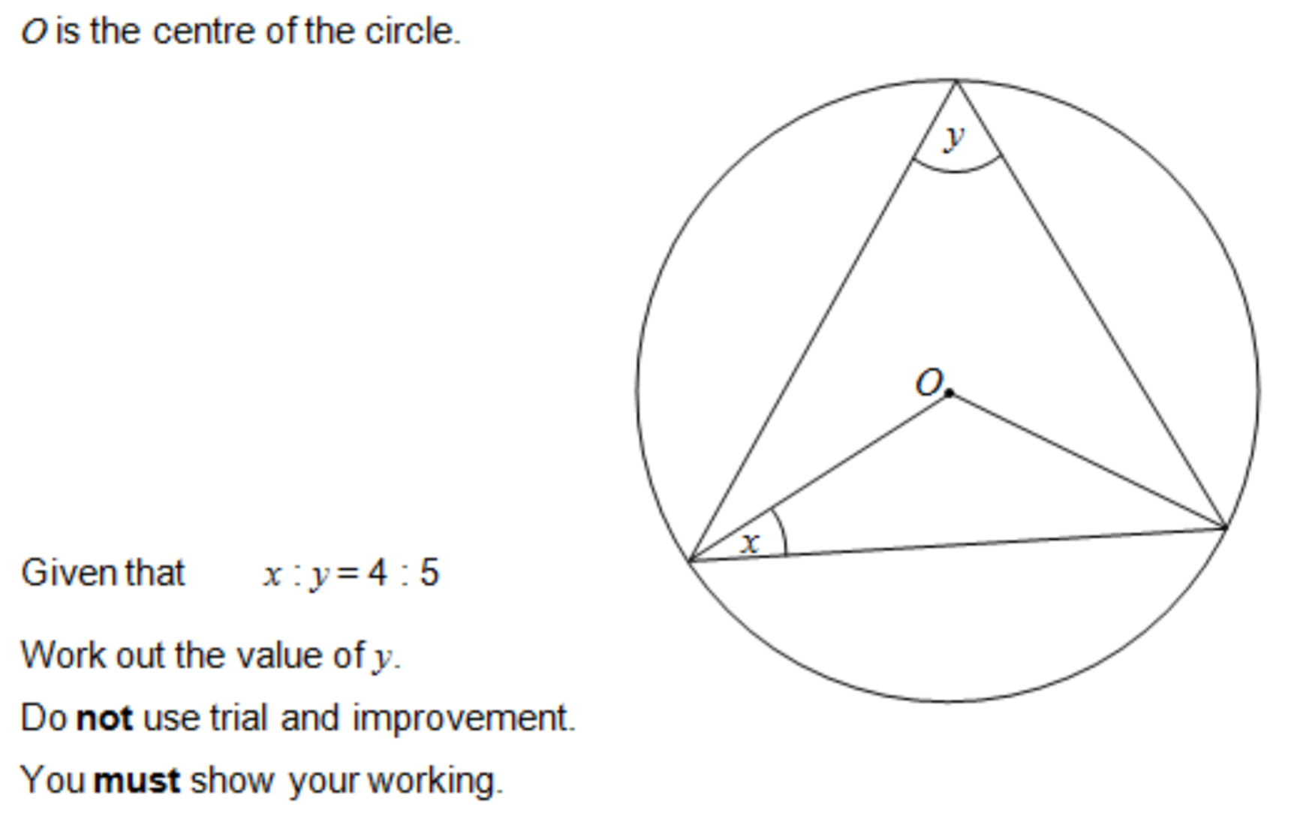
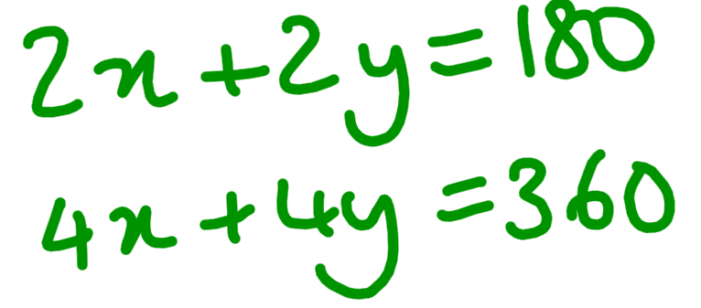
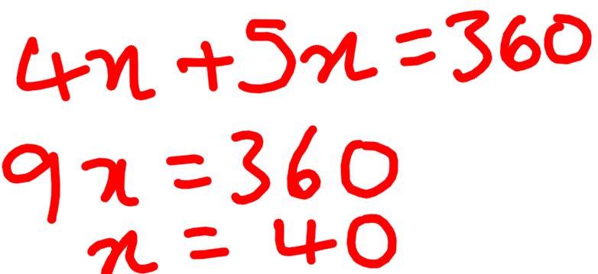
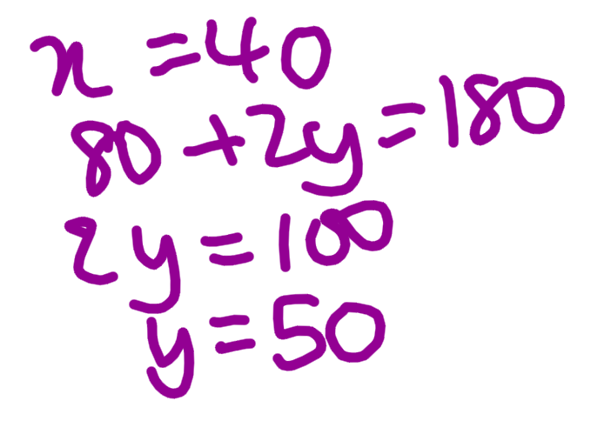

Slide 36
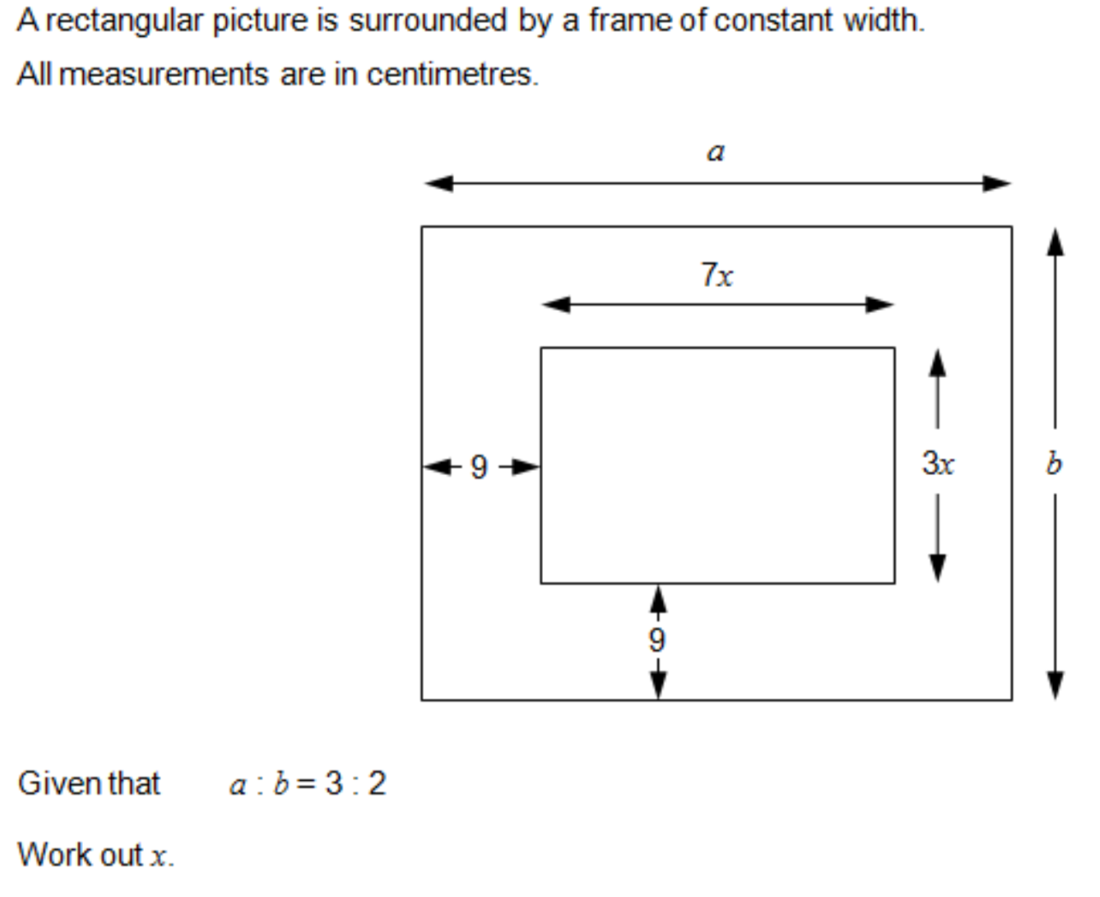

Slide 38
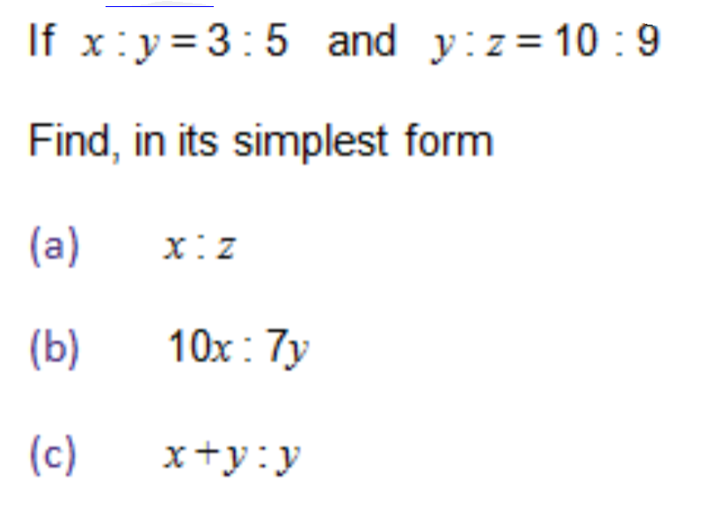
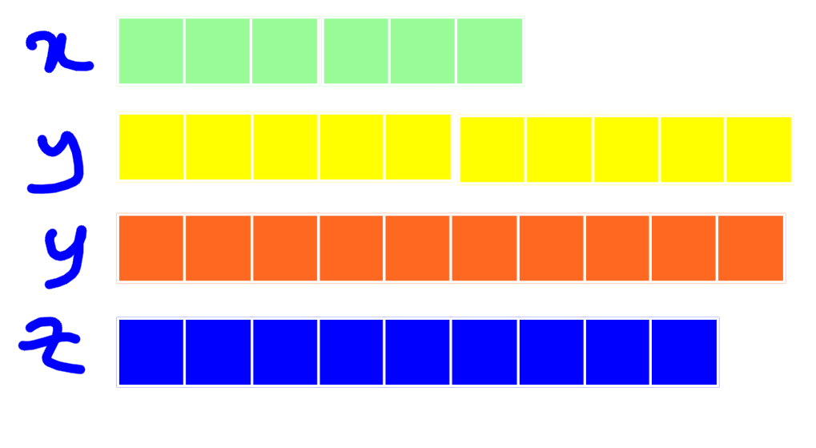

Slide 39
Ratio Value
Why might the word ‘ratio’ cause confusion for students learning trigonometry?
o
o:a = 3:4
h
o
a
Ɵ
o = $\frac{3}{4} a$
$\frac{0}{a}$ = $\frac{3}{4}$
a
a = $\frac{4}{3} o$
$\frac{a}{o}$ = $\frac{4}{3}$
Write as many equations as you can for the ratio o:h and a:h

Slide 40
Ratio Value
o:a = 6:8
h
o
o = $\frac{6}{8} a$
$\frac{0}{a}$ = $\frac{6}{8}$
a = $\frac{8}{6} o$
$\frac{a}{o}$ = $\frac{8}{6}$
Ɵ
a
Write as many equations as you can for the ratio o:h and a:h

Slide 41
Ratio Value
h
o
Ɵ
a
h
o
Which form of the ratio would you use to compare o:a for these triangles?
If a ratio is in the form o:a
$$\frac{o}{a} is called the ratio value$$
Ɵ
a

Slide 42
Ratio Value
If a ratio is in the form o:a, $\frac{o}{a} is called the ratio value$
Write the following as ratio values
3:4
6:8
9:12
12:20
21:28
$$\frac{3}{4}$$
What is the same and what is different?
$$\frac{6}{8}$$
$$The ratio value is \frac{3}{4}$$
$$The lengths of the sides$$
$$\frac{9}{12}$$
$$The size of the angles$$
$$\frac{12}{20}$$
$$\frac{21}{28}$$

Slide 43
Ratio Value
If a ratio is in the form a:b, $\frac{a}{b} is called the ratio value$
π is the ratio of the circumference to the diameter on a circle
π is C:d
C
Write this as a ratio value
π =
d

