Slide 1
Ratio: Ratio to fraction selection
Silent
Teacher
Intelligent Practice
Narration
Your Turn
The ratio of $a :b$ is $3 :1$
$b$ is $\frac{ ? }{?}$ of the whole
The ratio of $a :b$ is $3 :1$
$b$ is $\frac{ ? }{?}$ of $a$
Practice

Slide 2
Worked Example
Your Turn
The ratio of $p :q$ is $3 :4$
$p$ is $\frac{ ? }{?}$ of the whole
The ratio of $p :q$ is $5 :4$
$p$ is $\frac{ ? }{?}$ of the whole
The ratio of $p :q$ is $3 :4$
$p$ is $\frac{ ? }{?}$ of $q$
The ratio of $p :q$ is $5 :4$
$p$ is $\frac{ ? }{?}$ of $q$
@mrbartonmaths

Slide 3
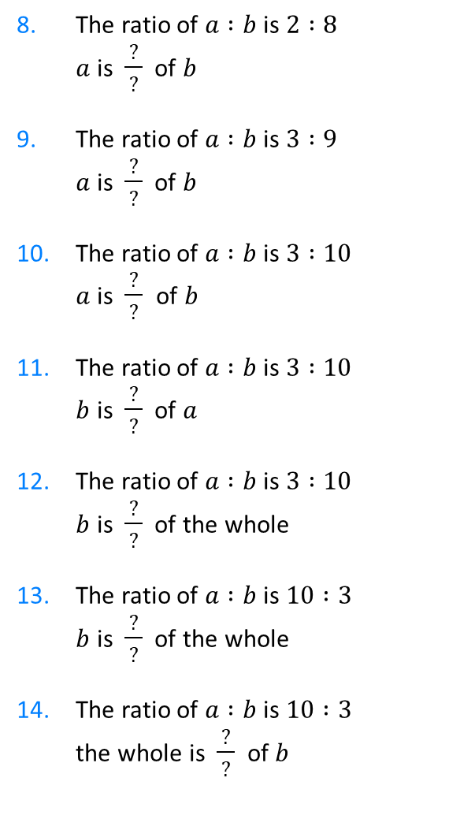
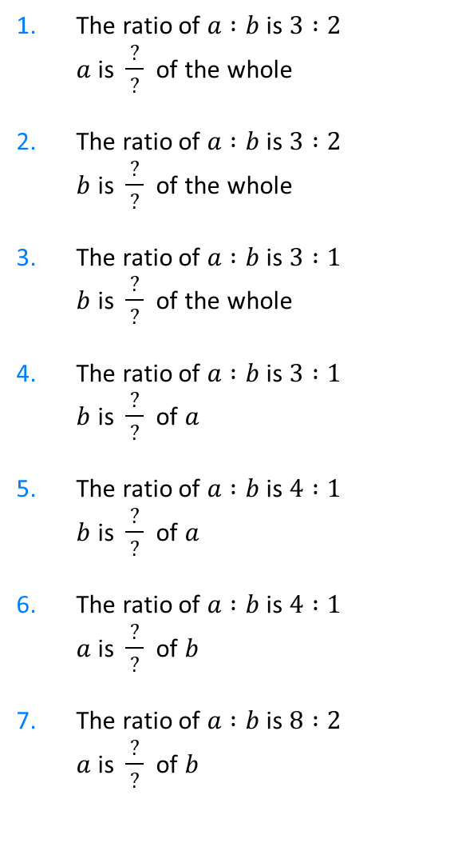
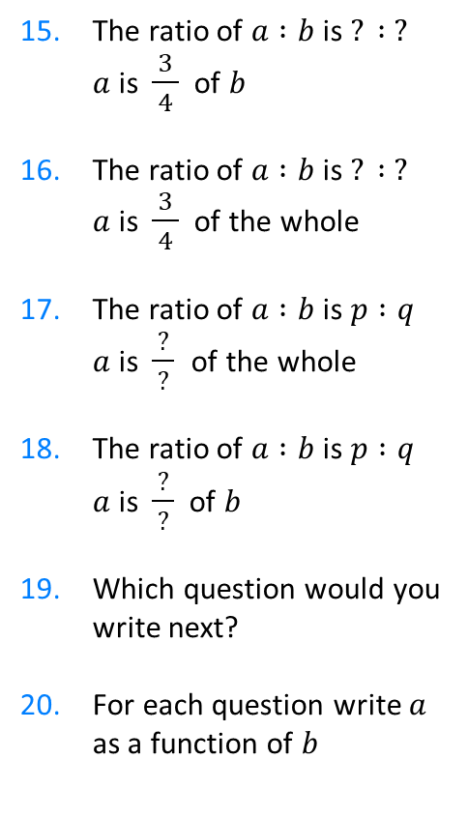
1. The ratio of $a :b$ is $3 :2$
$a$ is $\frac{ ? }{?}$ of the whole
2. The ratio of $a :b$ is $3 :2$
$b$ is $\frac{ ? }{?}$ of the whole
3. The ratio of $a :b$ is $3 :1$
$b$ is $\frac{ ? }{?}$ of the whole
4. The ratio of $a :b$ is $3 :1$
$b$ is $\frac{ ? }{?}$ of $a$
5. The ratio of $a :b$ is $4 :1$
$b$ is $\frac{ ? }{?}$ of $a$
6. The ratio of $a :b$ is $4 :1$
$a$ is $\frac{ ? }{?}$ of $b$
7. The ratio of $a :b$ is $8 :2$
$a$ is $\frac{ ? }{?}$ of $b$
8. The ratio of $a :b$ is $2 :8$
$a$ is $\frac{ ? }{?}$ of $b$
9. The ratio of $a :b$ is $3 :9$
$a$ is $\frac{ ? }{?}$ of $b$
10. The ratio of $a :b$ is $3 :10$
$a$ is $\frac{ ? }{?}$ of $b$
11. The ratio of $a :b$ is $3 :10$
$b$ is $\frac{ ? }{?}$ of $a$
12. The ratio of $a :b$ is $3 :10$
$b$ is $\frac{ ? }{?}$ of the whole
13. The ratio of $a :b$ is $10 :3$
$b$ is $\frac{ ? }{?}$ of the whole
14. The ratio of $a :b$ is $10 :3$
the whole is $\frac{ ? }{?}$ of $b$
15. The ratio of $a :b$ is $? : ?$
$a$ is $\frac{ 3 }{4}$ of $b$
16. The ratio of $a :b$ is $? : ?$
$a$ is $\frac{ 3 }{4}$ of the whole
17. The ratio of $a :b$ is $p :q$
$a$ is $\frac{ ? }{?}$ of the whole
18. The ratio of $a :b$ is $p :q$
$a$ is $\frac{ ? }{?}$ of $b$
19. Which question would you write next?
20. For each question write $a$ as a function of $b$
@mrbartonmaths

Slide 4

1. The ratio of $a :b$ is $3 :2$
$a$ is $\frac{ ? }{?}$ of the whole
2. The ratio of $a :b$ is $3 :2$
$b$ is $\frac{ ? }{?}$ of the whole
3. The ratio of $a :b$ is $3 :1$
$b$ is $\frac{ ? }{?}$ of the whole
4. The ratio of $a :b$ is $3 :1$
$b$ is $\frac{ ? }{?}$ of $a$
5. The ratio of $a :b$ is $4 :1$
$b$ is $\frac{ ? }{?}$ of $a$
6. The ratio of $a :b$ is $4 :1$
$a$ is $\frac{ ? }{?}$ of $b$
7. The ratio of $a :b$ is $8 :2$
$a$ is $\frac{ ? }{?}$ of $b$
8. The ratio of $a :b$ is $2 :8$
$a$ is $\frac{ ? }{?}$ of $b$
9. The ratio of $a :b$ is $3 :9$
$a$ is $\frac{ ? }{?}$ of $b$
10. The ratio of $a :b$ is $3 :10$
$a$ is $\frac{ ? }{?}$ of $b$
11. The ratio of $a :b$ is $3 :10$
$b$ is $\frac{ ? }{?}$ of $a$
12. The ratio of $a :b$ is $3 :10$
$b$ is $\frac{ ? }{?}$ of the whole
13. The ratio of $a :b$ is $10 :3$
$b$ is $\frac{ ? }{?}$ of the whole
14. The ratio of $a :b$ is $10 :3$
the whole is $\frac{ ? }{?}$ of $b$
15. The ratio of $a :b$ is $? : ?$
$a$ is $\frac{ 3 }{4}$ of $b$
16. The ratio of $a :b$ is $? : ?$
$a$ is $\frac{ 3 }{4}$ of the whole
17. The ratio of $a :b$ is $p :q$
$a$ is $\frac{ ? }{?}$ of the whole
18. The ratio of $a :b$ is $p :q$
$a$ is $\frac{ ? }{?}$ of $b$
19. Which question would you write next?
20. For each question write $a$ as a function of $b$
$$3 :4$$
$$\frac{3}{5}$$
$$\frac{2}{8}$$
$$3 :1$$
$$\frac{2}{5}$$
$$\frac{3}{9}$$
$$\frac{1}{4}$$
$$\frac{3}{10}$$
$$\frac{p}{p+q}$$
$$\frac{1}{3}$$
$$\frac{10}{3}$$
$$\frac{p}{q}$$
$$\frac{1}{4}$$
$$\frac{10}{13}$$
$$\frac{4}{1}$$
$$\frac{3}{13}$$
$$\frac{8}{2}$$
$$\frac{13}{3}$$
@mrbartonmaths

