Slide 1
Transformations: Reflections with coordinates
Silent
Teacher
Intelligent Practice
Narration
Your Turn
Practice

Slide 2
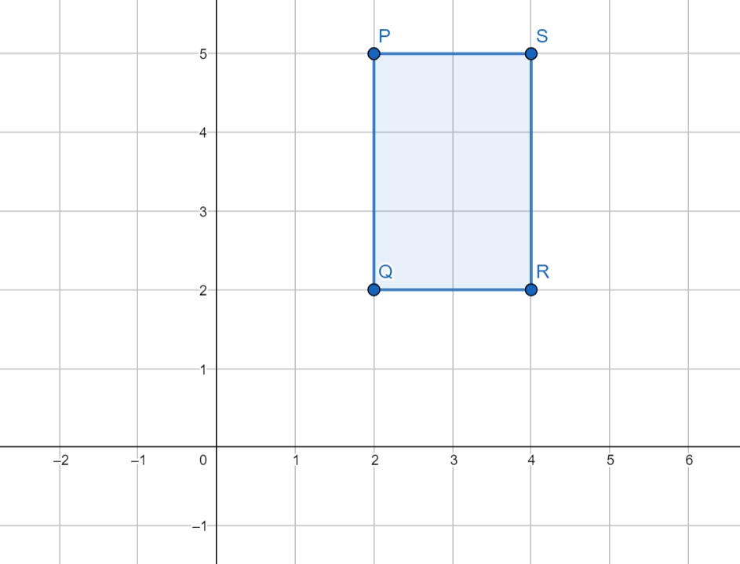
Worked Example
Your turn
The coordinates of the vertices of Shape 0 are: $(2, 5)$, $(2, 2)$, $(4, 2)$ and $(4, 5)$
The coordinates of the vertices of Shape 0 are: $(2, 5)$, $(2, 2)$, $(4, 2)$ and $(4, 5)$
Describe the reflection that transforms Shape 0 to a shape with vertices:
$(0, 5)$, $(0, 2)$, $(−2, 2)$ and $(−2, 5)$
Describe the reflection that transforms Shape 0 to a shape with vertices:
$(2, −3)$, $(2, 0)$, $(4, 0)$ and $(4, −3)$
@mrbartonmaths

Slide 3
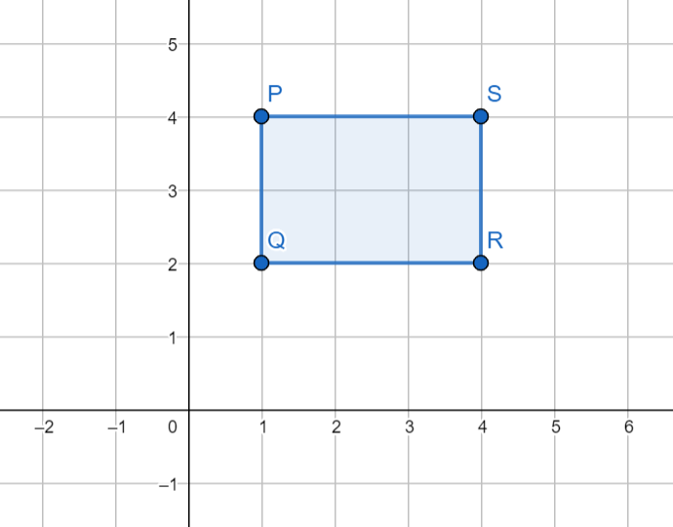
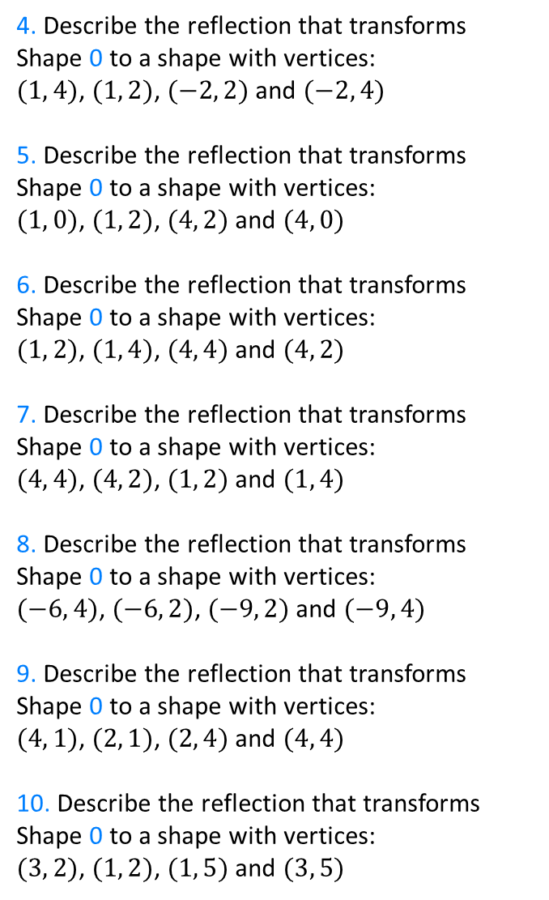
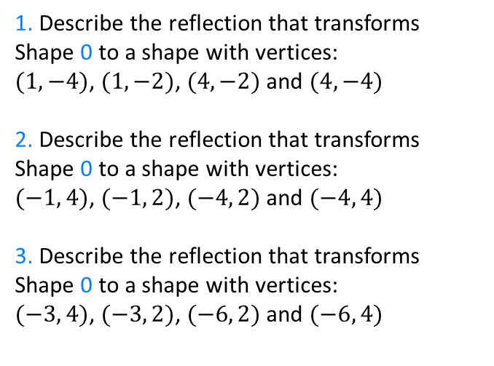
The coordinates of the vertices of Shape 0 are: $(1, 4)$, $(1, 2)$, $(4, 2)$ and $(4, 4)$
4. Describe the reflection that transforms Shape 0 to a shape with vertices:
$(1, 4)$, $(1, 2)$, $(−2, 2)$ and $(−2, 4)$
5. Describe the reflection that transforms Shape 0 to a shape with vertices:
$(1, 0)$, $(1, 2)$, $(4, 2)$ and $(4, 0)$
6. Describe the reflection that transforms Shape 0 to a shape with vertices:
$(1, 2)$, $(1, 4)$, $(4, 4)$ and $(4, 2)$
7. Describe the reflection that transforms Shape 0 to a shape with vertices:
$(4, 4)$, $(4, 2)$, $(1, 2)$ and $(1, 4)$
8. Describe the reflection that transforms Shape 0 to a shape with vertices:
$(−6, 4)$, $(−6, 2)$, $(−9, 2)$ and $(−9, 4)$
9. Describe the reflection that transforms Shape 0 to a shape with vertices:
$(4, 1)$, $(2, 1)$, $(2, 4)$ and $(4, 4)$
10. Describe the reflection that transforms Shape 0 to a shape with vertices:
$(3, 2)$, $(1, 2)$, $(1, 5)$ and $(3, 5)$
0
1. Describe the reflection that transforms Shape 0 to a shape with vertices:
$(1, −4)$, $(1, −2)$, $(4, −2)$ and $(4, −4)$
2. Describe the reflection that transforms Shape 0 to a shape with vertices:
$(−1, 4)$, $(−1, 2)$, $(−4, 2)$ and $(−4, 4)$
3. Describe the reflection that transforms Shape 0 to a shape with vertices:
$(−3, 4)$, $(−3, 2)$, $(−6, 2)$ and $(−6, 4)$

Slide 4
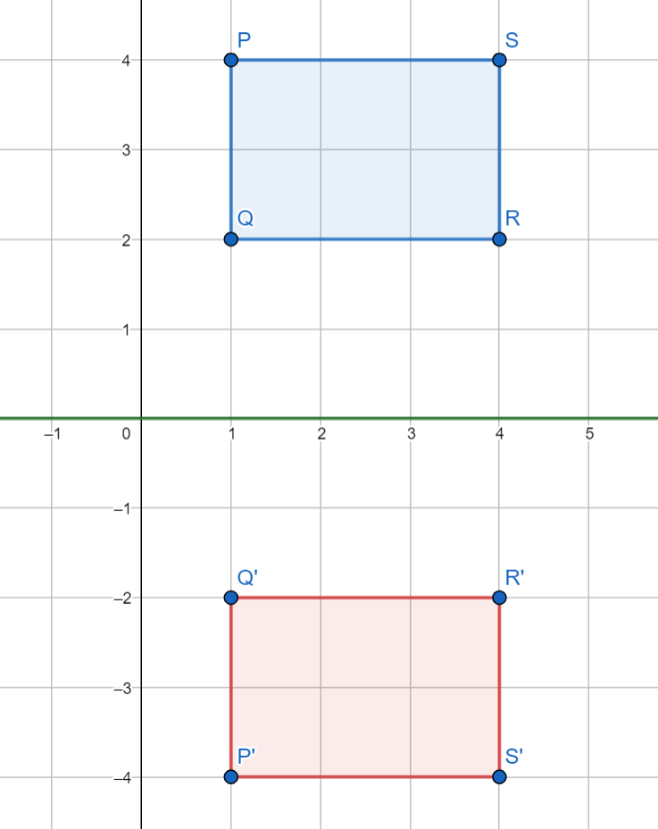
The coordinates of the vertices of Shape 0 are: $(1, 4)$, $(1, 2)$, $(4, 2)$ and $(4, 4)$
1. Describe the reflection that transforms Shape 0 to a shape with vertices:
$(1, −4)$, $(1, −2)$, $(4, −2)$ and $(4, −4)$
Reflection in the line $y=0$
0
0

Slide 5
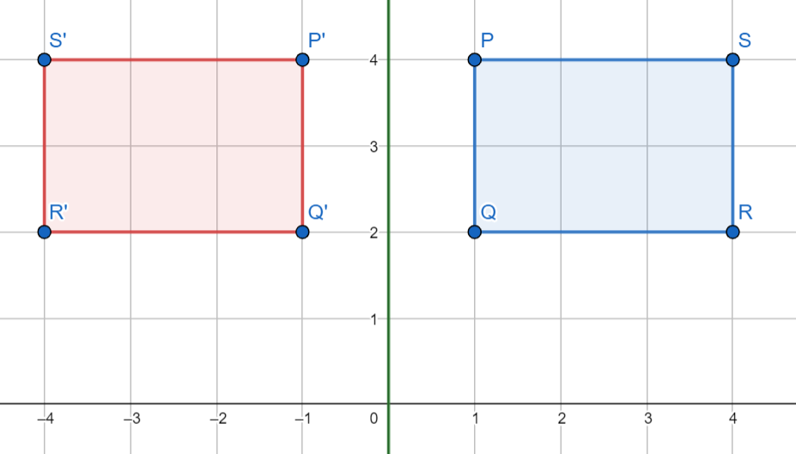
The coordinates of the vertices of Shape 0 are: $(1, 4)$, $(1, 2)$, $(4, 2)$ and $(4, 4)$
2. Describe the reflection that transforms Shape 0 to a shape with vertices:
$(−1, 4)$, $(−1, 2)$, $(−4, 2)$ and $(−4, 4)$
Reflection in the line $x=0$
0
0

Slide 6
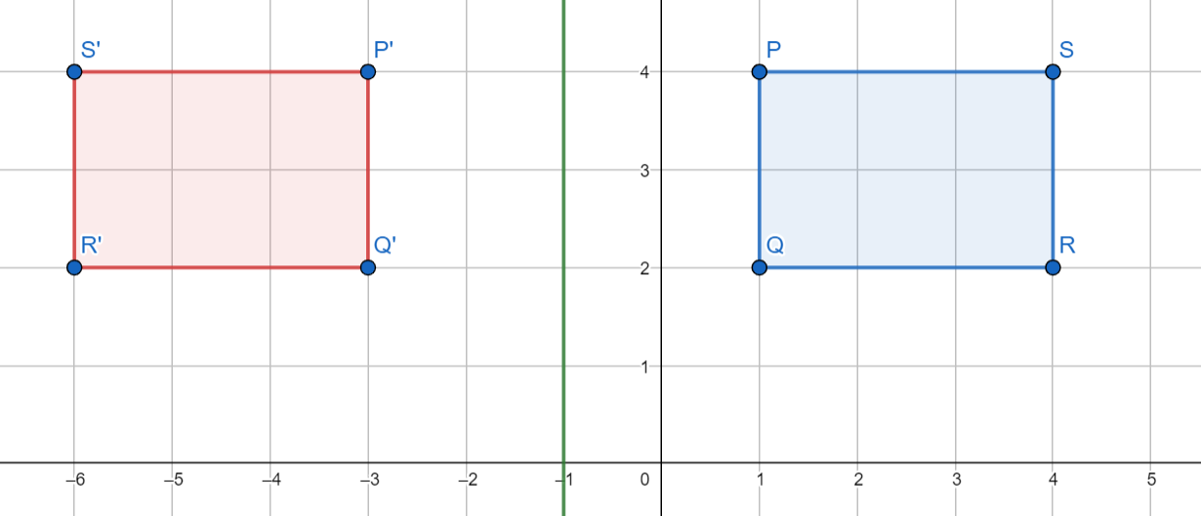
The coordinates of the vertices of Shape 0 are: $(1, 4)$, $(1, 2)$, $(4, 2)$ and $(4, 4)$
3. Describe the reflection that transforms Shape 0 to a shape with vertices:
$(−3, 4)$, $(−3, 2)$, $(−6, 2)$ and $(−6, 4)$
Reflection in the line $x=−1$
0
0

Slide 7
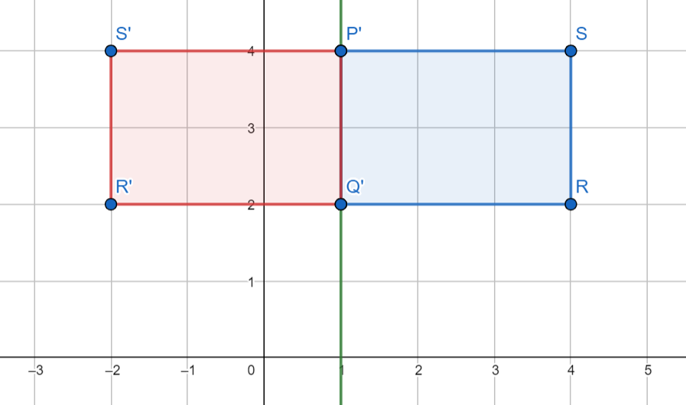
The coordinates of the vertices of Shape 0 are: $(1, 4)$, $(1, 2)$, $(4, 2)$ and $(4, 4)$
4. Describe the reflection that transforms Shape 0 to a shape with vertices:
$(1, 4)$, $(1, 2)$, $(−2, 2)$ and $(−2, 4)$
Reflection in the line $x=1$
0
0

Slide 8
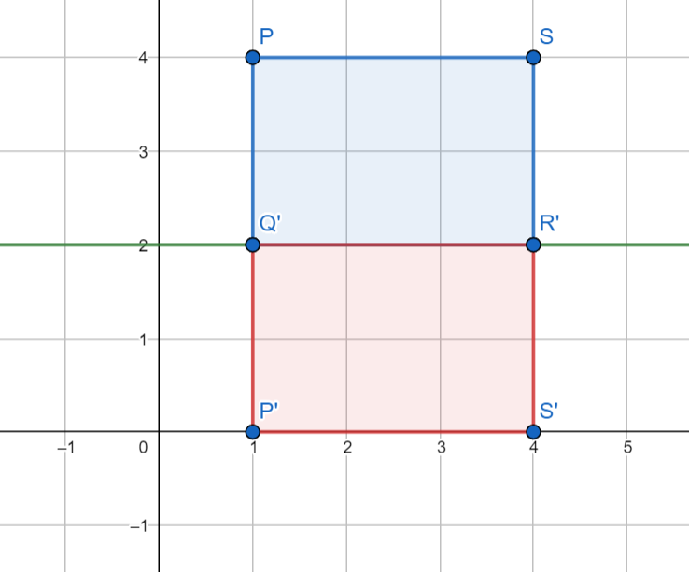
The coordinates of the vertices of Shape 0 are: $(1, 4)$, $(1, 2)$, $(4, 2)$ and $(4, 4)$
5. Describe the reflection that transforms Shape 0 to a shape with vertices:
$(1, 0)$, $(1, 2)$, $(4, 2)$ and $(4, 0)$
Reflection in the line $y=2$
0
0

Slide 9
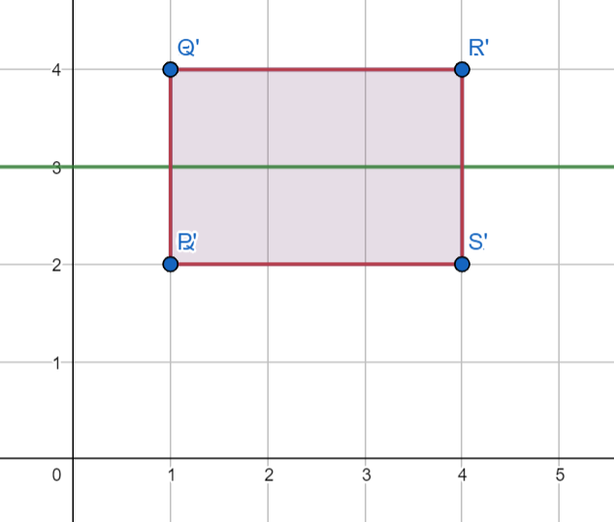
The coordinates of the vertices of Shape 0 are: $(1, 4)$, $(1, 2)$, $(4, 2)$ and $(4, 4)$
6. Describe the reflection that transforms Shape 0 to a shape with vertices:
$(1, 2)$, $(1, 4)$, $(4, 4)$ and $(4, 2)$
Reflection in the line $y=3$
0
0

Slide 10
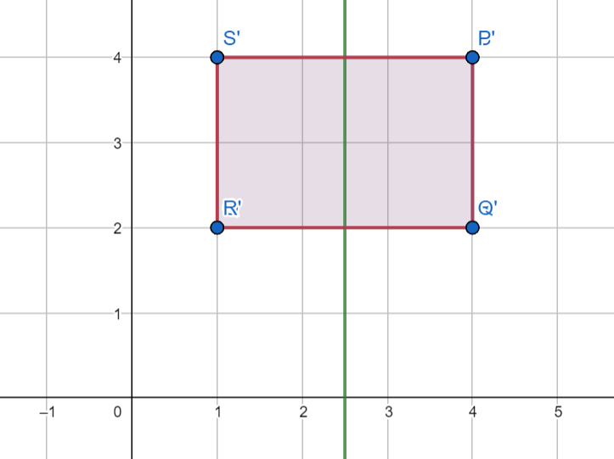
The coordinates of the vertices of Shape 0 are: $(1, 4)$, $(1, 2)$, $(4, 2)$ and $(4, 4)$
7. Describe the reflection that transforms Shape 0 to a shape with vertices:
$(4, 4)$, $(4, 2)$, $(1, 2)$ and $(1, 4)$
Reflection in the line $x=2.5$
0
0

Slide 11
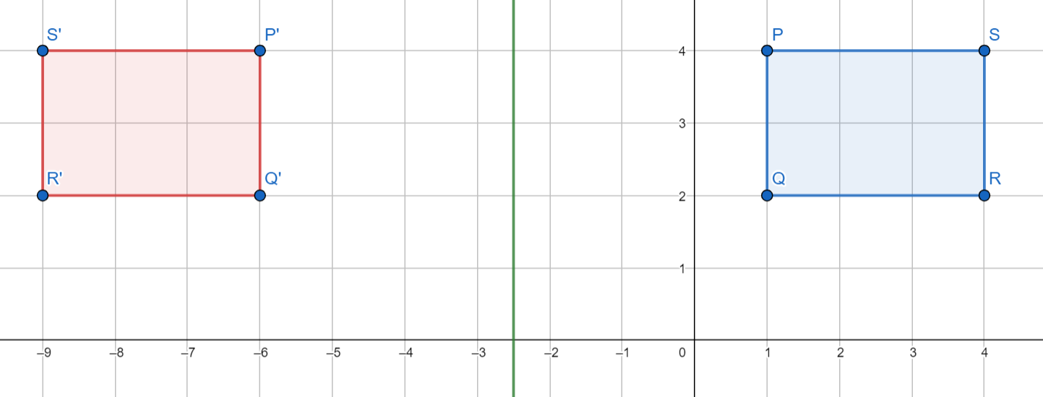
The coordinates of the vertices of Shape 0 are: $(1, 4)$, $(1, 2)$, $(4, 2)$ and $(4, 4)$
8. Describe the reflection that transforms Shape 0 to a shape with vertices:
$(−6, 4)$, $(−6, 2)$, $(−9, 2)$ and $(−9, 4)$
Reflection in the line $x=−2.5$
0
0

Slide 12
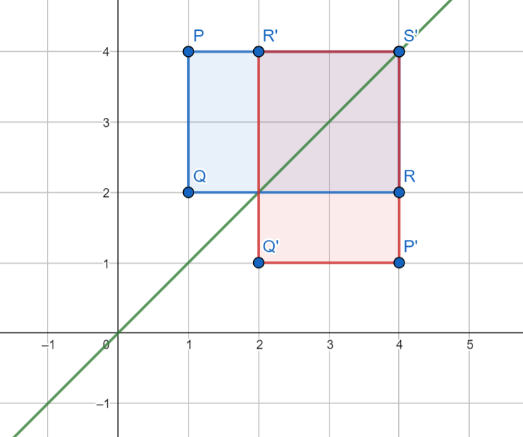
The coordinates of the vertices of Shape 0 are: $(1, 4)$, $(1, 2)$, $(4, 2)$ and $(4, 4)$
9. Describe the reflection that transforms Shape 0 to a shape with vertices:
$(4, 1)$, $(2, 1)$, $(2, 4)$ and $(4, 4)$
Reflection in the line $y=x$
0
0

Slide 13
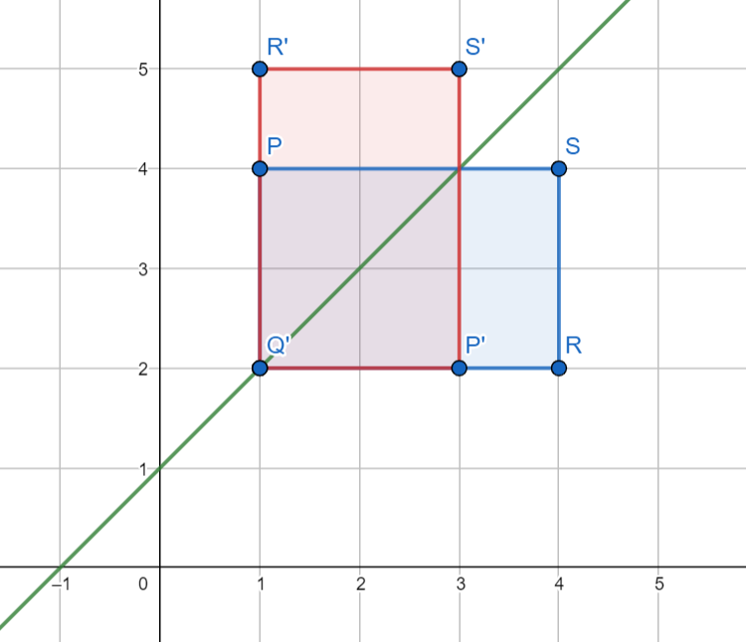
The coordinates of the vertices of Shape 0 are: $(1, 4)$, $(1, 2)$, $(4, 2)$ and $(4, 4)$
10. Describe the reflection that transforms Shape 0 to a shape with vertices:
$(3, 2)$, $(1, 2)$, $(1, 5)$ and $(3, 5)$
Reflection in the line $y=x+1$
0
0

