Slide 1
Surface area : Surface area of a prism
Silent
Teacher
Intelligent Practice
Narration
Your Turn
Practice

Slide 2
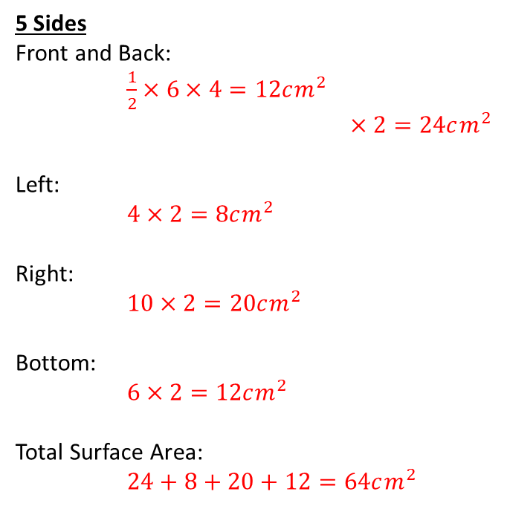
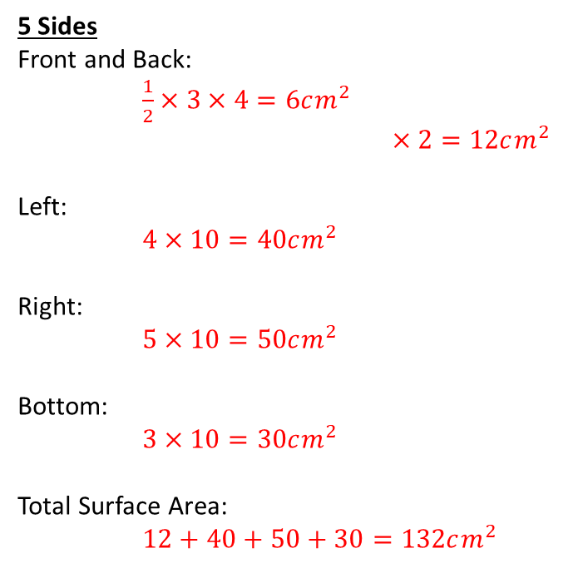
Worked Example
Your Turn
5cm
10cm
4cm
4cm
10cm
2cm
3cm
6cm
5 Sides
Front and Back:
$\frac{1}{2}×3×4=6cm^{2}$
$×2=12cm^{2}$
Left:
$4×10=40cm^{2}$
Right:
$5×10=50cm^{2}$
Bottom:
$3×10=30cm^{2}$
Total Surface Area:
$12+40+50+30=132cm^{2}$
5 Sides
Front and Back:
$\frac{1}{2}×6×4=12cm^{2}$
$×2=24cm^{2}$
Left:
$4×2=8cm^{2}$
Right:
$10×2=20cm^{2}$
Bottom:
$6×2=12cm^{2}$
Total Surface Area:
$24+8+20+12=64cm^{2}$

Slide 3
2cm
10cm
4cm
5cm
4cm
4cm
2cm
4cm
4cm
4cm
6cm
6cm
6cm
2cm
10cm
4cm
5cm
4cm
4cm
8cm
2cm
2cm
6cm
6cm
6cm
2cm
10cm
3cm
3cm
4cm
4cm
8cm
2cm
2cm
6cm
6cm
6cm
Notes:
CHALLENGE: Draw different triangular prisms with a volume of 60cm³. Put them in order from smallest surface area to largest. Which triangular prism with volume 60cm³ has the smallest possible surface area? Is it possible to have a largest? Why/Why not?

Slide 4
2cm
10cm
4cm
104cm²
5cm
88cm²
4cm
4cm
2cm
112cm²
4cm
4cm
4cm
6cm
6cm
6cm
2cm
10cm
4cm
184cm²
5cm
4cm
4cm
56cm²
2cm
72cm²
8cm
2cm
2cm
6cm
6cm
6cm
2cm
10cm
3cm
170cm²
3cm
48cm²
4cm
4cm
3cm
80cm²
8cm
2cm
2cm
6cm
6cm
6cm

