Slide 1
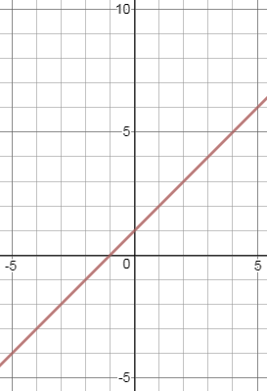
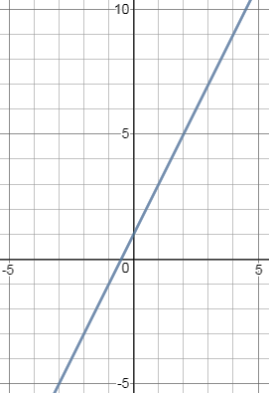
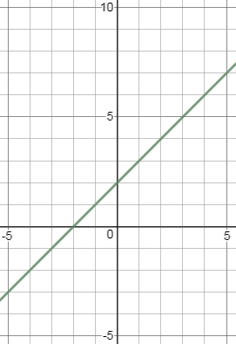
Equation of a straight line from a graph
Silent
Teacher
Intelligent Practice
Narration
Your Turn
Practice
$$y=x+1$$
$$y=2x+1$$
$$y=x+2$$

Slide 2
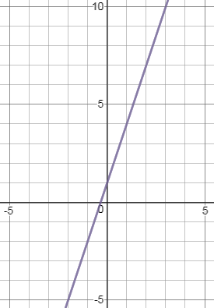
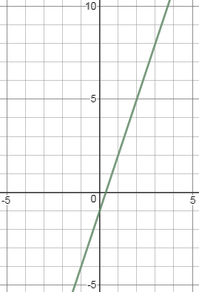
Worked Example
Your Turn
What is the equation of the graph?
What is the equation of the graph?
-1
3
1
Gradient is $\frac{3}{1}=3$
$y$-intercept is $−1$
Equation is $y=3x−1$

Slide 3
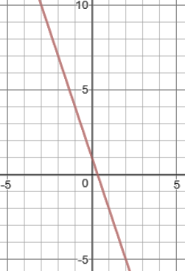
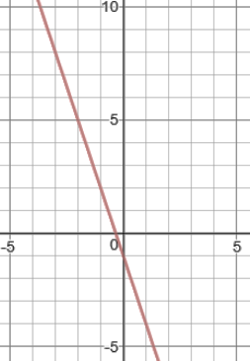
Worked Example
Your Turn
What is the equation of the graph?
What is the equation of the graph?
-1
1
3
Gradient is $−\frac{3}{1}=−3$
$y$-intercept is $−1$
Equation is $y=−3x−1$

Slide 4
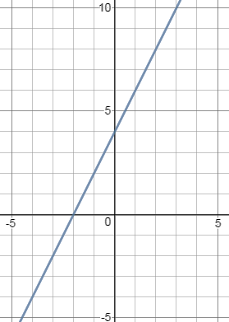
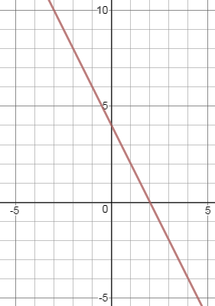
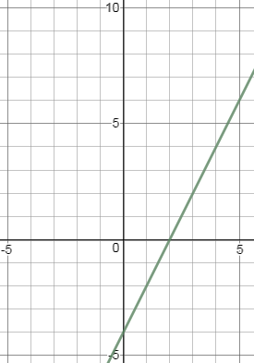
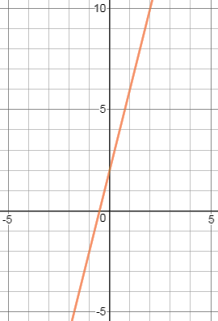
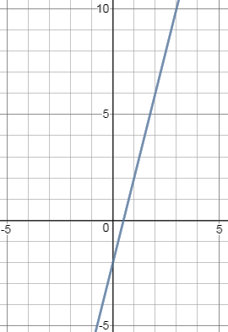
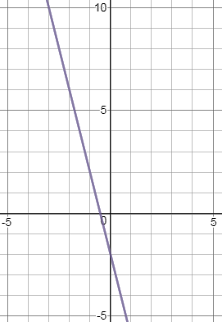
Find the equation of each line
1
2
3
4
5
6

Slide 5
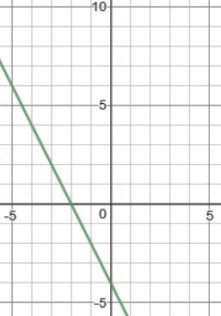
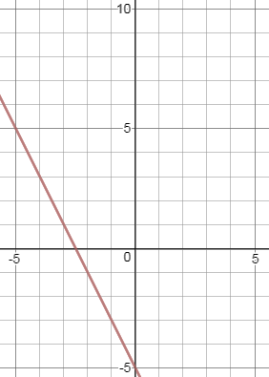
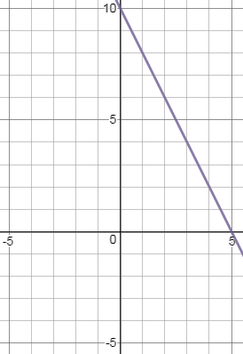
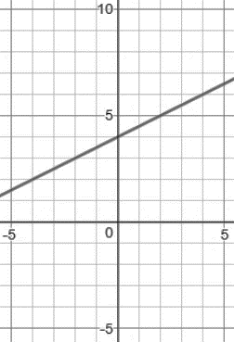
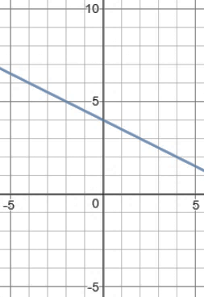
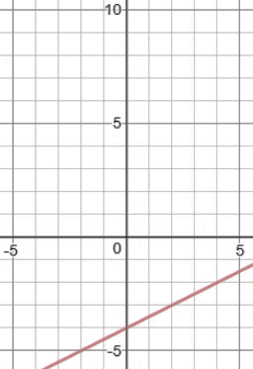
Find the equation of each line
7
8
9
10
12
11

Slide 6
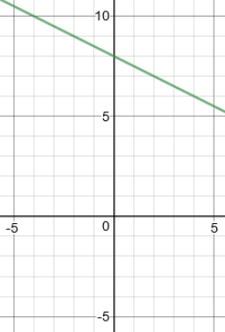
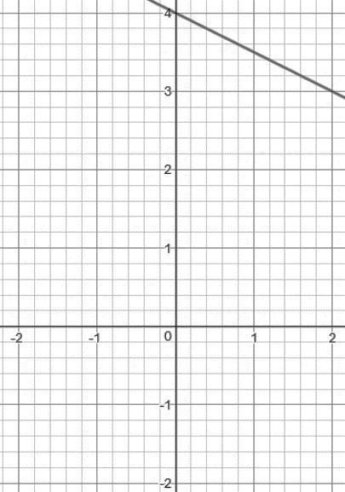
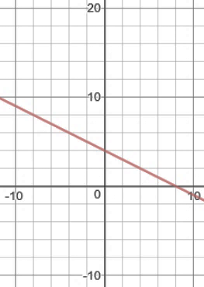
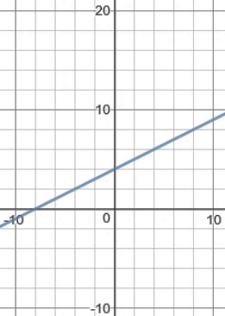
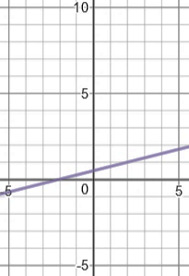
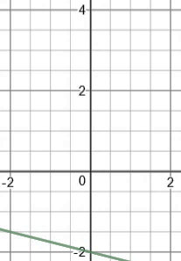
Find the equation of each line
13
14
15
16
17

Slide 7
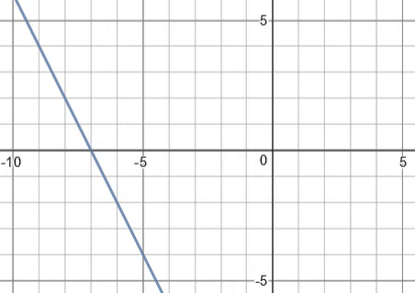
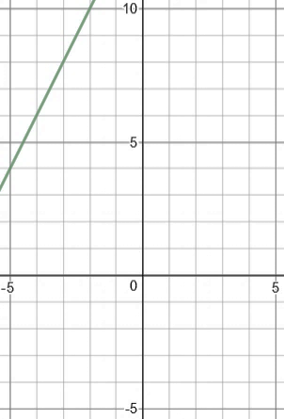
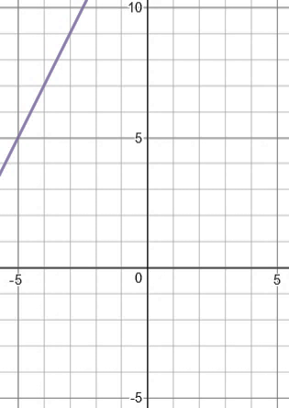
Challenge Questions
Find the equation of each line
19
20
21

Slide 8
Find the equation of each line
1
2
3
$$y=2x−4$$
$$y=2x+4$$
$$y=−2x+4$$
4
5
6
$$y=−4x−2$$
$$y=4x−2$$
$$y=4x+2$$

Slide 9
Find the equation of each line
7
8
9
$$y=−2x−4$$
$$y=−2x−5$$
$$y=−2x+10$$
10
12
11
$$y=\frac{1}{2}x−4$$
$$y=\frac{1}{2}x+4$$
$$y=−\frac{1}{2}x+4$$

Slide 10
Find the equation of each line
13
14
15
$$y=−\frac{1}{2}x+4$$
$$y=−\frac{1}{2}x+8$$
$$y=−\frac{1}{2}x+4$$
16
17
18
$$y=\frac{1}{4}x+\frac{1}{2}$$
$$y=−\frac{1}{4}x−2$$
$$y=\frac{1}{2}x+4$$

Slide 11
Challenge Questions
Find the equation of each line
19
20
21
$$y=−2x−14$$
$$y=2x+14$$
$$y=2x+15$$

