Slide 1
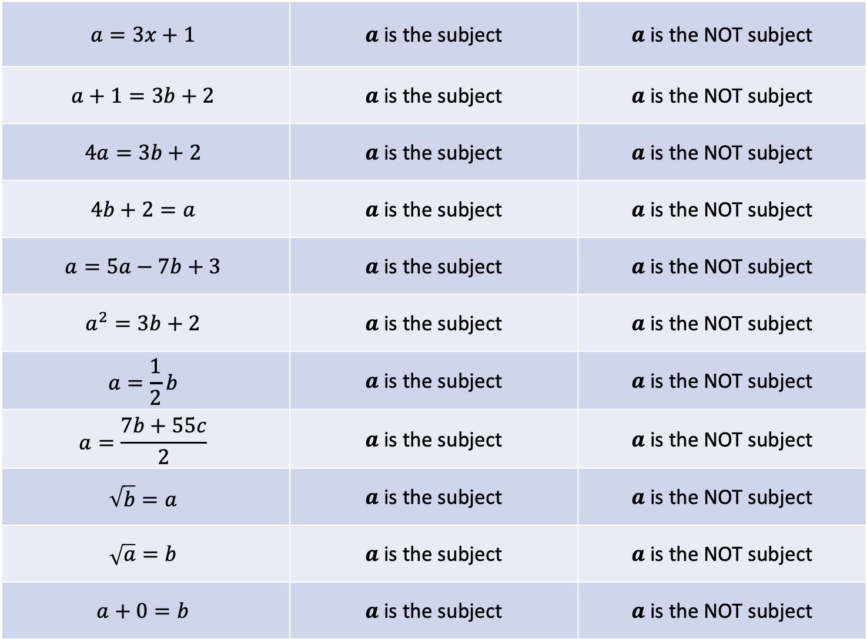
$$a=3x+1$$ | $a$ is the subject | $a$ is the NOT subject
$$a+1=3b+2$$ | $a$ is the subject | $a$ is the NOT subject
$$4a=3b+2$$ | $a$ is the subject | $a$ is the NOT subject
$$4b+2=a$$ | $a$ is the subject | $a$ is the NOT subject
$$a=5a−7b+3$$ | $a$ is the subject | $a$ is the NOT subject
$$a^{2}=3b+2$$ | $a$ is the subject | $a$ is the NOT subject
$$a=\frac{1}{2}b$$ | $a$ is the subject | $a$ is the NOT subject
$$a=\frac{7b+55c}{2}$$ | $a$ is the subject | $a$ is the NOT subject
$$\sqrt{b}=a$$ | $a$ is the subject | $a$ is the NOT subject
$$\sqrt{a}=b$$ | $a$ is the subject | $a$ is the NOT subject
$$a+0=b$$ | $a$ is the subject | $a$ is the NOT subject

