Slide 1
Changing the Subject of a Formula: One Step Subtraction
Silent
Teacher
Intelligent Practice
Narration
Your Turn
$$x+y=3$$
$$x+y=a$$
$$a=x+y$$
Practice

Slide 2
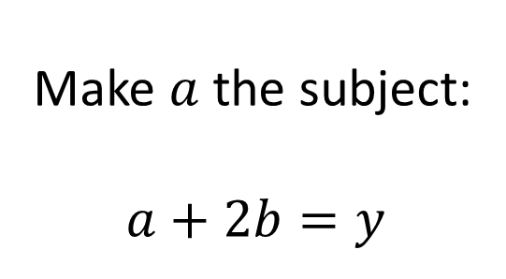
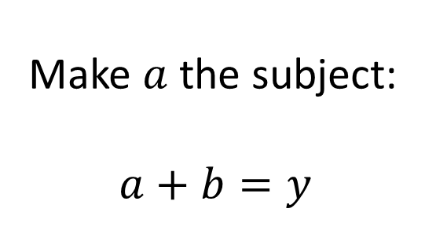
Worked Example
Your Turn
Make $a$ the subject:
$$a+b=y$$
Make $a$ the subject:
$$a+2b=y$$
@fortyninecubed

Slide 3


Make $x$ the subject:
$$x+y=3$$
$$x+y=a$$
$$a=x+y$$
$$a+b=x+y$$
$$a+b+c=x+y$$
$$a+b+c=x+2y$$
$$a^{2}+b=x+2y$$
$$a^{2}b=x+2y$$
$$a^{2}b=2y+x$$
$$\frac{a^{2}b}{5}=2y+x$$
$$a^{2}b=\frac{2y}{5}+x$$
$$\frac{a^{2}b}{5}=\frac{2y}{5}+x$$
@fortyninecubed

Slide 4



Make $x$ the subject:
$$x+y=3$$
$$x+y=a$$
$$a=x+y$$
$$a+b=x+y$$
$$a+b+c=x+y$$
$$a+b+c=x+2y$$
$$a^{2}+b=x+2y$$
$$a^{2}b=x+2y$$
$$a^{2}b=2y+x$$
$$\frac{a^{2}b}{5}=2y+x$$
$$a^{2}b=\frac{2y}{5}+x$$
$$\frac{a^{2}b}{5}=\frac{2y}{5}+x$$
$${x=a}^{2}+b−2y$$
$$x=a^{2}b−2y$$
$$x=a^{2}b−2y$$
$$x=\frac{a^{2}b}{5}−2y$$
$$x{=a}^{2}b−\frac{2y}{5}$$
$$x=\frac{a^{2}b−2y}{5}$$
$$x=3−y$$
$$x=a−y$$
$$x=a−y$$
$$x=a+b−y$$
$$x=a+b+c−y$$
$x=a+b+c−2y$
@fortyninecubed

