Slide 1
Determining if Vectors are Parallel
Silent
Teacher
Intelligent Practice
Narration
Your Turn
$$a+b$$ | $$2a+2b$$
$$a+b$$ | $$3a+3b$$
$$a+b$$ | $$3a−3b$$
Practice

Slide 2
Worked Example
Your Turn
Are $a+b and$
$5a+5b$parallel?
Are $a+b and$
$a+5b$parallel?
Are $a+b and$
$−a+b$parallel?
Are $a+b and$
$−a−b$parallel?
@fortyninecubed

Slide 3
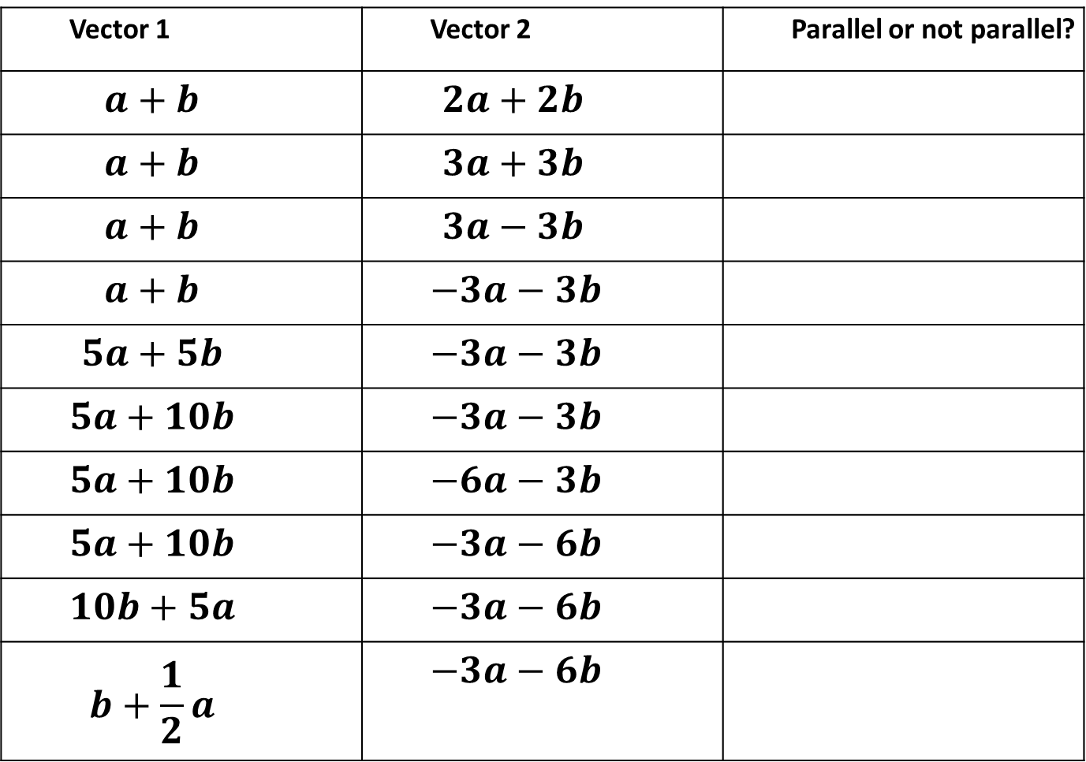
Vector 1 | Vector 2 | Parallel or not parallel?
$$a+b$$ | $$2a+2b$$
$$a+b$$ | $$3a+3b$$
$$a+b$$ | $$3a−3b$$
$$a+b$$ | $$−3a−3b$$
$$5a+5b$$ | $$−3a−3b$$
$$5a+10b$$ | $$−3a−3b$$
$$5a+10b$$ | $$−6a−3b$$
$$5a+10b$$ | $$−3a−6b$$
$$10b+5a$$ | $$−3a−6b$$
$$b+\frac{1}{2}a$$ | $$−3a−6b$$
@fortyninecubed

Slide 4
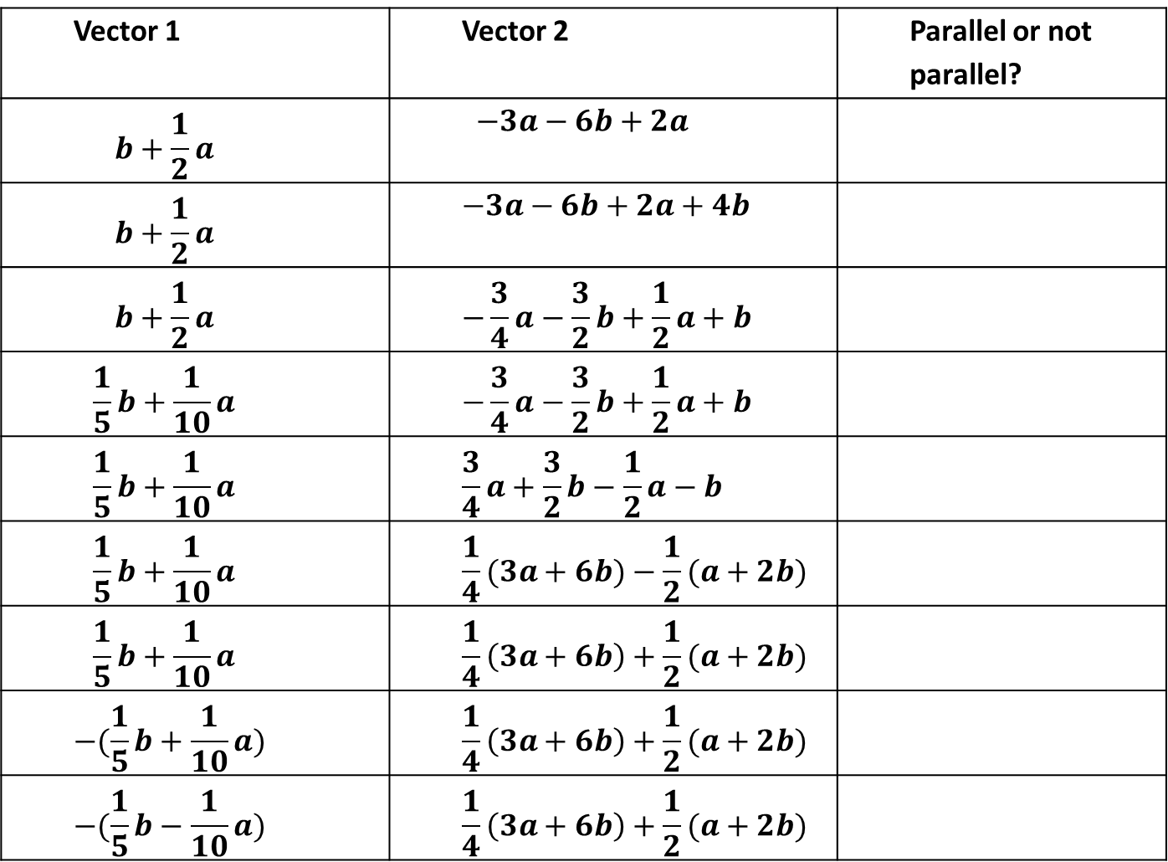
Vector 1 | Vector 2 | Parallel or not parallel?
$$b+\frac{1}{2}a$$ | $$−3a−6b+2a$$
$$b+\frac{1}{2}a$$ | $$−3a−6b+2a+4b$$
$$b+\frac{1}{2}a$$ | $$−\frac{3}{4}a−\frac{3}{2}b+\frac{1}{2}a+b$$
$$\frac{1}{5}b+\frac{1}{10}a$$ | $$−\frac{3}{4}a−\frac{3}{2}b+\frac{1}{2}a+b$$
$$\frac{1}{5}b+\frac{1}{10}a$$ | $$\frac{3}{4}a+\frac{3}{2}b−\frac{1}{2}a−b$$
$$\frac{1}{5}b+\frac{1}{10}a$$ | $$\frac{1}{4}(3a+6b)−\frac{1}{2}(a+2b)$$
$$\frac{1}{5}b+\frac{1}{10}a$$ | $$\frac{1}{4}\left(3a+6b\right)+\frac{1}{2}(a+2b)$$
$$−(\frac{1}{5}b+\frac{1}{10}a)$$ | $$\frac{1}{4}\left(3a+6b\right)+\frac{1}{2}(a+2b)$$
$$−(\frac{1}{5}b−\frac{1}{10}a)$$ | $$\frac{1}{4}\left(3a+6b\right)+\frac{1}{2}(a+2b)$$
@fortyninecubed

Slide 5
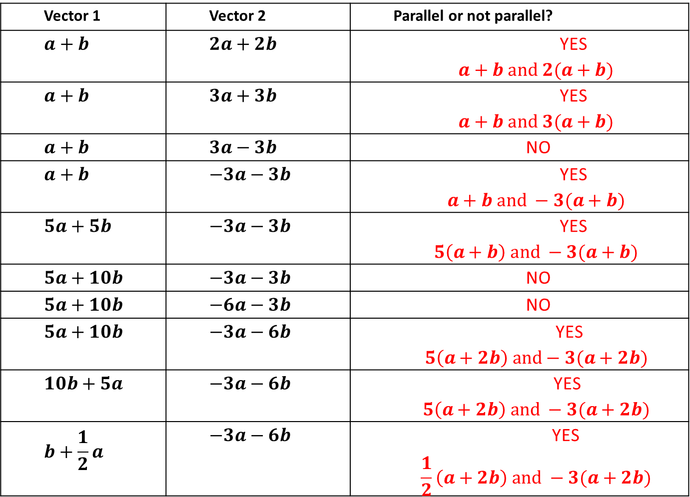
Vector 1 | Vector 2 | Parallel or not parallel?
$$a+b$$ | $$2a+2b$$ | YES $$a+b and 2(a+b)$$
$$a+b$$ | $$3a+3b$$ | YES $$a+b and 3(a+b)$$
$$a+b$$ | $$3a−3b$$ | NO
$$a+b$$ | $$−3a−3b$$ | YES $$a+b and −3(a+b)$$
$$5a+5b$$ | $$−3a−3b$$ | YES $$5\left(a+b\right) and −3(a+b)$$
$$5a+10b$$ | $$−3a−3b$$ | NO
$$5a+10b$$ | $$−6a−3b$$ | NO
$$5a+10b$$ | $$−3a−6b$$ | YES $$5\left(a+2b\right) and−3(a+2b)$$
$$10b+5a$$ | $$−3a−6b$$ | YES $$5\left(a+2b\right) and −3(a+2b)$$
$$b+\frac{1}{2}a$$ | $$−3a−6b$$ | YES $$\frac{1}{2}\left(a+2b\right) and −3(a+2b)$$
@fortyninecubed

Slide 6
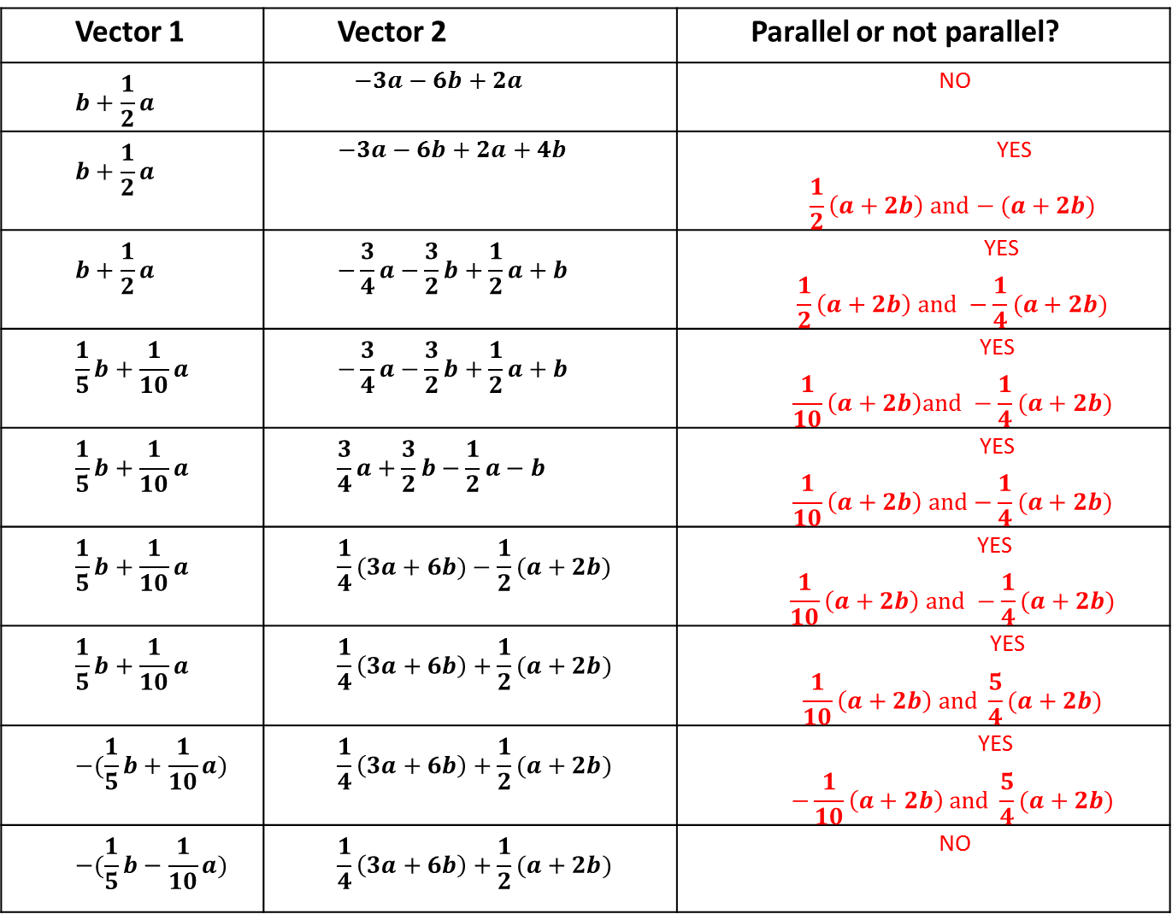
Vector 1 | Vector 2 | Parallel or not parallel?
$$b+\frac{1}{2}a$$ | $$−3a−6b+2a$$ | NO
$$b+\frac{1}{2}a$$ | $$−3a−6b+2a+4b$$ | YES $$\frac{1}{2}\left(a+2b\right) and−(a+2b)$$
$$b+\frac{1}{2}a$$ | $$−\frac{3}{4}a−\frac{3}{2}b+\frac{1}{2}a+b$$ | YES $$\frac{1}{2}\left(a+2b\right) and −\frac{1}{4}(a+2b)$$
$$\frac{1}{5}b+\frac{1}{10}a$$ | $$−\frac{3}{4}a−\frac{3}{2}b+\frac{1}{2}a+b$$ | YES $$\frac{1}{10}\left(a+2b\right)and −\frac{1}{4}(a+2b)$$
$$\frac{1}{5}b+\frac{1}{10}a$$ | $$\frac{3}{4}a+\frac{3}{2}b−\frac{1}{2}a−b$$ | YES $$\frac{1}{10}\left(a+2b\right) and−\frac{1}{4}(a+2b)$$
$$\frac{1}{5}b+\frac{1}{10}a$$ | $$\frac{1}{4}(3a+6b)−\frac{1}{2}(a+2b)$$ | YES $$\frac{1}{10}\left(a+2b\right) and −\frac{1}{4}(a+2b)$$
$$\frac{1}{5}b+\frac{1}{10}a$$ | $$\frac{1}{4}\left(3a+6b\right)+\frac{1}{2}(a+2b)$$ | YES $$\frac{1}{10}\left(a+2b\right) and \frac{5}{4}(a+2b)$$
$$−(\frac{1}{5}b+\frac{1}{10}a)$$ | $$\frac{1}{4}\left(3a+6b\right)+\frac{1}{2}(a+2b)$$ | YES $$−\frac{1}{10}\left(a+2b\right) and \frac{5}{4}(a+2b)$$
$$−(\frac{1}{5}b−\frac{1}{10}a)$$ | $$\frac{1}{4}\left(3a+6b\right)+\frac{1}{2}(a+2b)$$ | NO
@fortyninecubed

