Slide 1
Quadratic Equations from Functions
Silent
Teacher
Intelligent Practice
Narration
Your Turn
$$f\left(x\right)=3x+10$$
$$g\left(x\right)=2x^{2}$$
Solve: $fg\left(x\right)=f(x)$
Practice

Slide 2
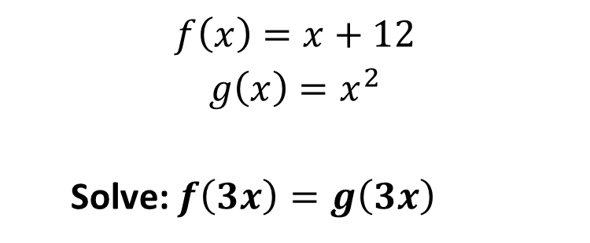
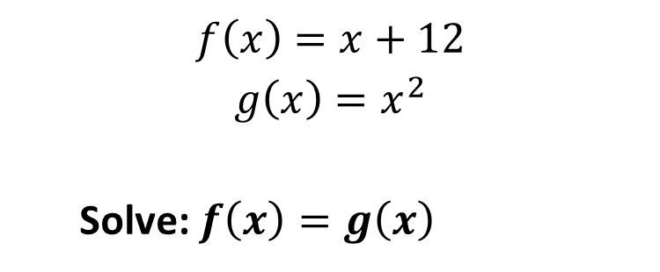
Worked Example
Your Turn
$$f\left(x\right)=x+12$$
$$g\left(x\right)=x^{2}$$
Solve: $f\left(x\right)=g\left(x\right)$
$$f\left(x\right)=x+12$$
$$g\left(x\right)=x^{2}$$
Solve: $f\left(3x\right)=g\left(3x\right)$
@fortyninecubed

Slide 3
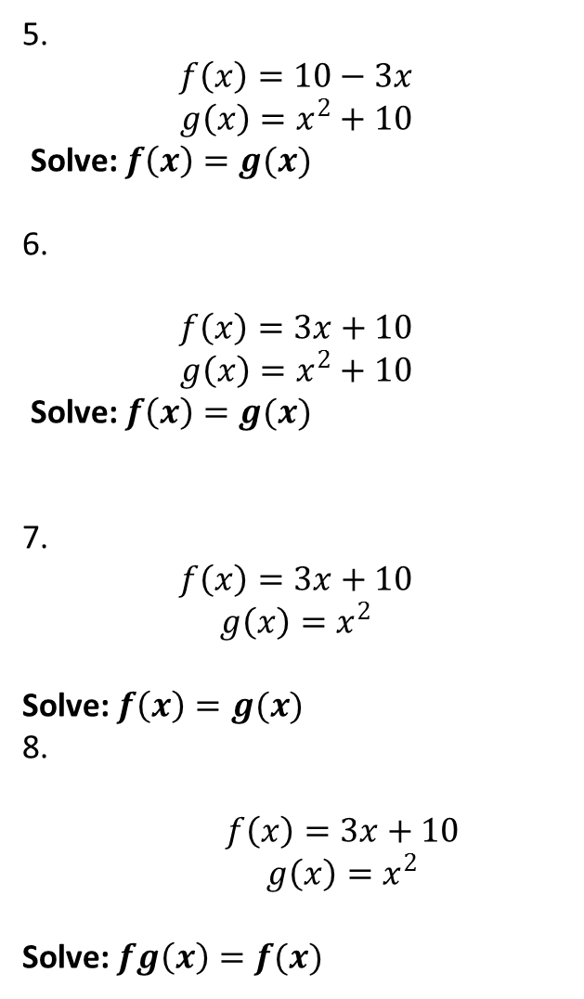
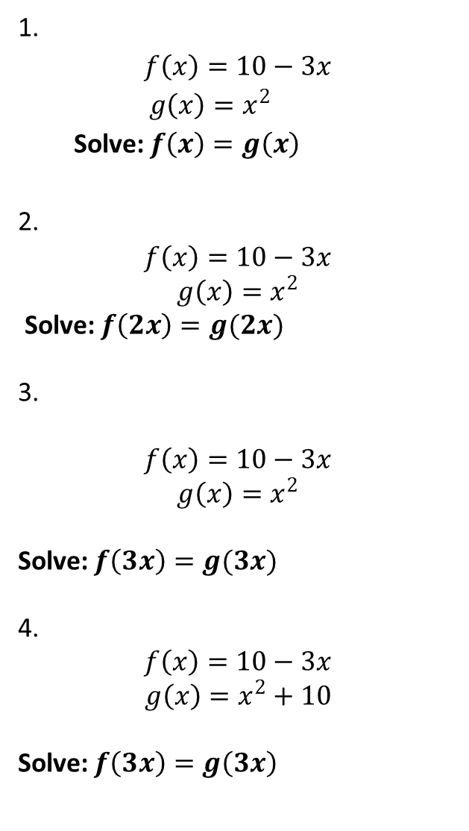
1.
$$f\left(x\right)=10−3x$$
$$g\left(x\right)=x^{2}$$
Solve: $f\left(x\right)=g\left(x\right)$
2.
$$f\left(x\right)=10−3x$$
$$g\left(x\right)=x^{2}$$
Solve: $f\left(2x\right)=g(2x)$
3.
$$f\left(x\right)=10−3x$$
$$g\left(x\right)=x^{2}$$
Solve: $f\left(3x\right)=g(3x)$
4.
$$f\left(x\right)=10−3x$$
$$g\left(x\right)=x^{2}+10$$
Solve: $f\left(3x\right)=g\left(3x\right)$
5.
$$f\left(x\right)=10−3x$$
$$g\left(x\right)=x^{2}+10$$
Solve: $f\left(x\right)=g(x)$
6.
$$f\left(x\right)=3x+10$$
$$g\left(x\right)=x^{2}+10$$
Solve: $f\left(x\right)=g(x)$
7.
$$f\left(x\right)=3x+10$$
$$g\left(x\right)=x^{2}$$
Solve: $f\left(x\right)=g(x)$
8.
$$f\left(x\right)=3x+10$$
$$g\left(x\right)=x^{2}$$
Solve: $fg\left(x\right)=f(x)$
@fortyninecubed

Slide 4
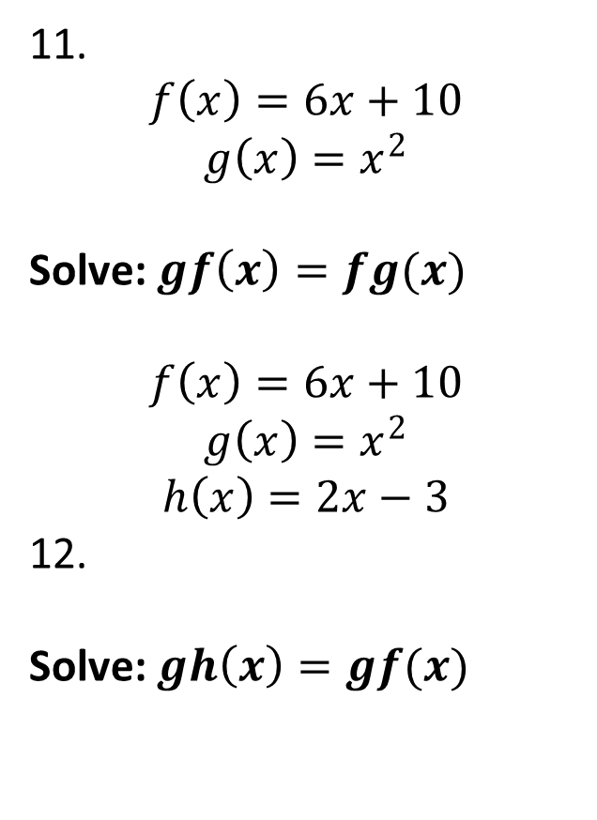
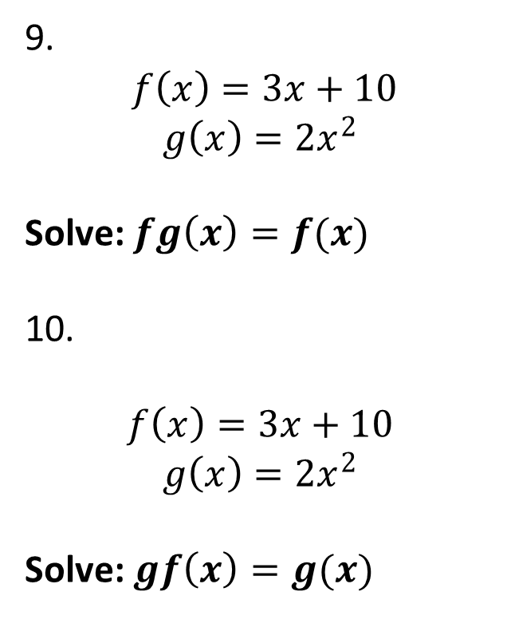
9.
$$f\left(x\right)=3x+10$$
$$g\left(x\right)=2x^{2}$$
Solve: $fg\left(x\right)=f(x)$
10.
$$f\left(x\right)=3x+10$$
$$g\left(x\right)=2x^{2}$$
Solve: $gf\left(x\right)=g(x)$
11.
$$f\left(x\right)=6x+10$$
$$g\left(x\right)=x^{2}$$
Solve: $gf\left(x\right)=fg(x)$
$$f\left(x\right)=6x+10$$
$$g\left(x\right)=x^{2}$$
$$h\left(x\right)=2x−3$$
12.
Solve: $gh\left(x\right)=gf(x)$
@fortyninecubed

Slide 5

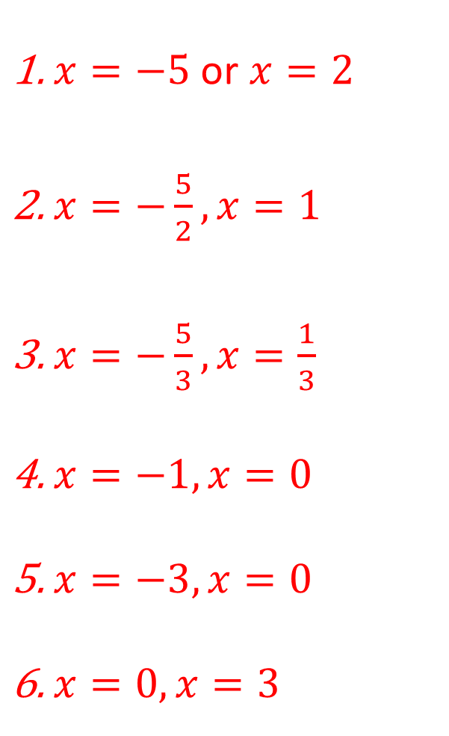
$x=−5$ or $x=2$
$x=−\frac{5}{2}, x=1$
$x=−\frac{5}{3}, x=\frac{1}{3}$
$x=−1, x=0$
$x=−3, x=0$
$x=0, x=3$
$x=−5$ or $x=2$
$x=0,x=1$
$x=0,x=\frac{1}{2}$
$x=−5, x=−\frac{5}{2}$
$x=−3, x=−1$
$x=−\frac{13}{4}, x=−\frac{7}{8}$
@fortyninecubed

