Slide 1
Vectors: Adding and subtracting
Silent
Teacher
Intelligent Practice
Narration
Your Turn
a) $\left({1 \atop 4}\right)+\left({2 \atop 3}\right)$ =
b) $\left({2 \atop 3}\right)+\left({1 \atop 4}\right)$ =
c) $\left({3 \atop 2}\right)+\left({1 \atop 4}\right)$ =
Practice

Slide 2
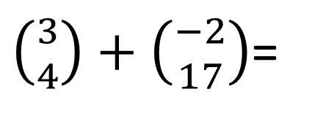
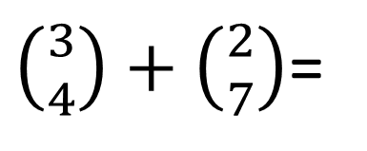
Worked Example
Your Turn
$\left({3 \atop 4}\right)+\left({2 \atop 7}\right)$=
$\left({3 \atop 4}\right)+\left({−2 \atop 17}\right)$=

Slide 3
a) $\left({1 \atop 4}\right)+\left({2 \atop 3}\right)$ =
h) $\left({−2 \atop −2}\right)+\left({−5 \atop 3}\right)$ =
b) $\left({2 \atop 3}\right)+\left({1 \atop 4}\right)$ =
i) $\left({−2 \atop −2}\right)+\left({−5 \atop −3}\right)$ =
c) $\left({3 \atop 2}\right)+\left({1 \atop 4}\right)$ =
j) $\left({7 \atop 6}\right)+\left({−7 \atop −6}\right)$ =
d) $\left({17 \atop 19}\right)+\left({1 \atop 4}\right)$ =
k) $\left({7 \atop 6}\right)−\left({−7 \atop −6}\right)$ =
e) $\left({17 \atop 19}\right)+\left({5 \atop 3}\right)$ =
l) $\left({11 \atop 10}\right)+\left({−7 \atop −6}\right)$ =
f) $\left({−2 \atop 2}\right)+\left({5 \atop 3}\right)$ =
m) $\left({11 \atop 10}\right)−\left({\frac{1}{2} \atop 2.5}\right)$ =
g) $\left({−2 \atop −2}\right)+\left({5 \atop 3}\right)$ =
n) $\left({\frac{1}{2} \atop 2}\right)−\left({\frac{1}{2} \atop 2.5}\right)$ =

Slide 4
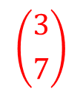
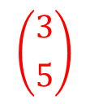
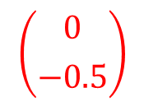
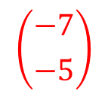
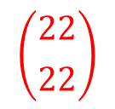

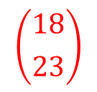
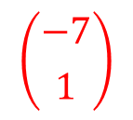
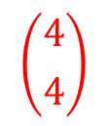
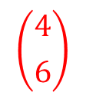
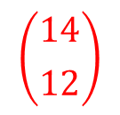
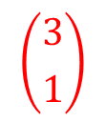
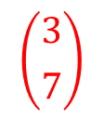
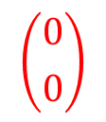
a) $\left({1 \atop 4}\right)+\left({2 \atop 3}\right)$ =
$$\left({3 \atop 7}\right)$$
h) $\left({−2 \atop −2}\right)+\left({−5 \atop 3}\right)$ =
$$\left({−7 \atop 1}\right)$$
b) $\left({2 \atop 3}\right)+\left({1 \atop 4}\right)$ =
$$\left({3 \atop 7}\right)$$
i) $\left({−2 \atop −2}\right)+\left({−5 \atop −3}\right)$ =
$$\left({−7 \atop −5}\right)$$
c) $\left({3 \atop 2}\right)+\left({1 \atop 4}\right)$ =
$$\left({4 \atop 6}\right)$$
j) $\left({7 \atop 6}\right)+\left({−7 \atop −6}\right)$ =
$$\left({0 \atop 0}\right)$$
d) $\left({17 \atop 19}\right)+\left({1 \atop 4}\right)$ =
$$\left({18 \atop 23}\right)$$
k) $\left({7 \atop 6}\right)−\left({−7 \atop −6}\right)$ =
$$\left({14 \atop 12}\right)$$
e) $\left({17 \atop 19}\right)+\left({5 \atop 3}\right)$ =
$$\left({22 \atop 22}\right)$$
l) $\left({11 \atop 10}\right)+\left({−7 \atop −6}\right)$ =
$$\left({4 \atop 4}\right)$$
f) $\left({−2 \atop 2}\right)+\left({5 \atop 3}\right)$ =
m) $\left({11 \atop 10}\right)−\left({\frac{1}{2} \atop 2.5}\right)$ =
$$\left({10.5 \atop 7.5}\right)$$
$$\left({3 \atop 5}\right)$$
g) $\left({−2 \atop −2}\right)+\left({5 \atop 3}\right)$ =
$$\left({3 \atop 1}\right)$$
n) $\left({\frac{1}{2} \atop 2}\right)−\left({\frac{1}{2} \atop 2.5}\right)$ =
$$\left({0 \atop −0.5}\right)$$

