Slide 1
Powers and indices: Applying Rules of Indices
Silent
Teacher
Intelligent Practice
Narration
Your Turn
$$7^{x}×7^{49}=7^{2x} ⇔ so x+49=2x ⇔so x=49$$
$$7^{x}÷7^{49}=7^{2x} ⇔ so x−49=2x ⇔so x=\frac{49}{3}$$
$$7^{x}×{49}^{7}=7^{2x} ⇔ so x+14=2x ⇔so x=14$$
Example

Slide 2
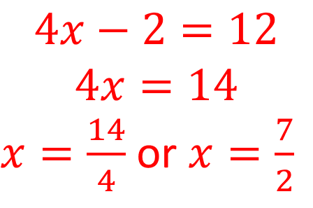
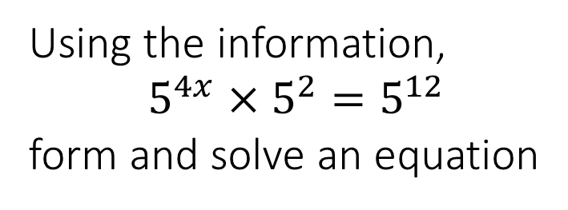
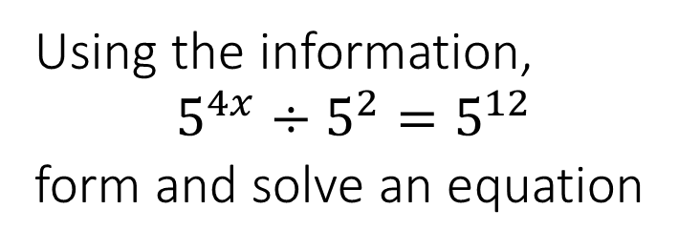
Worked Example
Your Turn
Using the information,
$$5^{4x}×5^{2}=5^{12}$$
form and solve an equation
Using the information,
$$5^{4x}÷5^{2}=5^{12}$$
form and solve an equation
$$4x−2=12$$
$$4x=14$$
$x=\frac{14}{4}$ or $x=\frac{7}{2}$

Slide 3
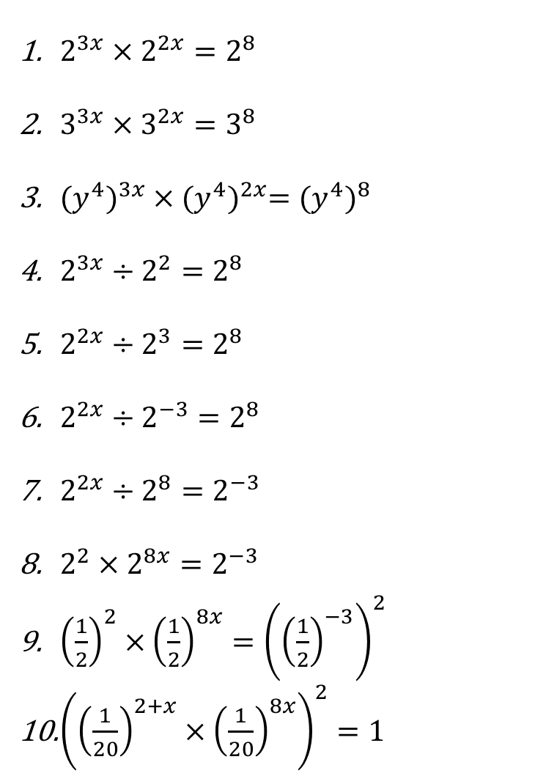
For each question, form and solve an equation in $x$
$2^{3x}×2^{2x}=2^{8}$
$3^{3x}×3^{2x}=3^{8}$
${{(y}^{4})}^{3x}×{(y^{4})}^{2x}={(y^{4})}^{8}$
$2^{3x}÷2^{2}=2^{8}$
$2^{2x}÷2^{3}=2^{8}$
$2^{2x}÷2^{−3}=2^{8}$
$2^{2x}÷2^{8}=2^{−3}$
$2^{2}×2^{8x}=2^{−3}$
${\left(\frac{1}{2}\right)}^{2}×{\left(\frac{1}{2}\right)}^{8x}={\left({\left(\frac{1}{2}\right)}^{−3}\right)}^{2}$
${\left({\left(\frac{1}{20}\right)}^{2+x}×{\left(\frac{1}{20}\right)}^{8x}\right)}^{2}=1$

Slide 4
For each question, form and solve an equation in $x$
$2^{3x}×2^{2x}=2^{8}$
$3^{3x}×3^{2x}=3^{8}$
${{(y}^{4})}^{3x}×{(y^{4})}^{2x}={(y^{4})}^{8}$
$2^{3x}÷2^{2}=2^{8}$
$2^{2x}÷2^{3}=2^{8}$
$2^{2x}÷2^{−3}=2^{8}$
$2^{2x}÷2^{8}=2^{−3}$
$2^{2}×2^{8x}=2^{−3}$
${\left(\frac{1}{2}\right)}^{2}×{\left(\frac{1}{2}\right)}^{8x}={\left({\left(\frac{1}{2}\right)}^{−3}\right)}^{2}$
${\left({\left(\frac{1}{20}\right)}^{2+x}×{\left(\frac{1}{20}\right)}^{8x}\right)}^{2}=1$
$3x+2x=8$ So, $x=\frac{8}{5}$
$3x+2x=8$ So, $x=\frac{8}{5}$
$3x+2x=8$ $(or 12x+8x=32)$ So, $x=\frac{8}{5}$
$3x−2=8$ So, $x=\frac{10}{3}$
$2x−3=8$ So, $x=\frac{11}{2}$
$2x+3=8$ So, $x=\frac{5}{2}$
$2x−8=−3$ So, $x=\frac{5}{2}$
$2+8x=−3$ So, $x=−\frac{5}{8}$
$2+8x=−6$ So, $x=−1$
$2(2+x+8x)=0$ So, $x=−\frac{2}{9}$

Slide 5
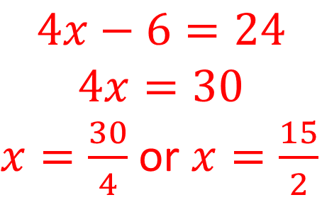
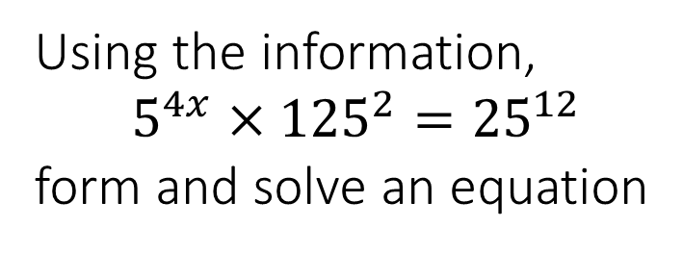
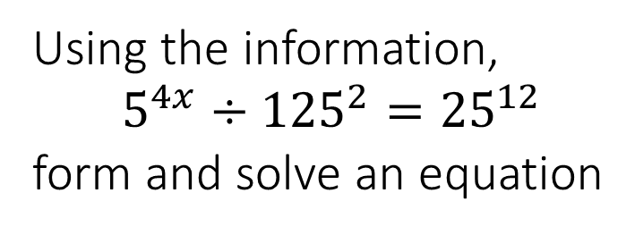
Worked Example
Your Turn
Using the information,
$$5^{4x}×{125}^{2}={25}^{12}$$
form and solve an equation
Using the information,
$$5^{4x}÷{125}^{2}={25}^{12}$$
form and solve an equation
$$4x−6=24$$
$$4x=30$$
$x=\frac{30}{4}$ or $x=\frac{15}{2}$

Slide 6
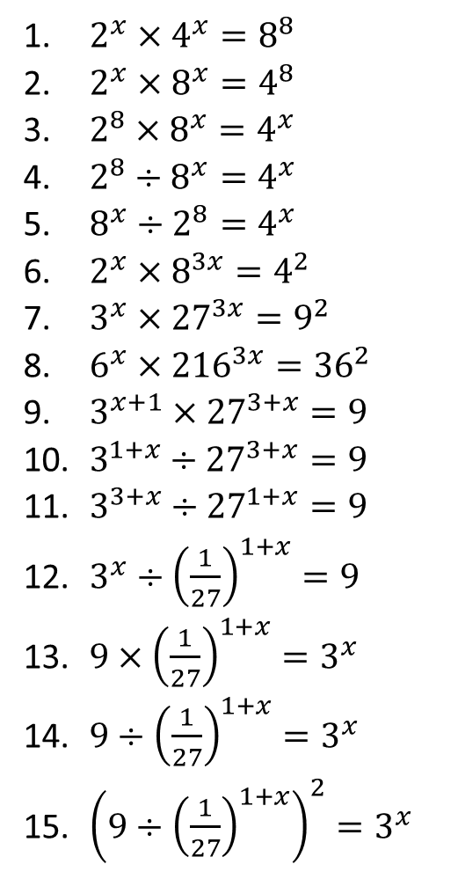
For each question, form and solve an equation in $x$
$2^{x}×4^{x}=8^{8}$
$2^{x}×8^{x}=4^{8}$
$2^{8}×8^{x}=4^{x}$
$2^{8}÷8^{x}=4^{x}$
$8^{x}÷2^{8}=4^{x}$
$2^{x}×8^{3x}=4^{2}$
$3^{x}×{27}^{3x}=9^{2}$
$6^{x}×{216}^{3x}={36}^{2}$
$3^{x+1}×{27}^{3+x}=9$
$3^{1+x}÷{27}^{3+x}=9$
$3^{3+x}÷{27}^{1+x}=9$
$3^{x}÷{\left(\frac{1}{27}\right)}^{1+x}=9$
$9×{\left(\frac{1}{27}\right)}^{1+x}=3^{x}$
$9÷{\left(\frac{1}{27}\right)}^{1+x}=3^{x}$
${\left(9÷{\left(\frac{1}{27}\right)}^{1+x}\right)}^{2}=3^{x}$

Slide 7
For each question, form and solve an equation in $x$
$2^{x}×4^{x}=8^{8}$
$2^{x}×8^{x}=4^{8}$
$2^{8}×8^{x}=4^{x}$
$2^{8}÷8^{x}=4^{x}$
$8^{x}÷2^{8}=4^{x}$
$2^{x}×8^{3x}=4^{2}$
$3^{x}×{27}^{3x}=9^{2}$
$6^{x}×{216}^{3x}={36}^{2}$
$3^{x+1}×{27}^{3+x}=9$
$3^{1+x}÷{27}^{3+x}=9$
$3^{3+x}÷{27}^{1+x}=9$
$3^{x}÷{\left(\frac{1}{27}\right)}^{1+x}=9$
$9×{\left(\frac{1}{27}\right)}^{1+x}=3^{x}$
$9÷{\left(\frac{1}{27}\right)}^{1+x}=3^{x}$
${\left(9÷{\left(\frac{1}{27}\right)}^{1+x}\right)}^{2}=3^{x}$
$x+2x=24$ So, $x=8$
$x+3x=16$ So, $x=4$
$8+3x=2x$ So, $x=−8$
$8−3x=2x$ So, $x=\frac{8}{5}$
$3x−8=2x$ So, $x=8$
$x+9x=4$ So, $x=\frac{2}{5}$
$x+9x=4$ So, $x=\frac{2}{5}$
$x+9x=4$ So, $x=\frac{2}{5}$
$x+1+3\left(3+x\right)=2$ So, $x=−2$
$x+1−3\left(3+x\right)=2$ So, $x=−5$
$3+x−3\left(1+x\right)=2$ So, $x=−1$
$x−−3\left(1+x\right)=2$ So, $x=−\frac{1}{4}$
$2−3\left(1+x\right)=x$ So, $x=−\frac{1}{4}$
$2+3\left(1+x\right)=x$ So, $x=−\frac{5}{2}$
$2\left(2+3\left(1+x\right)\right)=x$ So, $x=−2$

