Slide 1
Differential Equations: Separation of Variables
Silent
Teacher
Intelligent Practice
Narration
Your Turn
$$\frac{dy}{dx}=xy$$
$$y\frac{dy}{dx}=x$$
$$\frac{dy}{dx}=\frac{1}{xy}$$
Practice

Slide 2
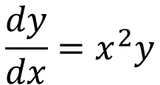
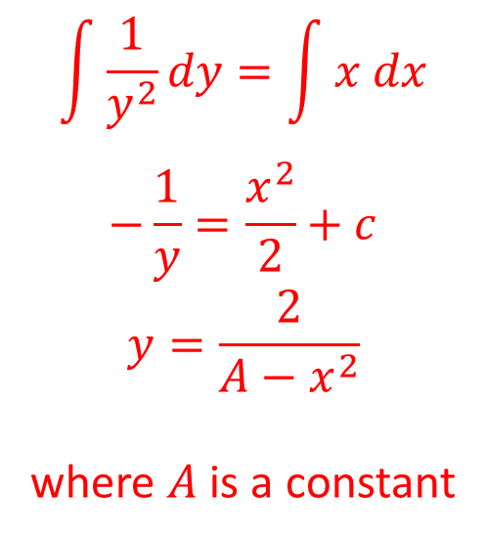
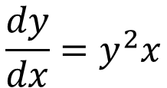
Worked Example
Your Turn
Find a general solution to
Find a general solution to
$$\frac{dy}{dx}=x^{2}y$$
$$\frac{dy}{dx}=y^{2}x$$
$$\int{\frac{1}{y^{2}}dy}=\int{x dx}$$
$$−\frac{1}{y}=\frac{x^{2}}{2}+c$$
$$y=\frac{2}{A−x^{2}}$$
where $A$ is a constant

Slide 3

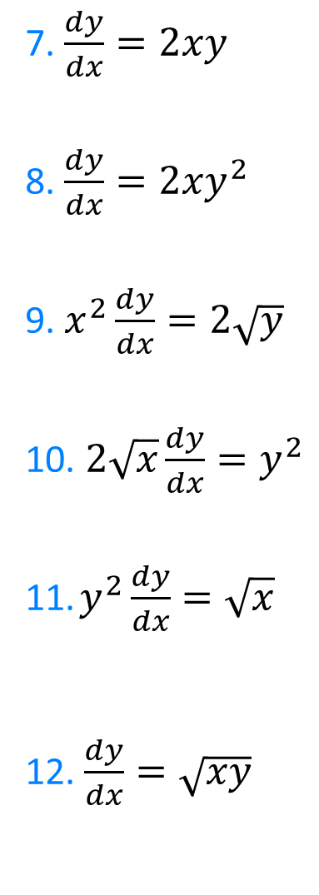
Find the general solution to each differential equation in the form $y=f(x)$
1.$y\frac{dy}{dx}=2x$
2. $2x\frac{dy}{dx}=y$
3. $\frac{2}{x}\frac{dy}{dx}=\frac{1}{y}$
4. $\frac{2}{x}\frac{dy}{dx}=y$
5. $\frac{2}{x}\frac{dx}{dy}=y$
6. $\frac{1}{xy}\frac{dy}{dx}=\frac{1}{2}$
7. $\frac{dy}{dx}=2xy$
8. $\frac{dy}{dx}=2xy^{2}$
9. $x^{2}\frac{dy}{dx}=2\sqrt{y}$
10. $2\sqrt{x}\frac{dy}{dx}=y^{2}$
11. $y^{2}\frac{dy}{dx}=\sqrt{x}$
12. $\frac{dy}{dx}=\sqrt{xy}$

Slide 4
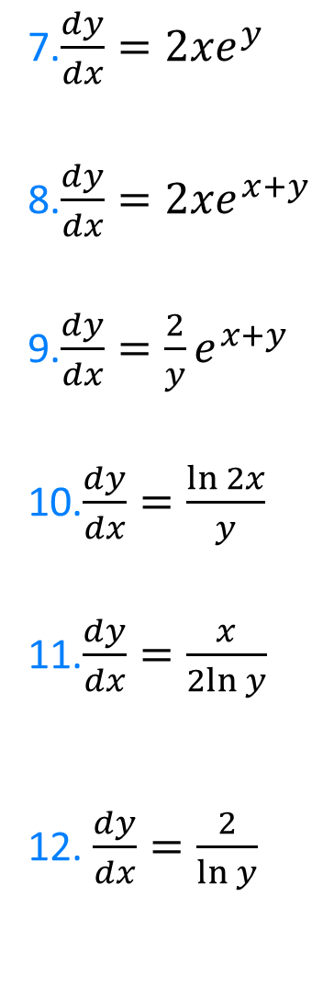
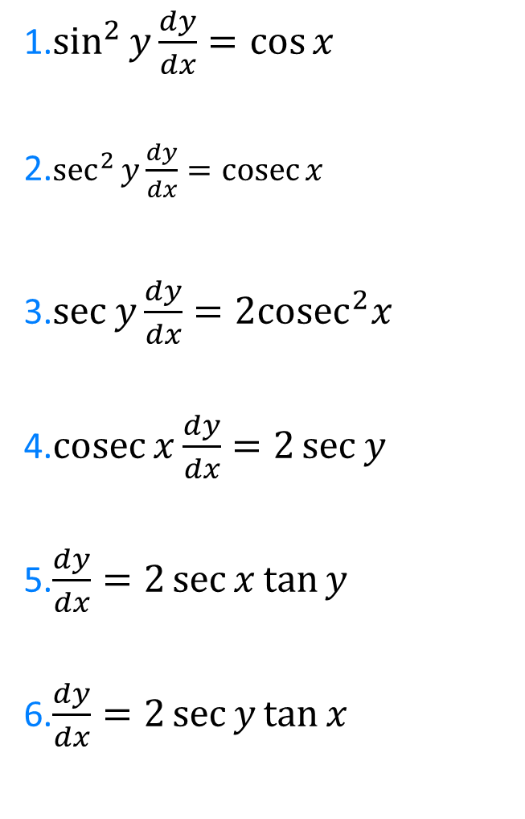
Find the general solution to each differential equation
1.$\sin^{2}{y}\frac{dy}{dx}=\cos{x}$
2.$\sec^{2}{y}\frac{dy}{dx}=\operatorname{cosec}{x}$
3.$\sec{y}\frac{dy}{dx}=2{cosec}^{2}x$
4.$\operatorname{cosec}{x}\frac{dy}{dx}=2\sec{y}$
5.$\frac{dy}{dx}=2\sec{x}\tan{y}$
6.$\frac{dy}{dx}=2\sec{y}\tan{x}$
7.$\frac{dy}{dx}=2xe^{y}$
8.$\frac{dy}{dx}=2xe^{x+y}$
9.$\frac{dy}{dx}=\frac{2}{y}e^{x+y}$
10.$\frac{dy}{dx}=\frac{\ln{2x}}{y}$
11.$\frac{dy}{dx}=\frac{x}{2ln{y}}$
12. $\frac{dy}{dx}=\frac{2}{\ln{y}}$

Slide 5

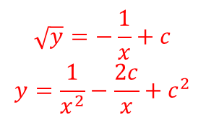

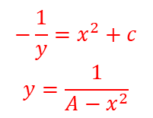
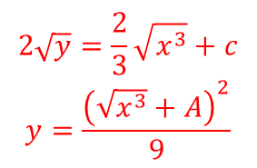
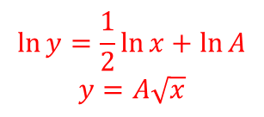
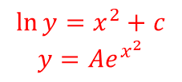

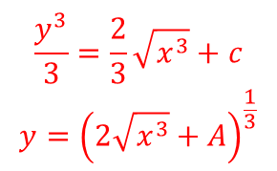
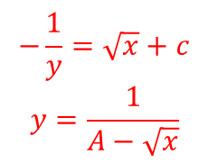
Find the general solution to each differential equation in the form $y=f(x)$
1.$y\frac{dy}{dx}=2x$
2. $2x\frac{dy}{dx}=y$
3. $\frac{2}{x}\frac{dy}{dx}=\frac{1}{y}$
4. $\frac{2}{x}\frac{dy}{dx}=y$
5. $\frac{2}{x}\frac{dx}{dy}=y$
6. $\frac{1}{xy}\frac{dy}{dx}=\frac{1}{2}$
7. $\frac{dy}{dx}=2xy$
8. $\frac{dy}{dx}=2xy^{2}$
9. $x^{2}\frac{dy}{dx}=2\sqrt{y}$
10. $2\sqrt{x}\frac{dy}{dx}=y^{2}$
11. $y^{2}\frac{dy}{dx}=\sqrt{x}$
12. $\frac{dy}{dx}=\sqrt{xy}$
$$y^{2}=2x^{2}+A$$
$$y=±\sqrt{{2x}^{2}+A}$$
$$\ln{y}=x^{2}+c$$
$$y=Ae^{x^{2}}$$
$$\ln{y}=\frac{1}{2}\ln{x}+\ln{A}$$
$$y=A\sqrt{x}$$
$$−\frac{1}{y}=x^{2}+c$$
$$y=\frac{1}{A−x^{2}}$$
$$y^{2}=\frac{x^{2}}{2}+A$$
$$y=±\sqrt{\frac{x^{2}}{2}+A}$$
$$\sqrt{y}=−\frac{1}{x}+c$$
$$y=\frac{1}{x^{2}}−\frac{2c}{x}+c^{2}$$
$$\ln{y}=\frac{x^{2}}{4}+c$$
$$y=Ae^{\frac{x^{2}}{`4}}$$
$$−\frac{1}{y}=\sqrt{x}+c$$
$$y=\frac{1}{A−\sqrt{x}}$$
$$\frac{y^{3}}{3}=\frac{2}{3}\sqrt{x^{3}}+c$$
$$y={\left(2\sqrt{x^{3}}+A\right)}^{\frac{1}{3}}$$
$$y=±2\ln{Ax}$$
$$\ln{y}=\frac{x^{2}}{4}+c$$
$$y=Ae^{\frac{x^{2}}{`4}}$$
$$2\sqrt{y}=\frac{2}{3}\sqrt{x^{3}}+c$$
$$y=\frac{{\left(\sqrt{x^{3}}+A\right)}^{2}}{9}$$

Slide 6
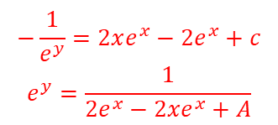
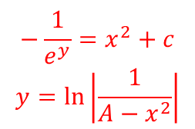
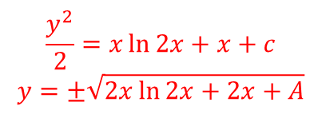
Find the general solution to each differential equation
1.$\sin^{2}{y}\frac{dy}{dx}=\cos{x}$
2.$\sec^{2}{y}\frac{dy}{dx}=\operatorname{cosec}{x}$
3.$\sec{y}\frac{dy}{dx}=2{cosec}^{2}x$
4.$\operatorname{cosec}{x}\frac{dy}{dx}=2\sec{y}$
5.$\frac{dy}{dx}=2\sec{x}\tan{y}$
6.$\frac{dy}{dx}=2\sec{y}\tan{x}$
7.$\frac{dy}{dx}=2xe^{y}$
8.$\frac{dy}{dx}=2xe^{x+y}$
9.$\frac{dy}{dx}=\frac{2}{y}e^{x+y}$
10.$\frac{dy}{dx}=\frac{\ln{2x}}{y}$
11.$\frac{dy}{dx}=\frac{x}{2ln{y}}$
12. $\frac{dy}{dx}=\frac{2}{\ln{y}}$
$$−\frac{1}{e^{y}}=x^{2}+c$$
$$y=\ln\left|\frac{1}{A−x^{2}}\right|$$
$$\frac{y}{2}−\frac{1}{2}\sin{2y}=\sin{x}+c$$
$$−\frac{1}{e^{y}}=2xe^{x}−2e^{x}+c$$
$$e^{y}=\frac{1}{2e^{x}−2xe^{x}+A}$$
$$\tan{y}=\ln{A}−\ln{|\operatorname{cosec}{x+\cot{x|}}}$$
$$\tan{y=\ln{\frac{A}{\operatorname{cosec}{x+\cot{x}}}}}$$
$$−ye^{−y}−e^{−y}=2e^{x}+c$$
$$e^{−y}\left(y+1\right)=2e^{x}+c$$
$$\ln\left|\sec{y}+\tan{y}\right|=−2cot{x}+c$$
$$\frac{y^{2}}{2}=x\ln{2x+x+c}$$
$$y=±\sqrt{2x\ln{2x}+2x+A}$$
$$\sin{y=−2\cos{x}+c}$$
$$y\ln{y+y}=\frac{x^{2}}{4}+c$$
$$\ln\left|\sin{y}\right|=\ln\left|\sec{y}+\tan{y}\right|+\ln{A}$$
$$\ln\left|\sin{y}\right|=\ln{(A(\sec{y+\tan{y })})}$$
$$y\ln{y+y}=2x+c$$
$$\sin{y}=\ln\left|\sec{x}\right|+\ln{A}$$
$$\sin{y}=\ln{(A\sec{x})}$$

